Slide 1
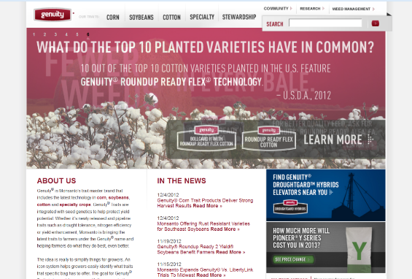
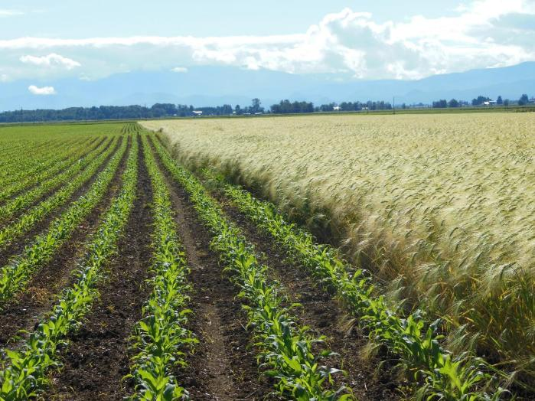
Transgenic Plants
(Genetically modified organisms (plants)
Genetically engineered plants))

Slide 2
Why create transgenic plants?
When there is no naturally occurring genetic variation for the target trait.
Examples:
Glyphosate herbicide resistance in soybean, corn
Vitamin A in rice
Blue roses

Slide 3
What genes to transfer?
One gene to a few genes - the CP4 ESPS example
Multiple genes - Golden Rice and Applause rose
In principle, any gene (or genes)
ORIGIN
1 cctttcctac tcactctgga caggaacagc tgtctgcagc cacgccgcgc ctgagtgagg
61 agaggcgtag gcaccagccg aggccaccca gcaaacatct atgctgactc tgaatgggcc
121 cagtcctccg gaacagctcc ggtagaagca gccaaagcct gtctgtccat ggcgggatgc
181 cgggagctgg agttgaccaa cggctccaat ggcggcttgg agttcaaccc tatgaaggag
241 tacatgatct tgagtgatgc gcagcagatc gctgtggcgg tgctgtgtac cctgatgggg
301 ctgctgagtg ccctggagaa cgtggctgtg ctctatctca tcctgtcctc gcagcggctc

Slide 4
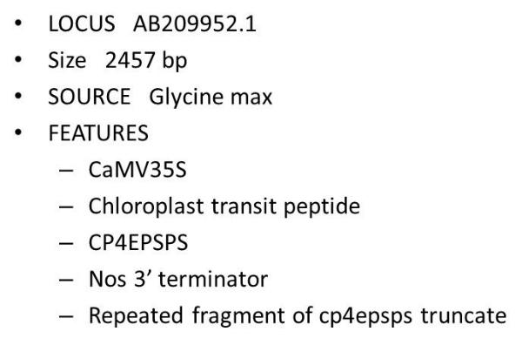
CP4 EPSPS: The gene conferring resistance to the herbicide Roundup
The gene was found in Agrobacterium tumefaciens and transferred to various plants
Coincidentally, this organism is also used for creating transgenic plants

Slide 5
Glyphosate Herbicide
Glyphosate inhibits EPSPS enzyme - impeding the synthesis of aromatic amino acids
CO₂
H₂O
NH₃
EPSPS
aromatic
amino acids
Proteins
CO₂
H₂O
NH₃
glyphosate
aromatic
amino acids
EPSPS
Proteins

Slide 6
Commercial RR crops
"Two key elements needed for the development of commercially viable glyphosate-tolerant crops are:
a resistant target enzyme
sufficient expression of that enzyme within the transgenic plant”
Heck et al. 2005. Development and Characterization of a CP4 EPSPS-Based, Glyphosate-Tolerant Corn Event: Crop Sci. 45:329-339 (2005).

Slide 7
Roundup Ready Crops
When incorporated into the genome of RR-susceptible plants, the Roundup ReadyTM gene (CP4 EPSPS) confers resistance to glyphosate
CO₂
H₂O
NH₃
glyphosate
aromatic
amino acids
EPSPS
Proteins
CP4 EPSPS

Slide 8
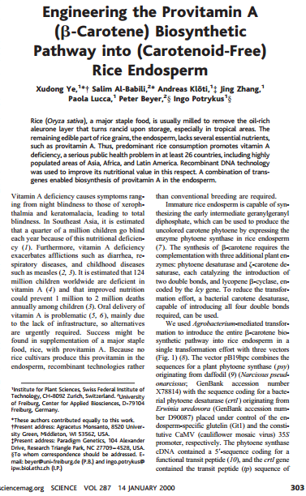
"Golden Rice”
Creation of a biosynthetic pathway in rice using genes from daffodil and bacteria; portions of genes from pea, rice, and cauliflower mosaic virus

Slide 9
Golden Rice
Vitamin A deficiency in humans a serious problem
Rice is a major food crop
Rice lacks provitamin A
Create pathway for Beta-carotene synthesis
Phytoene synthase from Narcissus pseudonarcissus
Phytoene desaturase from Erwinia uredovora
Endosperm-specific glutelin promoter from Oryza sativa
CaMV promoter from cauliflower mosaic virus
Transit peptide sequence from Pisum sativum
www.forbes.com

Slide 10
Constructing transgenes The minimal requirements for the transgene are a promoter, coding region, and terminator
General structure:
5’---Promoter …..Coding region…….terminator---3’
Example: Bt gene with 35S promoter, nptII selectable marker, and Tnos terminator sequence
5’ --P35S…Bt…Tnos--//--P35S…nptII…Tnos---3’

Slide 11
Promoter: DNA sequence controlling spatial and/or temporal level of transgene expression. Promoters can be
constitutive
CaMV 35S: from Cauliflower mosaic virus 35S rRNA gene
tissue specific
Glutelin GT1: Endosperm specific
inducible
Cis-Jasmone: Arabidopsis genes induced by stress/wounding

Slide 12
Termination sequence: DNA sequence signaling end of the gene during transcription.
TNOS: Nopaline synthase gene from Agrobacterium tumefaciens
T-DNA pGKB5 (7599 b.p.)
Bluescript polylinker : 1-104
Right Border : 105-622
24 bp sequence : 574-596
GUS coding : 638-2446
NOS terminator : 2505-2766
OCS terminator : 2767-3489
KanR (nptII) : 3490-4479
NOS promoter : 4480-4766
35S promoter : 4767-5924
BastaR (bar) : 5925-6513
g7 terminator : 6514-6768
Left Border : 6790-7525
24 bp sequence : 6963-6986
Bluescript polylinker : 7526-7599
GGAAACAGCTATGACCATGATTACGCCAAGCTCGGAATTAACCCTCACTAAAGGGAACAAAAGCTGGAGC
TCCACCGCGGTGGCGGCCGCTCTAGAGGATCCCCCCACAGACAGCTCCGTAGCCCTCGTTCTCCTTGGAG
TTCTTCGGGAAATGGATCTTTCGATTCCCGATGATGTCTCTCTTATCTGCTTTGACGACGCCGACTGGAC

Slide 13
Selectable Marker: Encodes a protein (enzyme) that allows the transformed cells to grow while the growth of the non-transformed cells is inhibited. Examples include
Antibiotic resistance
Herbicide resistance
“Among the most widely used antibiotic resistance genes as selectable markers are neomycin phosphotransferase II (nptII) and hygromycin phosphotransferase (hpt). The enzyme NPTII inactivates by phosphorylation a number of aminoglycoside antibiotics such as kanamycin, neomycin, geneticin (or G418) and paromomycin. Of these, G418 is routinely used for selection of transformed mammalian cells. The other three are used in a diverse range of plant species, however, kanamycin has proved to be ineffective to select legumes and gramineae.
Hygromycin phosphotransferase is a suitable marker system for both plant and animal systems. The HPT enzyme inactivates the antibiotic hygromycin B. Hygromycin is usually more toxic than kanamycin and kills sensitive cells more quickly. It is nowadays one of the preferred antibiotic resistance marker systems for transformation of monocotyledonous plants, particularly gramineae (cereals and forages).”
http://www.patentlens.net/daisy/Antibiotic/g1/1155.html

Slide 14
Selectable Marker: Encodes a protein (enzyme) that allows the transformed cells to grow while the growth of the non-transformed cells is inhibited. Examples include
Herbicide resistance
“..Members of the genus Streptomyces produce bialaphos, which leads to the production of glufosiante, ultimately inhibiting glutamine synthetase. The biochemical and toxicological characteristics of glufosinate have made it a popular, nonselective herbicide, which has been commercialized under the names Basta®, Buster® and Liberty® by Bayer Crop Science. Other Streptomyces spp. can detoxify glufosinate by producing an acetylating enzyme via production of a phosphinothricin acetyl transferase (PAT) enzyme encoded by the bar (bialaphos resistance) gene. Treatment of genetically modified plants carrying a bar gene with glufosinate or bialaphos provides a very efficient means of selection in genetic transformation protocols.”
http://www.patentlens.net/daisy/Phosph/g2/710.html

Slide 15
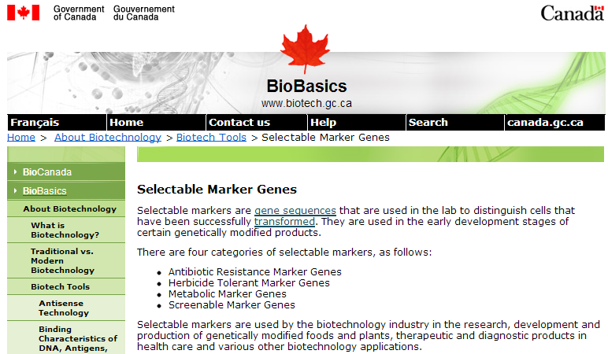
Selectable Markers. Details and examples of selectable markers

Slide 16
Reporter genes: Genes that, upon expression in the transgenic plants, provide a clear indication that genetic transformation did occur, and indicate the location and the level of expression.
Glucuronidase (GUS)
Luciferase, green fluorescent protein (GFP)

Slide 17
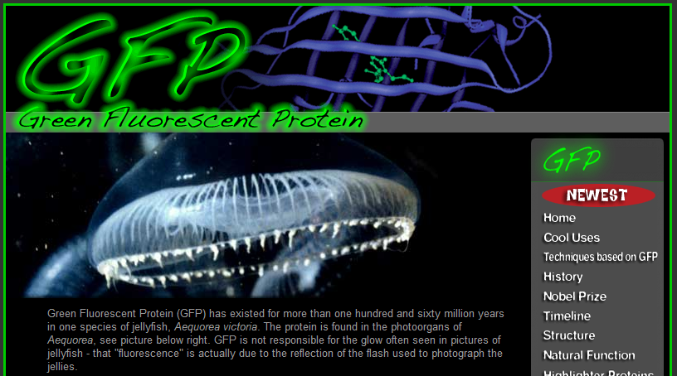
GFP: So many ways to be green

Slide 19
Transformation procedures:
In order for a transgene to be inherited, it must be incorporated into the genome of a cell which will give rise to tissues which will be asexually propagated or to tissues which will undergo gametogenesis
The two principal mechanisms for transforming tissues with a transgene
Biolistics = “Gene gun”
Agrobacterium tumefaciens = “Agro”

Slide 20
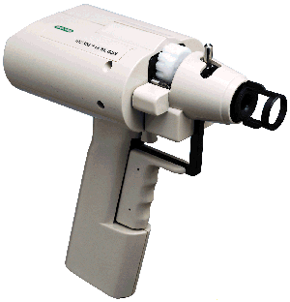
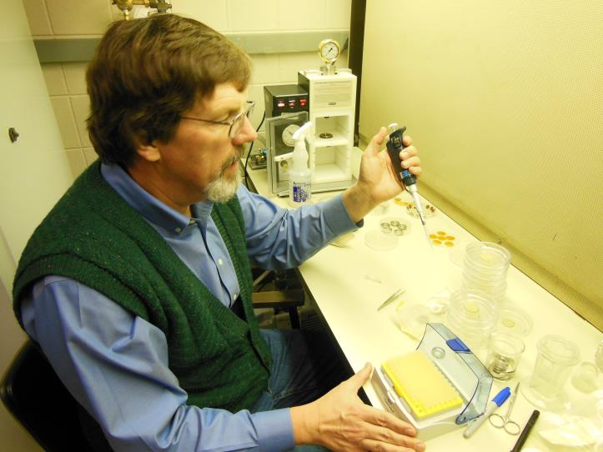
The gene gun
Micro projectile bombardment or the biolistic method
Small metal particles are coated with the transgene DNA
Particles are delivered to target tissues via an explosive force
“The Helios Gene Gun is a new way for in vivo transformation of cells or organisms apy and genetic immunization (DNA vaccination)). This gun uses Biolistic ® particle bombardment where DNA- or RNA-coated gold particles are loaded into the gun and you pull the trigger. A low pressure helium pulse delivers the coated gold particles into virtually any target cell or tissue. The particles carry the DNA so that you do not have to remove cells from tissue in order to transform the cells.”

Slide 21
The Agrobacterium method
Agrobacterium tumefaciens is a soil bacterium causing a root disease called crown gall
In the case of disease, A. tumefaciens invades the host plant and transfers a piece of its own DNA to the host genome
For transformation, A. tumefaciens has been engineered to carry and transfer transgenes and to not cause disease

Slide 22
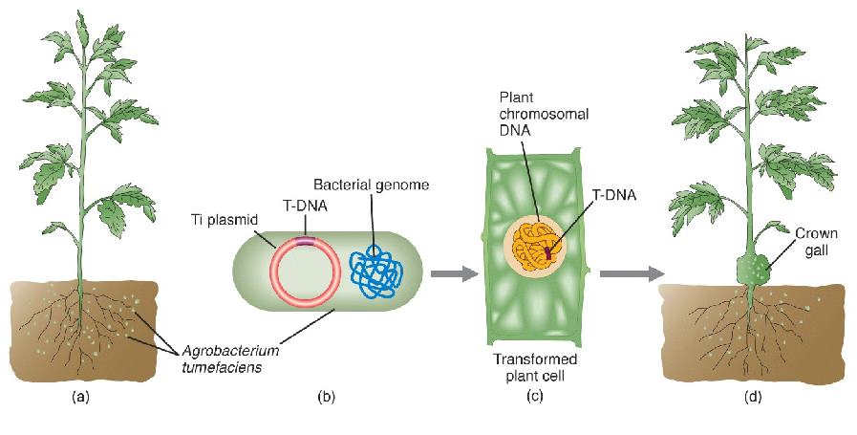

Slide 23
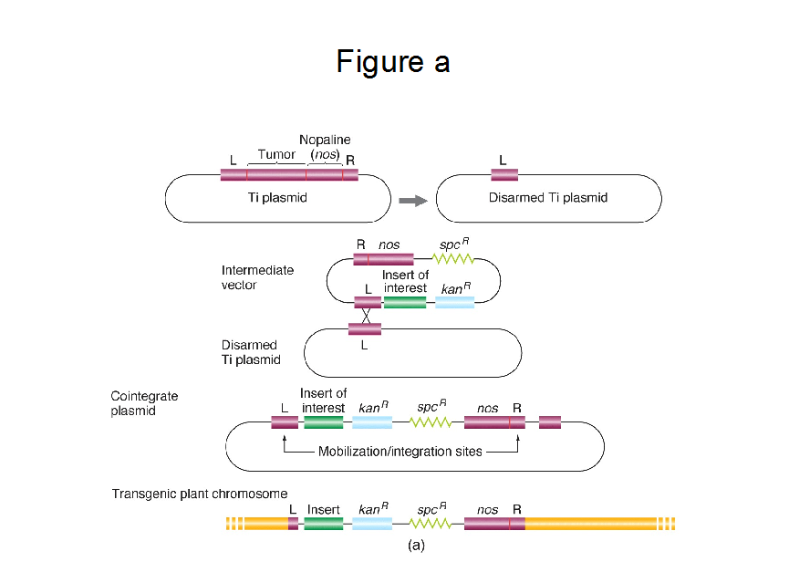

Slide 24
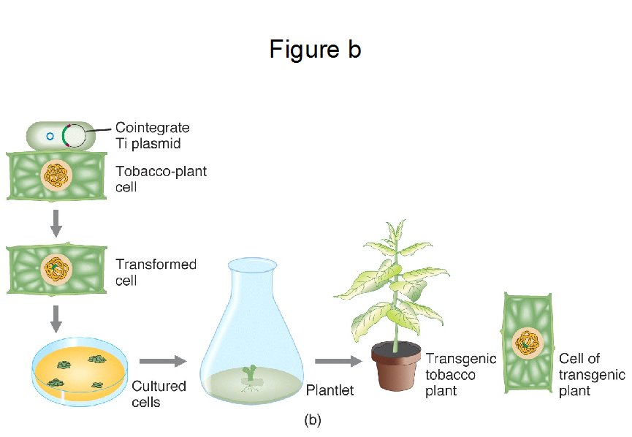

Slide 25
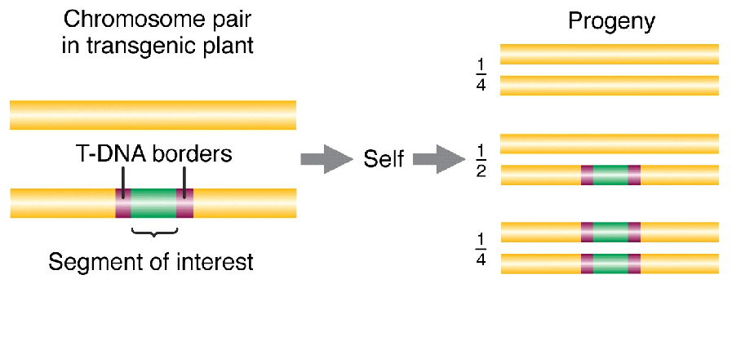
Selection and regeneration: a plant with one copy of the transgene is a hemizygote (heterozygous for transgene)

Slide 26
Concerns regarding transgenic plants
Cultural/ religious issues - e.g. animal genes in plants
Dietary concerns - e.g. allergies to novel proteins
Gene escape - e.g. RoundUp Ready beets
Non-target organisms - e.g. transgene plant products/ parts with unanticipated consequences
Wasting precious genes one at a time - e.g. widespread use of single Bt genes could provide intense selection pressure for resistant insects, rendering the use of Bt spray ineffective
Ownership - e.g. transgene technologies, and genes, are generally subject to intellectual property protection

Slide 27
Bringing it all home….to Oregon
Herbicide resistant bentgrass in Oregon (For the Willamette Valley sugarbeet story, see Lecture 1)

Slide 28
The plant: Creeping bent grass (Agrostis stolonifera L.)
Golf greens
Considered a weed in eight countries
Other Agrostis species (250 worldwide; 34 North American; 24 native)
Diploid to polyploid
Sexual propagation
Outcrossing
A. stolonifera is obligate outcrossing
Small seeds
Asexual propagation
stolons
rhizomes

Slide 29
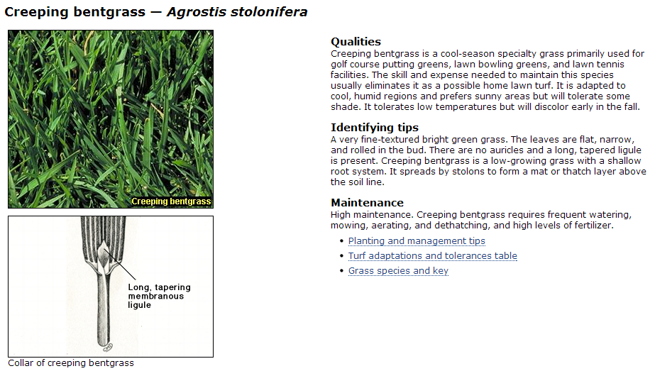
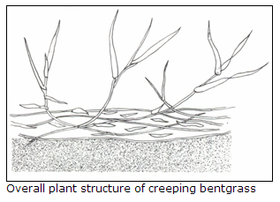

Slide 30
The gene: CP4 EPSPS

Slide 31
The case:
2003
Under APHIS permit, 162 ha test in Jefferson county of glyphosate-tolerant GM creeping bentgrass (event ASR368 by Scotts and Monsanto). The test was conducted within a 4453-ha control area established by the Oregon Dept. of Agriculture.
2004:
2.5 ha of production.
Documented gene flow primarily within ~ 2 km but up to 21 km (Watrud et al. 2004. PNAS 14533-14538)
Gene flow documented via seedling tests using
protein detection (TraitCheck)
PCR (using transgenic soybean CP4 EPSPS; GenBank Accession No. AF464188.1,
sequencing of cloned PCR products.

Slide 32
The case:
2005:
No production
Continued sampling
2006:
Detected plants expressing transgene - demonstrated pollen transfer and seed dispersal (Reichman et al. 2006. Mol. Ecology 15: 4243-4255)
Gene flow documented via using TraitChek, PCR, and sequencing
2007:
Issue settled with civil penalty
2011: Transgenic plants in central and southeastern Oregon
2012: Transgenic plants in Oregon and Idaho
2013, 2014, 2015, 2016, 2017……monitoring and reporting

Slide 33
What is and what is not a transgenic plant?

Slide 34
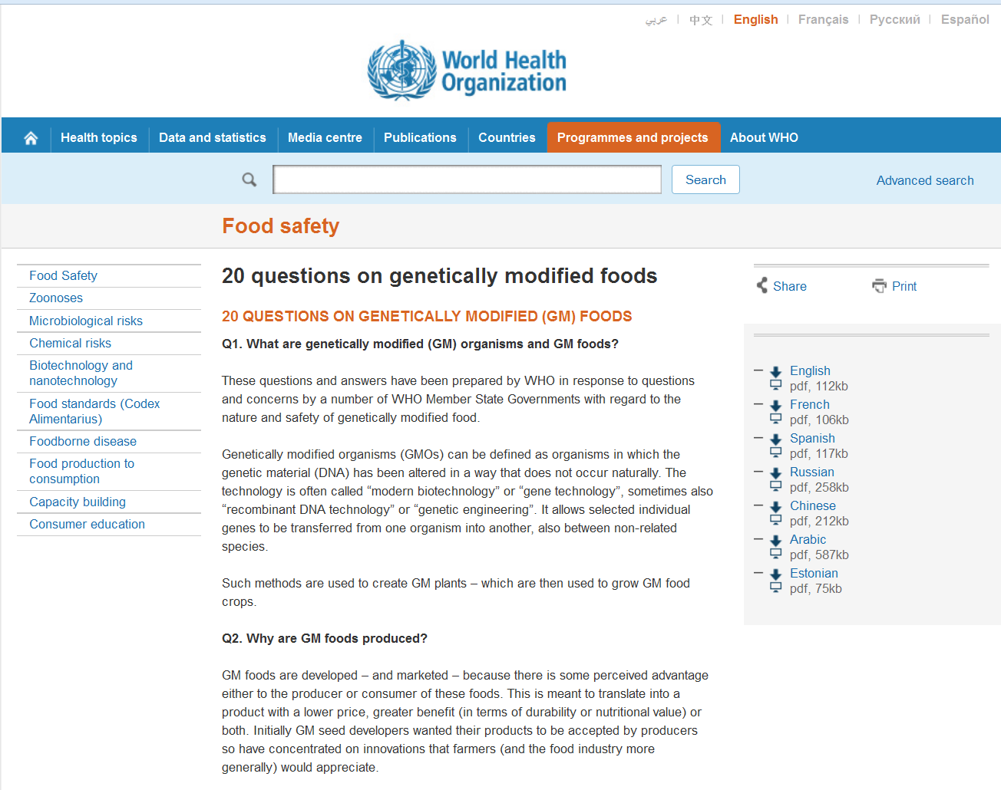

Slide 35
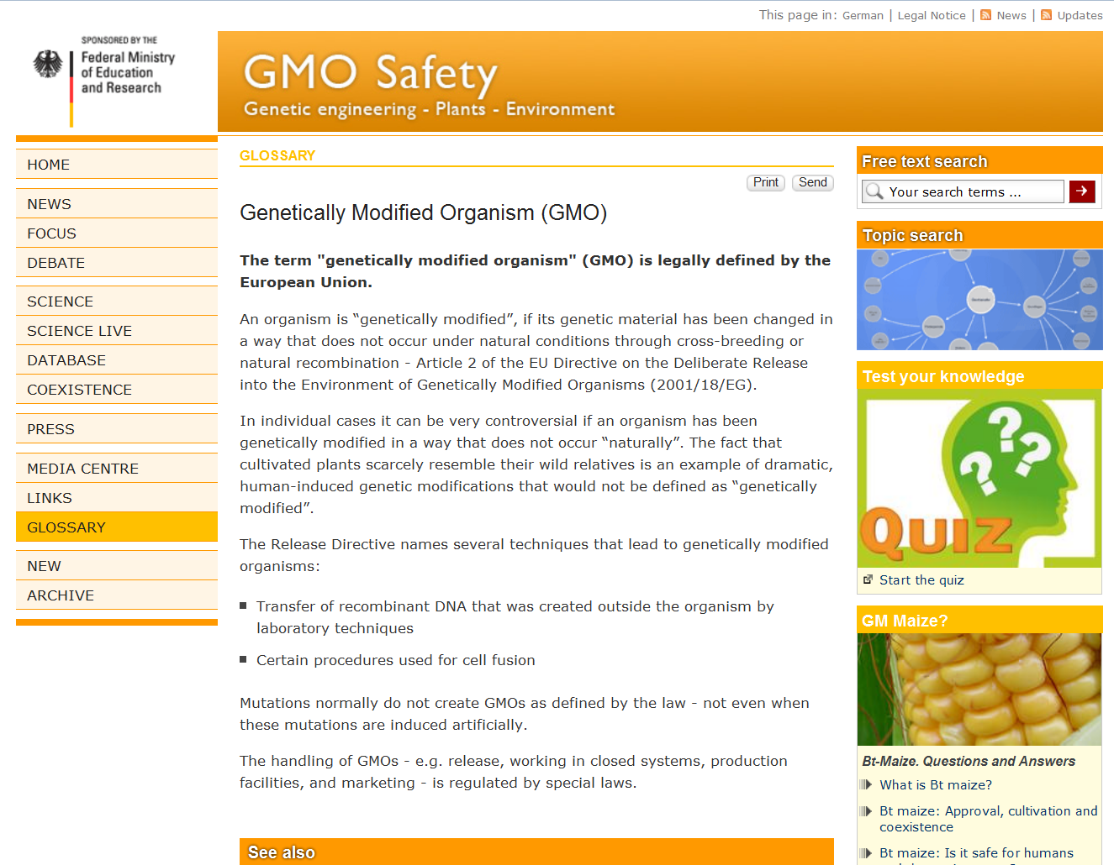

Slide 36
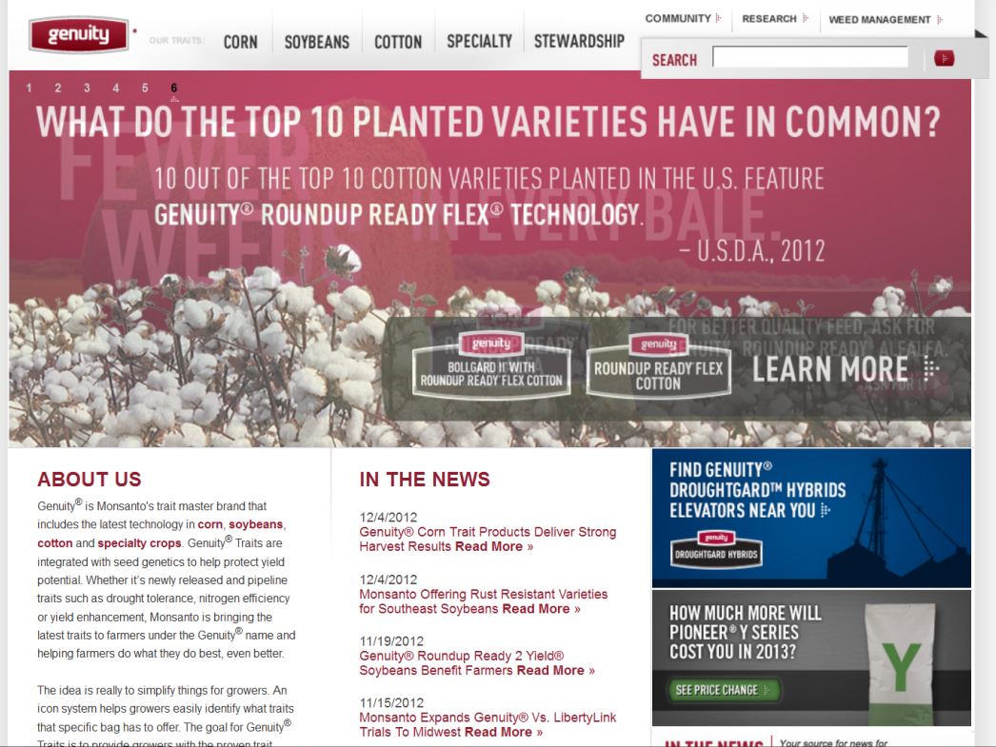

Slide 37
“Our work suggests that cisgenic insertion of additional copies of native genes involved in growth regulation may provide tools to help modify plant architecture, expand the genetic variance in plant architecture available to breeders and accelerate transfer of alleles between difficult-to-cross species.”

Slide 38
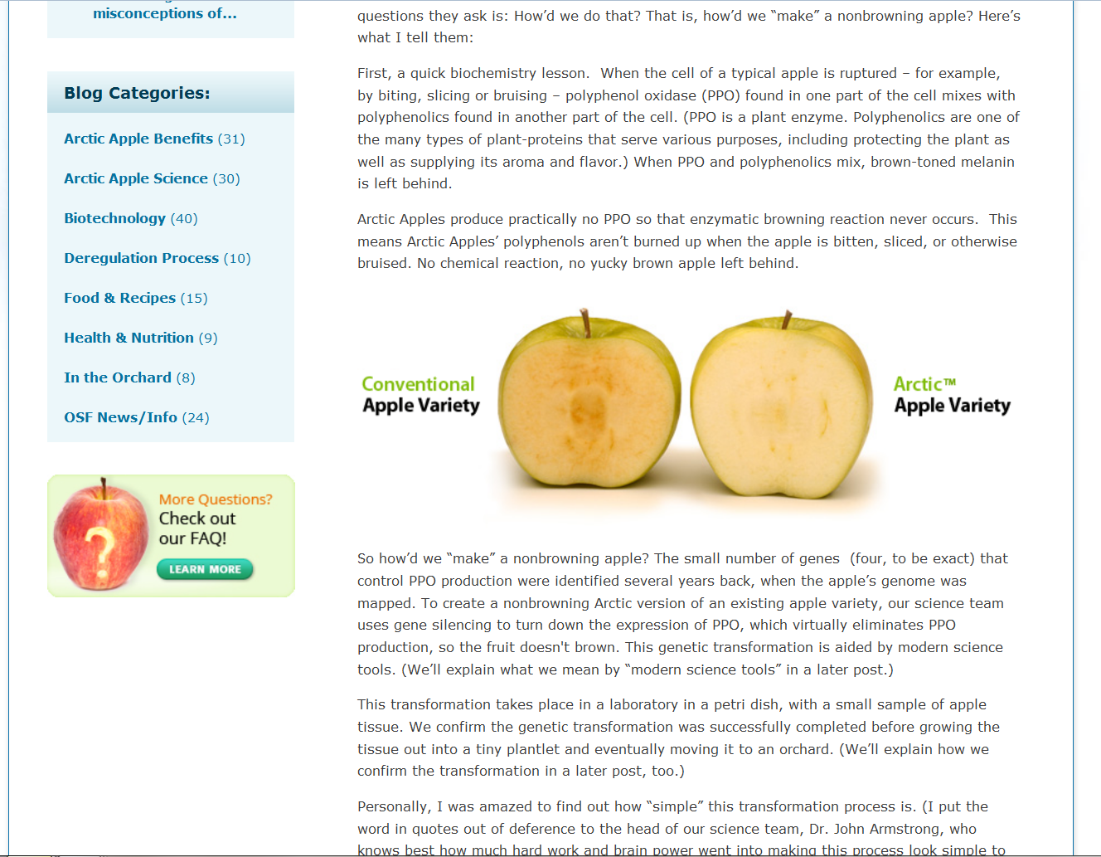

Slide 39
http://www.nature.com/nrg/multimedia/rnai/animation/index.html

Slide 40
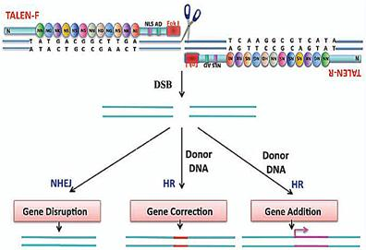
Transcription Activator Like Effector Nucleases - TALENs
Use TALEs to bind to a particular DNA region
Double Strand Break
Non-Homologous End Joining repair – error can alter function
Introduce new sequence
Exogenous DNS
Homology Directed Repair

Slide 41
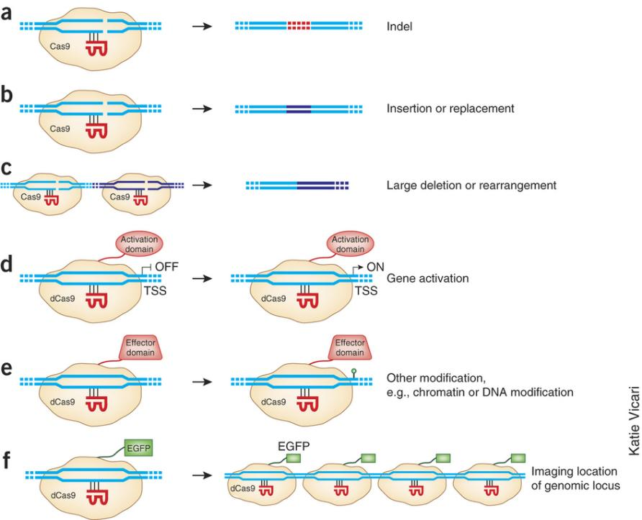
Clustered Regularly Interspaced Short Palindromic Repeats (CRISPR)
RNA guided nucleases with custom specificities for genome editing
Modify endogenous genes rapidly and efficiently
Regulation?
https://www.youtube.com/watch?v=2pp17E4E-O8

Slide 42
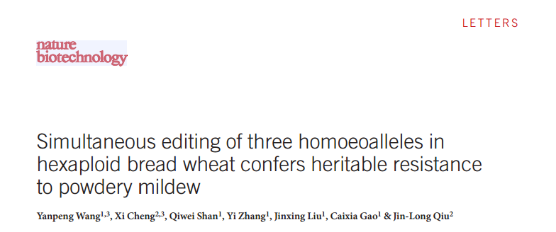
Genome Editing Example

Slide 43
Comparing “- enics” and “edits”
DNA
Transcription
Translation and beyond
Wild type gene
1
ATGCTC
Add a gene
2
ATGCTC
+ transgene
No protein, no phenotype
3
ATGCTC
+ RNAi construct
Degrade wild type mRNA
4
ATCTC
+ CRISPR construct
Change wild type DNA code

