Slide 1
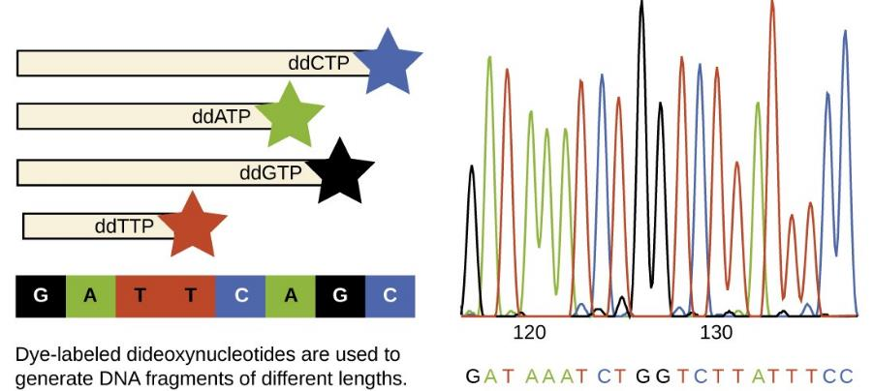
Genetics tools – PCR and DNA Sequencing
Notes:
In the previous two Units, we followed the Bradbury et al. paper on the genetic basis of aroma in rice, step by step. We saw that a fundamental technique that enabled their discovery of the aroma gene in rice was DNA sequencing.
In this Unit we will discuss a key tool in their work – the Polymerase Chain Reaction (PCR). PCR is a key tool in contemporary genetics. We will use PCR as a foundation for moving into a classical, and illustrative example of DNA sequencing. Sanger sequencing was the breakthrough that paved the way for whole genome sequencing and remains a technique of choice for accurately determining the sequence of relatively short DNA targets – such as alleles at a locus.
Faster, cheaper, more accurate DNA sequencing techniques are constantly being developed. Molecular tools are evolving – FAST: therefore in this class we will provide a theoretical background that should enable you to understand the principles of techniques described in current literature and to figure out the principles of techniques developed over the next several years.

Slide 2
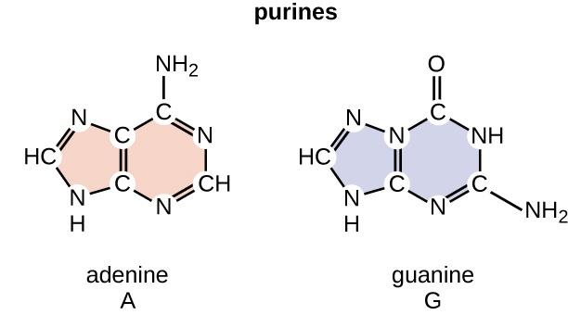
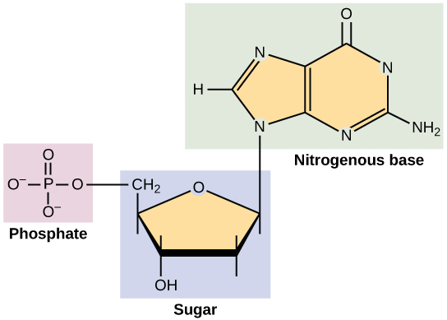
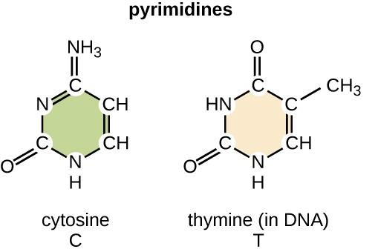
DNA nucleotide structure - Revisited
DNA nucleotide:
5-carbon sugar (“deoxyribose”)
Phosphate group
Nitrogen-containing base (A, G, T, or C)
“Deoxyribonucleotide triphosphate”
Notes:
Before looking at PCR and Sanger sequencing, it is essential to have in mind the structure of a DNA nucleotide. Please take a look back to Unit 1 and review as needed.
Key points: DNA is composed of a five carbon sugar (deoxyribose), a phosphate group and one of four nitrogen-containing bases. The nitrogen-containing base (A, T, C, or G) is bound to the 1’ carbon in the deoxyribose. Adenine and guanine are purines and thymine and cytosine are pyrimidines. An OH group is bound to the 3’ carbon, and a phosphate group to the 5’ carbon.
Deoxyribonucleotide triphosphate (abbreviated as dNTP) is a complete DNA nucleotide. The deoxy in the name refers to the lack of an oxygen binding to the 2’ carbon – in RNA nucleotides, there is an oxygen there, so an RNA nucleotide is called Ribonucleotide triphosphate. The N is a generic term standing for the 4 possible dNTPs: dATP, dCTP, dGTP, and dTTP. For example, dATP is the abbreviation for deoxyadenosine 5-triphosphate. Later in this Unit and in the next Unit, we will frequently be using the term “dNTPs”.
FYI: In a DNA strand, the nucleotides are actually dNMPs due to the removal of diphosphate from each nucleotide during the process of forming phosphodiester bonds. Further discussion of DNA chemistry we will leave to other classes.

Slide 3
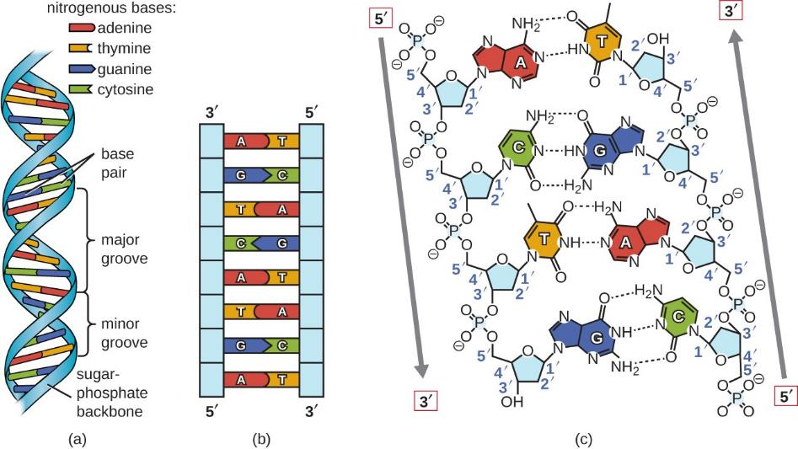
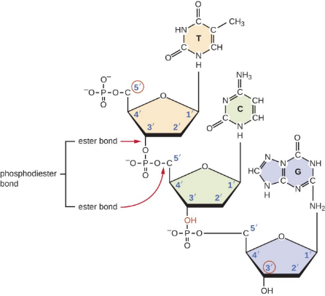
DNA structure - Revisited
5’ end of strand
Backbone of DNA strand: Phosphate group + Sugar group
Double helix:
Held together by a hydrogen bond between two complementary bases
Strands face opposite directions (5’ to 3’ versus 3’ to 5’)
3’ end of strand
Notes:
Phosphodiester bonds connect nucleotides (image on the lower left of the slide). These conjoined nucleotides are the backbones of a DNA strand because they form the continuous chain that holds the nucleotides together in that strand (panel a in the figure in the lower right). There are two anti-parallel backbones in the double helix. Phosphodiester bonds are stronger -than hydrogen bonds – a key consideration in denaturing DNA for PCR and sequencing.
Attached to the 1’ carbon of each nucleotide there is a base. Each base in one strand pairs in a complementary fashion – via hydrogen bonding – with a base in the other strand (panel b). There are three hydrogen bonds in the case of G:C and two hydrogen bonds in the case of A:T. The number of H bonds is an important consideration in terms of DNA manipulations and you will see the term “G-C rich” in this context. G-C-rich regions have more H bonds than A-T rich regions. Therefore, more energy is required to denature G-C rich regions, and this has implications for PCR. GC content is also predicted to affect genome function and species ecology – to learn more about that, please refer to the suggested supplementary reading.
This base pairing between the two backbones forms the DNA double helix. Note that the 2 strands are arranged in an anti-parallel fashion: they are parallel to each other but the strands are in opposite directions – in panel c, the left strand has the 5’ end facing “up” , and the right strand has the 5’ end facing “down”.
It is important to remember the anti-parallel nature of the DNA double helix for several reasons. 1.) during replication, new nucleotides are added to the 3’ ends of developing strands. 2.) DNA sequences, such as that shown in the upper right panel of the slide, are shown – by convention – as the coding strand, starting at the 5’ end and reading from left to right to the 3’ end.
Even though we usually show DNA sequences in linear alignments, keep in mind that the 2 strands form a three dimensional double helix.

Slide 4
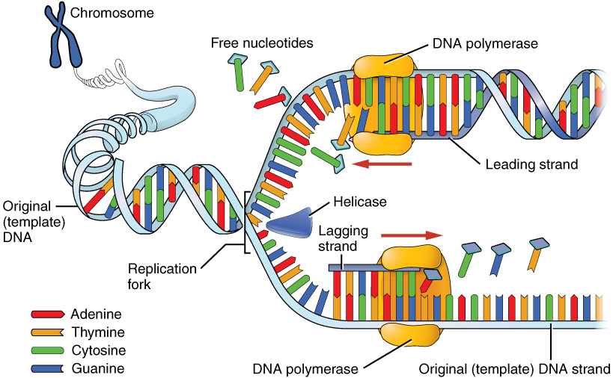
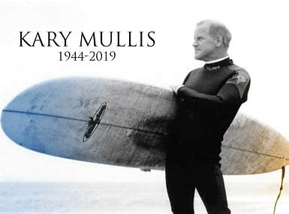
Polymerase Chain Reaction (PCR)
K.B Mullis - 1983
In vitro amplification (or replication) of any DNA sequence
Notes:
Prior to exploring DNA sequencing methods, it is essential to understand the principles of the Polymerase Chain Reaction (PCR). PCR is a way to increase the abundance of specific sequences of DNA, or DNA molecules, and abundance is key to many molecular marker and DNA sequencing strategies. In Unit 18 we will learn more about new developments in sequencing that are based on single molecules, but for now we will focus on the abundance of target sequences that can be generated by PCR.
PCR was invented by Kary Mullis (image on the right), who received a Nobel Prize for his discovery. The technique is based on the natural process of DNA replication (shown in the diagram on the left), which occurs during the S phase of mitosis and meiosis. Please review Units 1 and 2 in order to be sure that you are familiar with these processes. For additional review on these processes, watch the video called “DNA Replication”, posted in the Supplementary materials section in Canvas for this week. For more details on PCR, the Fisher website hyperlink provided in the Supplementary materials section is recommended.
By using PCR in the lab we can mimic S phase DNA replication to amplify (replicate) any DNA sequence we are interested in.
Key considerations in PCR are repeated cycles of amplification and a thermostable polymerase (tolerant of high temperatures) that can function during the DNA denaturation steps that are required in each of these cycles.
With the natural process of DNA replication in mind, please review how these are modified for the PCR by watching the video called “Polymerase Chain Reaction” – it is posted in the Required Video section in Canvas.
FYI: The key considerations that made PCR such a breakthrough are the repeated cycles of amplification and the thermostable polymerase. As we shall see later in this Unit, polymerases (specifically DNA polymerase I from E. coli) were already in use for DNA sequencing in the 1970’s.

Slide 5
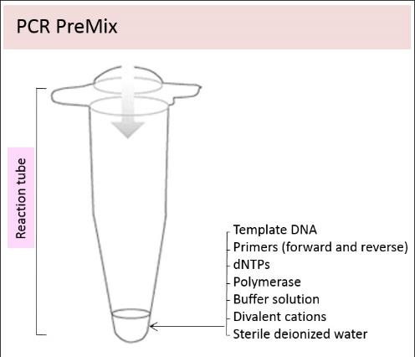
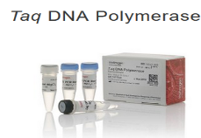
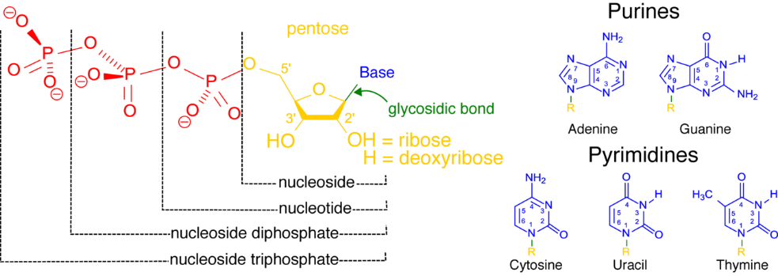
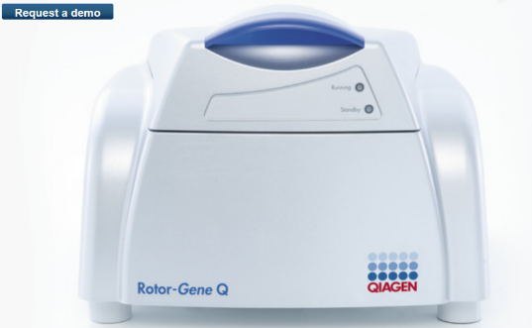
PCR
The PCR reaction consists of:
DNA template (entire genome or a DNA fragment)
Primers (oligonucleotides)
Deoxyribonucleotide triphosphates (dNTPs)
Thermostable DNA polymerase (Taq polymerase)
Buffer, cations, water
Notes:
Here is an overview of the PCR reaction – our goal is to provide a solid theoretical foundation for you to build on in future in-depth coursework and with hands-on experience.
1. A DNA template is essential – the PCR reaction requires it, since it is based on DNA replication, not de novo synthesis. The DNA template can be fragments of an entire genome or simply a single DNA fragment. The average length of a PCR amplicon is ~ several hundred bp, but a host of considerations and methods will determine if the amplicon is 100 or 1000 bp.
2. Primers: These are single stranded, short (~ 20 nucleotide long) DNA sequences. They are called oligonucleotides, because of their short length. As we have seen in the PCR video, primers are fundamental to the PCR reaction because they bracket the target sequence of interest and will determine what DNA will be replicated (amplified). Wherever they bind to in the target sequence, that is where the polymerase enzyme is going to start replicating. To put this in context, remember SSRs, as introduced in Unit 15. The primers could be based on the consensus sequences flanking the SSR and the amplification polymorphism will be based on the lengths of the repeat regions.
3. dNTPs: DNA nucleotides, in the deoxyribonucleotide triphosphate (dNTP) form. These are the building blocks of the new strands.
4. Polymerase: The enzyme Taq polymerase is an essential part of the process – it adds nucleotides to the developing strands under high temperature conditions. Taq polymerase is not one of the polymerases involved in the S phases of mitosis and meiosis in your favorite plant. For more on plant DNA polymerases, see the suggested Supplemental reading. Taq polymerase is a thermostable polymerase, isolated from the bacterium Thermus aquaticus – that is what the Taq stands for. It needs to be thermostable in order to remain functional during the near-boiling high temperature of the denaturation phase of PCR.
5. A buffer solution (plus divalent cations and water): allows for the repeated cycles of increasing and decreasing temperature. As we have seen in the PCR video, each cycle starts with high temperatures (~ 95 degrees C) – these cause the double stranded DNA to separate into 2 single strands (denaturation). The temperature is then lowered to ~ 55 degrees C to allow for the primers to bind (anneal). Finally, the temperature is raised to ~ 72 degrees C (but not to denaturation temperature), which is the ideal range for the polymerase enzyme to add nucleotides to the 3’ ends of the newly replicating strands.
In the lab, the process is relatively straightforward: mix the reactants in a small test tube, and put the tubes into a thermocycler (or more simply, “PCR machine”), such as the one shown in the lower right. The PCR machine is programmed to conduct the repeated cycles of denaturation, annealing, and primer extension.
FYI: PCR machines typically handle 96 samples at a time in a single plate with 96 wells: for that reason, samples and populations for genetic analysis typically occur in multiples of 96.
Buffers, Taq polymerase, dNTPs and primers can all easily be purchased online from a range of suppliers. You can often buy all those reactants together as a kit, and you can have primers specifically designed to target the sequence you are interested in.

Slide 6
PCR Principles
Steps in the reaction:
Denaturing the target DNA to make it single-stranded
Addition of the primers (single stranded oligonucleotides)
Hybridization (“annealing”) of the primers to the template
Primer extension (Taq polymerase)
The DNA between the primers is amplified by the polymerase
In subsequent reactions, the original template plus the newly amplified fragments will serve as templates
The choice of what DNA will be amplified by the polymerase is determined by the primers
Notes:
To reiterate the steps in the PCR protocol, and the outcome.
First, there is denaturing of the DNA double helix to pull apart the 2 strands (breaking hydrogen bonds between bases) but leaving the backbone intact. Then, the single stranded primers are hybridized, that is, they join their complementary base in the single stranded template DNA. Another word used for this binding (hybridization of primers) to the target sequence is “annealing”. Then, Taq polymerase catalyzes the addition of nucleotides to the 3’ end of the developing strand initiated by the primer– this last step is called primer extension.
With each cycle, as the double stranded DNA is opened up, each single strand is used as a template for DNA replication. Therefore, the number of DNA fragments increases quickly: per the PCR video, after 30 cycles you will have ~ 1 billion copies of the target sequence.
The 2 primers bracket the sequence that will be amplified, and will be included in the amplification event – in other words, replicated. So choosing the correct 2 primers is critical. In the next slide we’ll see a simplified overview of how you would you choose your primers, given a target sequence.

Slide 7
Primers and amplification target example – 1st and 2nd cycles
Primers: TGG (reverse)
ACT (forward)
DNA template: 5’ AAATACTGGGCACCAAA
Target sequence: 5’ ACTGGGCACC
First cycle
new
3’ TTTATGACCCGTGG
TGG
5’ AAATACTGGGCACCAAA
5’ AAATACTGGGCACCAAA
5’ AAA TAC TGG GCA CCA AA
3’ TTT ATG ACC CGT GGT TT
Nucleotides added to 3’ end of the developing strand
Denaturation
3’ TTTATGACCCGTGGTTT
3’ TTTATGACCCGTGGTTT
ACT
new
5’ ACTGGGCACCAAA
Second cycle
5’ ACTGGGCACC
new
ACT
3’ TTTATGACCCGTGG
3’ TTTATGACCCGTGG
3’ TTT ATG ACC CGT GG
Denaturation
5’ AAA TAC TGG GCA CCA AA
Nucleotides added to 3’ end of the developing strand
5’ AAATACTGGGCACCAAA
5’ AAATACTGGGCACCAAA
TGG
new
3’ TTTATGACCCGTGG
Notes:
This is an overview of primer design and action – learning to use the different software available for primer design is something you will do in future classes.
In this hypothetical example, the sequence of the target for amplification is shown in red and the target sequence is embedded in a slightly longer sequence – the non-target portions of which are shown in black.
The primers are shown in blue: TGG and ACT. Primers this short would not be used because they lack specificity – the target 3 nucleotide sequence could be found multiple times in a short target sequence and many more times in longer sequences. In order to achieve specificity, PCR primers will more likely be ~ 20 nucleotides, in order to achieve specificity to the target sequence.
In the first cycle of denaturation, the TGG primer anneals to the to the coding strand, which – as we have seen – is written 5’ to 3’. This is the top strand in this example. The primer that binds to the coding strand is called the “reverse” primer. In this case TGG is the reverse primer. The primer that binds to the non-coding (aka antisense) strand is called the forward primer – so in this case ACT is the forward primer.
Once the primers anneal to each strand, Taq polymerase will catalyze addition of nucleotides to the 3’ end of the developing strand. This addition of new nucleotides will not go on forever – a typical PCR reaction will amplify several hundred nucleotides. In designing the PCR program, the duration of the primer extension phase can also be adjusted depending on the length of the target. In this simplified example, the reverse primer will continue for 4 bases beyond the target region and the forward primer will continue 3 bases beyond the target region.
As explained in the assigned PCR video, primer extension will go beyond the target sequence in the early cycles of PCR. However, only amplification products of just the target sequence will soon exceed those that have “over-run” or “overhang” the target sequence.
For simplification, the second cycle shown in this slide refers only to the sequences amplified in the first cycle. Again, we have denaturation, the 2 primers bind and we have primer extension leading to 2 new double stranded DNA molecules. Already, we are starting to increase the abundance of just the target sequence – not the sequence on either side of the target.

Slide 8
Primers and Amplification Target example – 3rd cycle
Target sequence: 5’ ACTGGGCACC
Third cycle
new
3’ TGACCCGTGG
TGG
5’ ACTGGGCACC
Target Sequence
5’ ACTGGGCACC
5’ ACT GGG CAC C
3’ TTT ATG ACC CGT GG
Denaturation
Nucleotides added to 3’ end of the developing strand
3’ TTTATGACCCGTGG
3’ TTTATGACCCGTGG
ACT
5’ ACTGGGCACC
new
The primer sequences are “mirrored” in the target sequence:
forward
Target sequence: 5’ ACTGGGCACC
3’ TGACCCGTGG
(coding strand)
(non-coding strand)
reverse
Notes:
In the third cycle we repeat denaturation, annealing of primers and addition of nucleotides via primer extension. Note how by cycle 3 we generate a complete target sequence – double stranded - with no overhangs of the non-target sequence. Remember that we were just following one DNA molecule at the end of the first and second cycles, so in reality, by the end of cycle 3 we have 2 complete, doubled stranded, target sequences. From cycle 3 on, the number of target sequences increases exponentially with each cycle, because every new sequence formed serves as a DNA template for the next cycle. This is a very efficient process.
The key point of this simplified example was to illustrate the importance of the primers and the rapid approach to amplification of only the target sequence.
The sequence for the forward primer can be found at the 5’ end of the coding strand amplification product, in this example. The sequence for the reverse primer can be found at the 3’ end of the non-coding strand, in this example.
To reiterate, this example has only 3 nucleotides in order to facilitate visualization. Real world primers will more likely be ~ 20 nucleotides. We have barely scratched the surface of what’s involved in designing primers and a standard PCR program. For a deeper look, see the recommended website in the Supplemental readings.

Slide 9
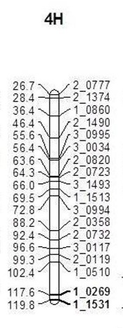
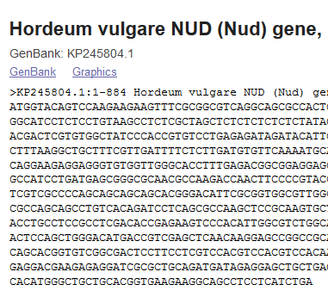
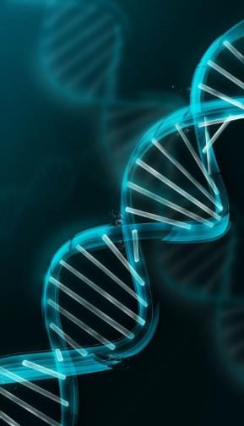
PCR Applications
Amplify a target sequence from a pool of DNA (your favorite gene, forensics, fossil DNA)
Start the process of genome sequencing
Generate abundant markers for linkage map construction molecular markers
My favorite gene
The “Iceman”
Linkage map
Notes:
To summarize, PCR can be used to increase the abundance specific DNA sequences, via the process of amplification. The target sequence can be an allele of your favorite gene or it could the remains of “Iceman’s” last meal (which included cereals). For more on the Iceman, and plants he was involved with, see the recommended reading in the Supplement.
In addition to amplifying DNA sequences, PCR is useful for many other things. We already mentioned that it is a required first step in some DNA sequencing procedures, and that includes some whole genome sequencing techniques. It is also a principal tool for generating markers with which to populate genetic linkage maps.
There are different types of PCR beyond the basic “standard” PCR we’ve described. RT-PCR, for example, allows the use of RNA as a template, having generated a cDNA equivalent of the mRNA using reverse transcriptase. qPCR allows for quantification of the amplified molecules. For more on different types of PCR, see the recommended reading in the Supplementary materials.

Slide 10
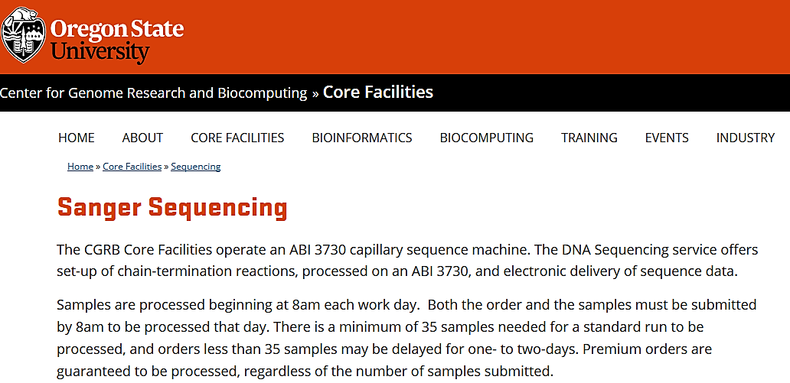
DNA Sequencing – Sanger Sequencing
F. Sanger – 1977
Classic but not obsolete
The first draft of the human genome was achieved using automated versions of this technique
It is still the gold standard for accurate sequencing of short (~ 500 bp) DNA sequences
Notes:
Now, after learning about PCR and how this technique is used to amplify a target DNA sequence, let’s finally see how you actually sequence your target DNA – be it a gene or a genome.
How do you go from a PCR amplicon to determining its sequence? Today there are many options – and faster, cheaper, more accurate DNA sequencing techniques are constantly being developed. But back in 2005, Bradbury and their colleagues did not have a lot of choices for DNA sequencing – they used an automated version of Sanger sequencing called an ABI3730 capillary sequencer, the same device still in use at the OSU Core Facilities Lab (shown in the screenshot).
Developed in 1977 by Dr. Fred Sanger, a British biochemist who won the Nobel prize in Chemistry in 1980 for the discovery, the technique named after its inventor has since been updated to include PCR and automated capillary electrophoresis. The first draft of the human genome, for example, was generated using Sanger sequencing. In 2005, “next generation sequencing” techniques became available. Next generation techniques, as we shall see in the next Unit, can sequence faster and more cheaply. However, Sanger capillary sequencing still has its uses. If your target is in the hundreds of bp in length, and you want highly accurate sequence, this is probably the technique you would go for. You can probably submit a sample today and get your sequence the day after tomorrow.
The concepts behind Sanger sequencing are so elegant that we will briefly review them – from the original version to what happens today, on campus. Furthermore, the essential elements of Sanger sequence are the basis for new generation sequencing techniques. Understanding why the following terms are (or are not) used for DNA sequencing will equip you to be conversant in understanding the principles of any type of DNA sequencing: 5’, 3’, dideoxynucleotide, electrophoresis, fluorescent tag, library, nucleotide, polymerase, primer, and template.

Slide 11
Key points in Sanger sequencing
Sequence one strand at a time
Starting with a sequencing primer, DNA polymerase synthesizes DNA sequences of varying lengths
dideoxynucleotide triphosphates (ddNTPs) - lack the 3' hydroxyl (OH)
Fragments of varying lengths based on when, and which, ddNTP incorporated
The result: a population of DNA fragments of varying lengths
Fragments are separated by size using electrophoresis
Fragment length differences resolved at 1 bp
After J. Adams (2008) https://www.nature.com/scitable/topicpage/dna-sequencing-technologies-key-to-the-human-828
Notes:
A standard PCR reaction may be used prior to Sanger sequencing to increase the abundance of the target sequence (or increased abundance of the target can be achieved by replication in a cloning vector)
Once the target sequence is present in sufficient abundance, Sanger sequencing capitalizes on chain termination PCR. A single primer (typically ~ 20 nucleotides long) is used to replicate a single strand. In a standard PCR amplification reaction reverse and forward primers bracket the target sequence. In Sanger sequencing, both strands may be sequenced, but each will have its own primer and sequencing reactions.
Unlike the standard PCR amplification reaction, in Sanger sequencing the polymerase synthesizes DNA sequences of varying lengths – not the full length of the target sequence.
The varying lengths of the newly synthesized fragments (millions to billions of each of them) are determined by the final dideoxy nucleotide that is incorporated
Dideoxy nucleotides ( abbreviated as ddNTPs (ddATP, ddGTP, ddCTP, or ddTTP ) lack the 3’OH group, meaning that they block further addition of nucleotides. No phosphodiester bond possible between the dideoxy nucleotide and the next dNTP during DNA strand elongation.
The result, after many replication events during which multiple copies of every possible length sequence are generated, is a population of fragments of different lengths, each terminating in a specific ddNTP.
The fragments are separated by size, using electrophoresis. Originally, electrophoresis was conducted in gel rigs – currently it is conducted using small capillaries. Either way, the smaller the fragment, the further it moves through the gel (or capillary). Fragment size resolution is at the single base pair level.

Slide 12
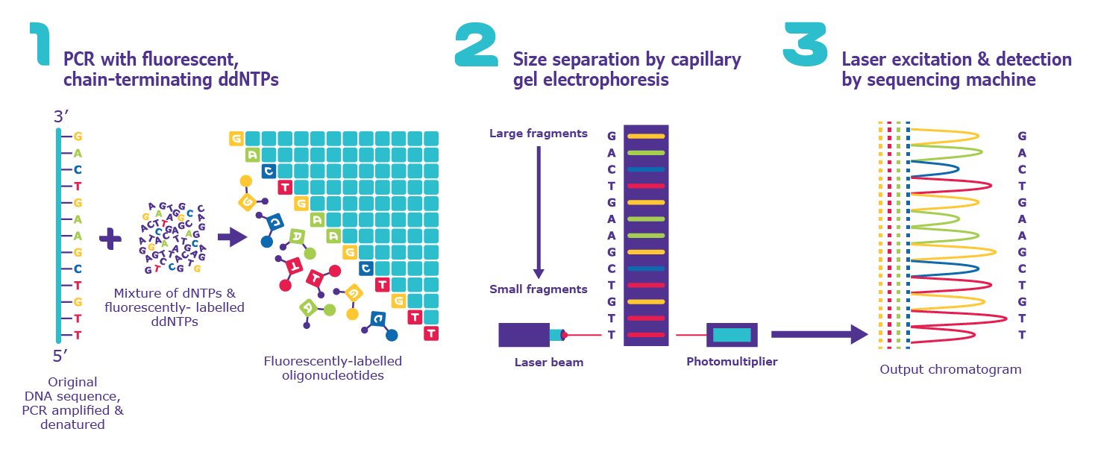
Key points in Sanger sequencing (Continued)
The terminal base in each fragment is known based on the specific label of each ddNTP
Based on the fragments size and label, the sequence of the single strand template is determined
https://www.sigmaaldrich.com/technical-documents/articles/biology/sanger-sequencing.html
Notes:
The terminal base in each fragment is known because its dideoxy form terminated the elongation of that fragment.
Each dideoxy nucleotide has a different fluorescent label.
Based on the fragments aligned by size, and their labels, the sequence of the target strand is determined.
The Figure shows ddNTPs, each with a distinct color label and the results of their incorporation into replication events.
This population of different size fragments is separated by electrophoresis
With these general considerations in mind, we’ll watch videos of the process and then re-cap the key considerations.

Slide 13
Sanger Sequencing – at The Movies!
https://dnalc.cshl.edu/resources/animations/cycseq-video.html
https://www.thermofisher.com/blog/behindthebench/how-does-sanger-sequencing-work/
Notes:
These videos animate the essential steps in Sanger sequencing.

Slide 14
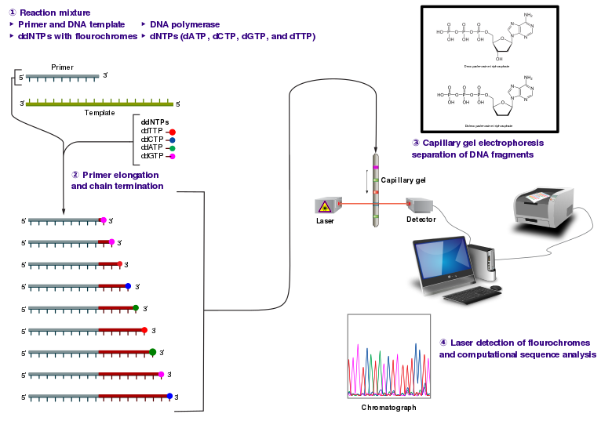
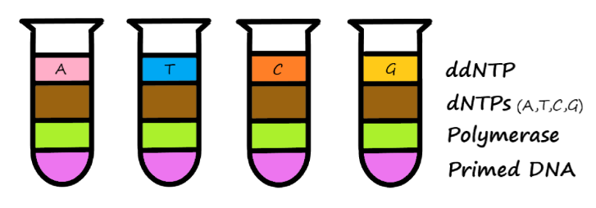
Sanger DNA Sequencing – Recap
Dideoxyribonucleotides (ddNTPs)
G
A
T
C
Notes:
Having watched the videos, we’ll now walk through the key steps in Sanger sequencing on more time.
In this simplified example, there are separate ddNTP versions of each of the 4 bases, in separate vials, along with other components of the reaction (upper left). One type of ddNTP is added per vial, as indicated and color coded. In automated sequencing, the four ddNTPs are mixed – each with a unique fluorescent label.
In diagrams/images of Sanger sequencing, you may see different colors used for each of the ddNTPs. The colors are often adjusted to enhance visualization. For example, in the Fisher video G is black, A is green, T is red and C is blue. In the DNALC video the colors are the same, except that G is yellow in the video and black in the electropherogram. The colors in the upper left panel of the slide match those in the center panel and bottom right panels, except for G, which is shown in pink.
The center panel shows the template sequence, the complementary primer, and the strands of varying lengths that are due to the incorporation of the four different ddNTPs. The flourescent tags at the end of each fragment are read by a laser as the frgaments move through capillary electrophoresis (smallest fragment first). The results of the electrophoresis are visualized in the electropherogram shown at the lower right.

Slide 15
By now, you should be able to…
Describe what happens (and why) during the main steps in a PCR reaction: DNA denaturation, annealing of primers, and primer extension.
Differentiate Taq polymerase from the DNA polymerase that is naturally occurring in plants and explain why the former, and not the latter, is used in PCR.
Describe primers and their essential role in PCR. Why is it said that ANY sequence can be amplified with PCR?
Given two aligned DNA sequences for a SSR and adjoining consensus regions, identify the regions you would use for primer designs and what you would expect to see in terms of amplification products.
Describe the main steps in Sanger sequencing. Why would one conduct a PCR on their target DNA prior to sequencing it using the Sanger method?
Explain what ddNTPs are, and describe their essential role in Sanger sequencing. Remember the key terms: “hydroxyl”, “chain termination” and “fluorescent tags”.
Given base call results from electrophoresis performed in Sanger sequencing, spell out the actual sequence. Remember: 1) the fragments differ by one base, and 2) the gel reading frame is complementary to the actual sequence.
Notes:
Here is a list of the learning outcomes of this lecture. If anything in this list is still unclear, please reach out to me and I’d be more than happy to clarify!
In Unit 18, we will build on the essential elements of Sanger sequencing that, in one way or another are enhanced, or replaced, in new generation sequencing techniques. Understanding why the following terms are (or are not) used for a particular method of DNA sequencing will equip you to be conversant in contemporary genomics: 5’, 3’, dideoxynucleotide, electrophoresis, fluorescent tag, library, nucleotide, polymerase, primer, and template.

