Slide 1
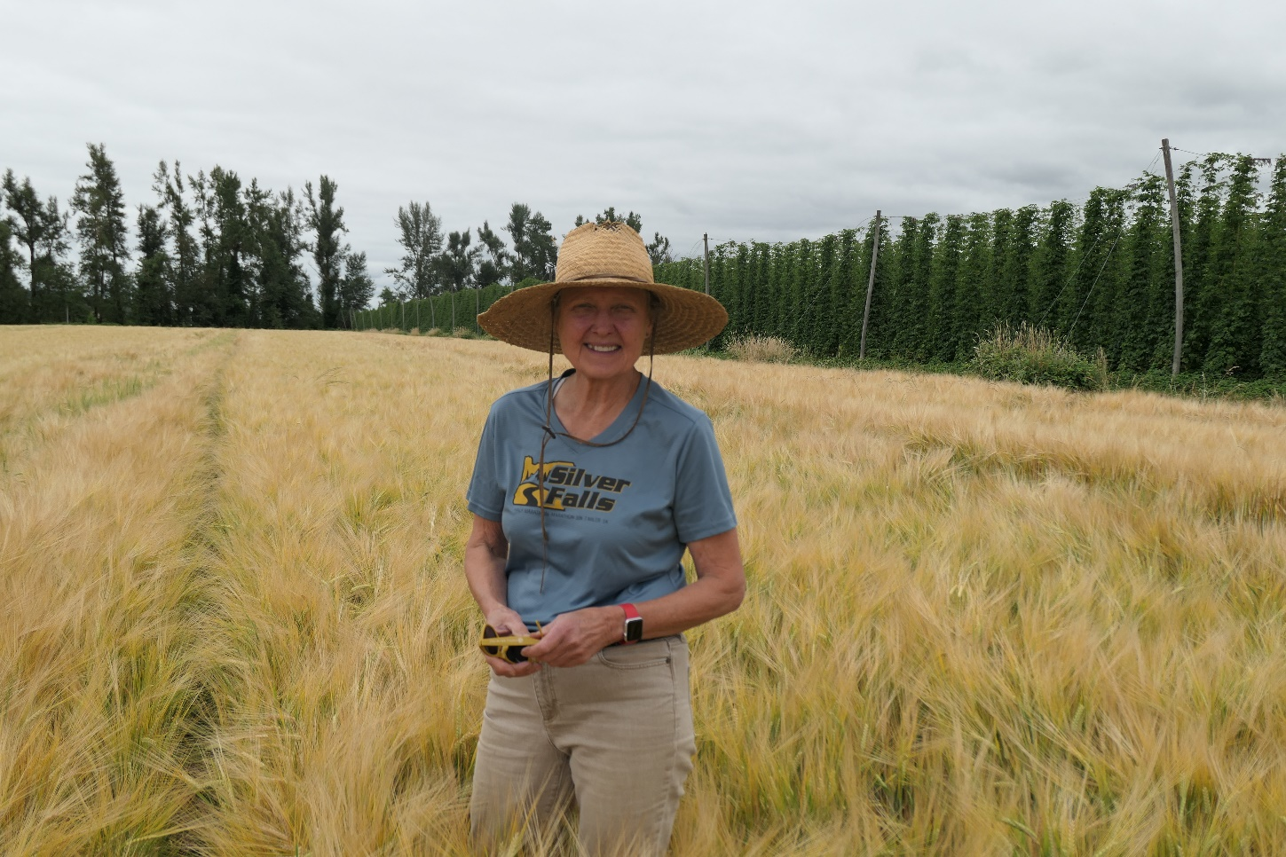
What is barley?
2n = 2x = 14
5.3 Gbp
~ 30,000 genes
Self-pollinated (hermaphroditic)

Slide 2
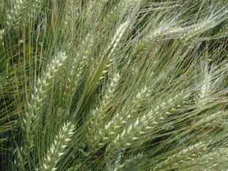
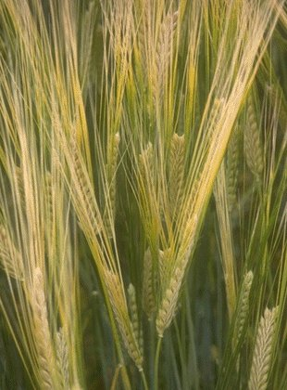
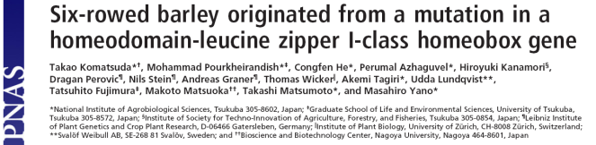
Inflorescence type
2-row vs. 6-row
1 gene/30,000 genes

Slide 3
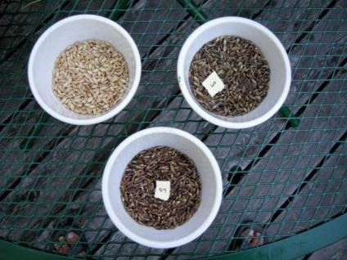
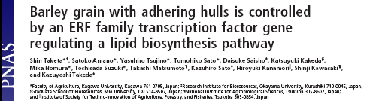
Covered vs. Naked
1 gene/30,000 genes

Slide 4
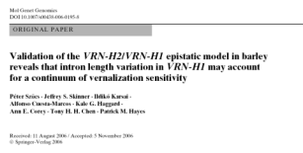
Growth habit and allied traits: 3 to a constellation of genes
 | Winter | Facultative | Spring
Low temperature tolerance | Yes | Yes | No
Vernalization sensitivity | Yes | No | No
Photoperiod sensitivity (short day) | Varies: insurance | Varies: necessary | Varies: value?

Slide 5
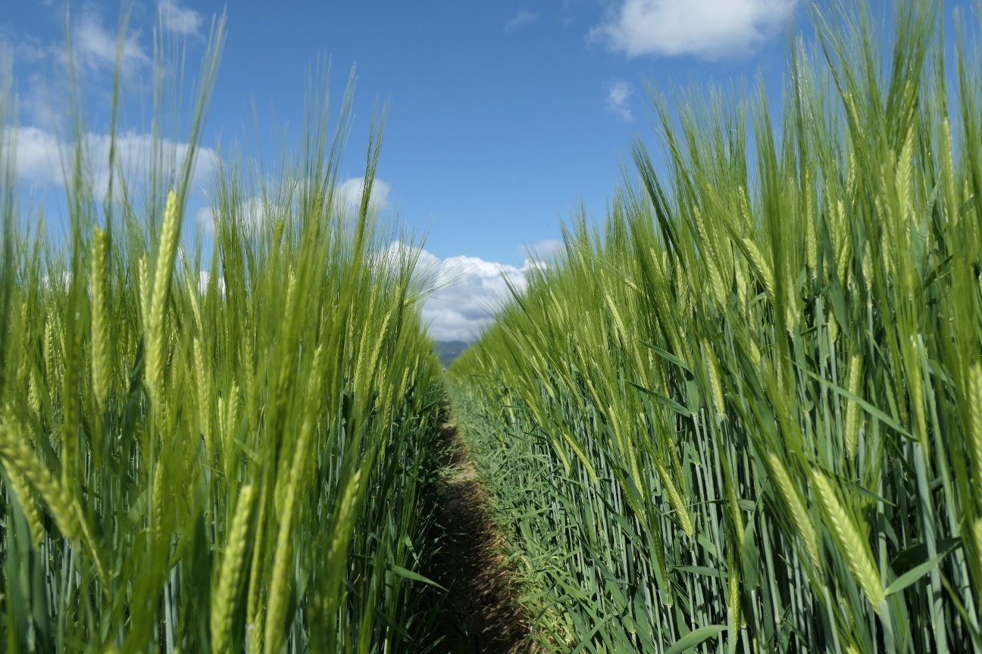
Facultative growth habit –
a tool addressing challenges of climate change
Plant in fall and cold tolerant
Plant in spring and no vernalization required
Fall planted Thunder (left) and Lightning (right) Corvallis, OR 2021

Slide 6
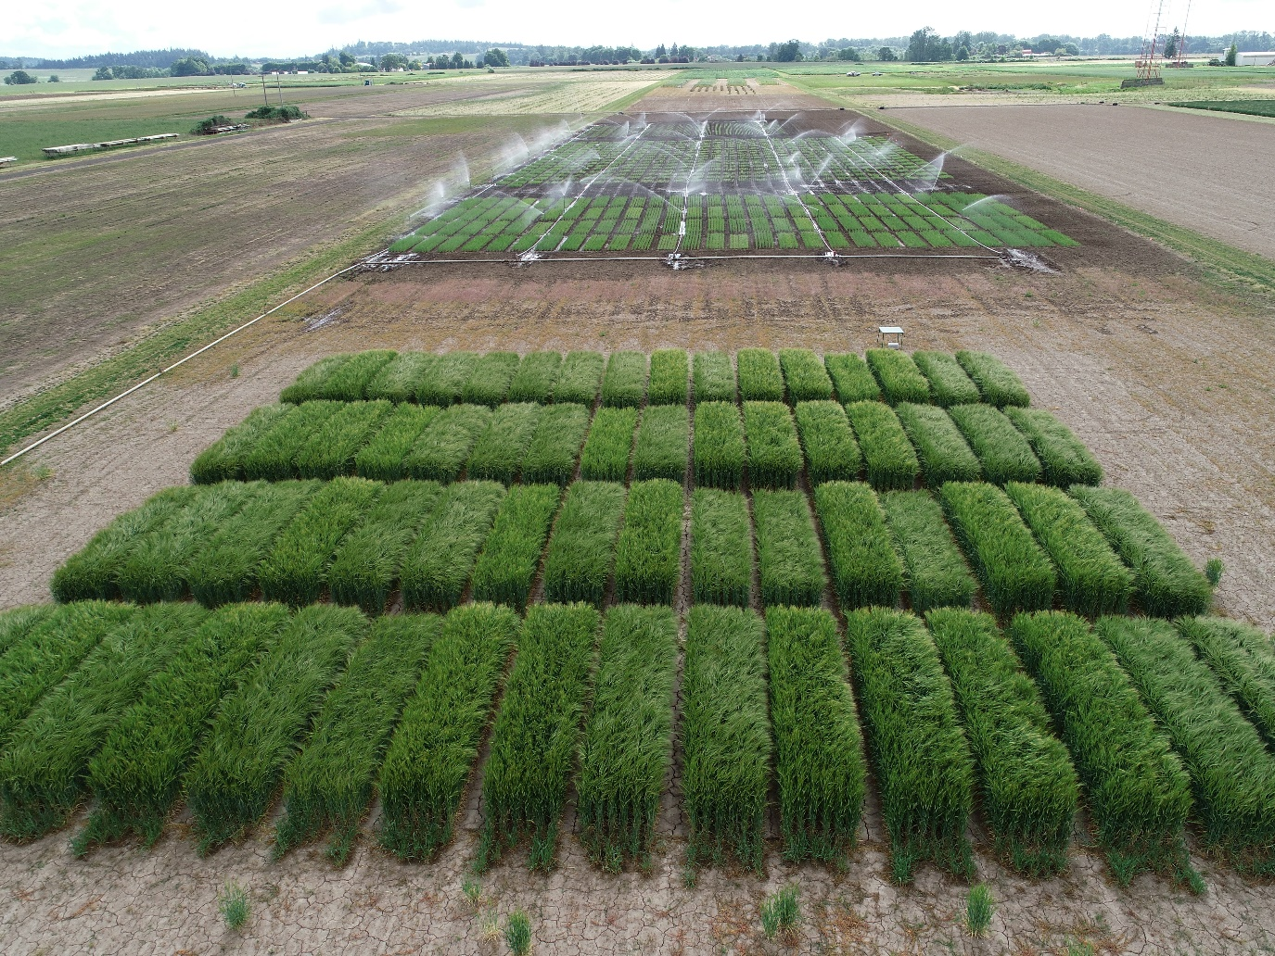
Facultative growth habit –
a tool addressing challenges of climate change
Save precious water
Flexibility and assurance for farmers, maltsters, and brewers

Slide 7
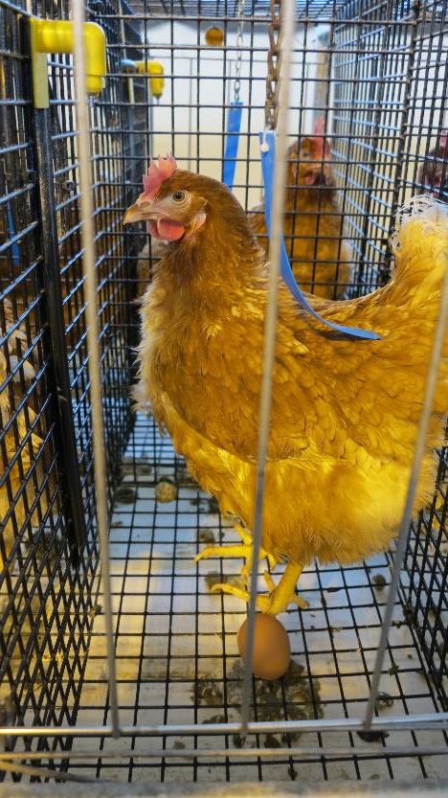

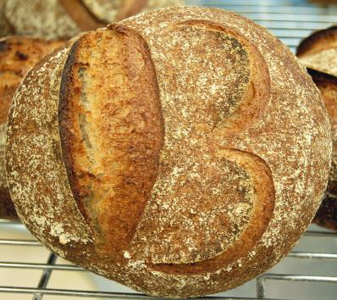
Why barley?
Beverage, food, feed

Slide 8
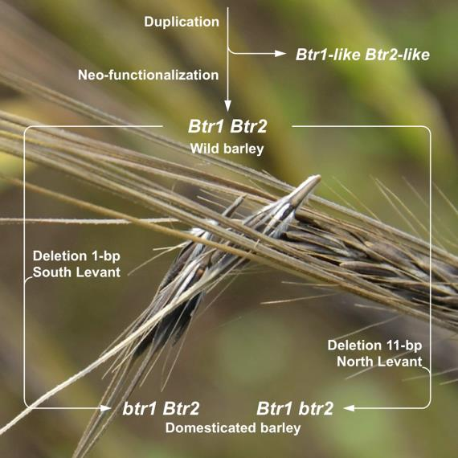
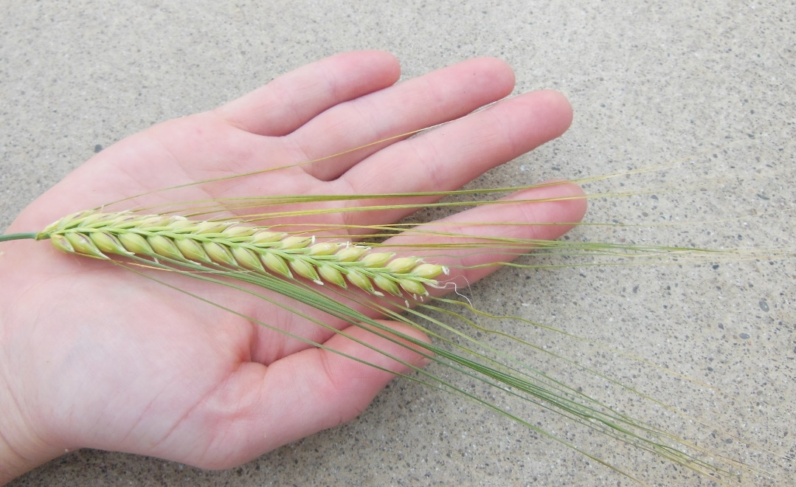
Whence barley? In the beginning there was Hordeum spontaneum
Now there are beverages, foods, feeds, and Hordeum vulgare*
* Technically speaking spontaneum and vulgare are both subspecies of H. vulgare

Slide 9
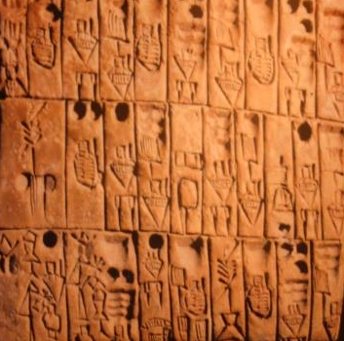
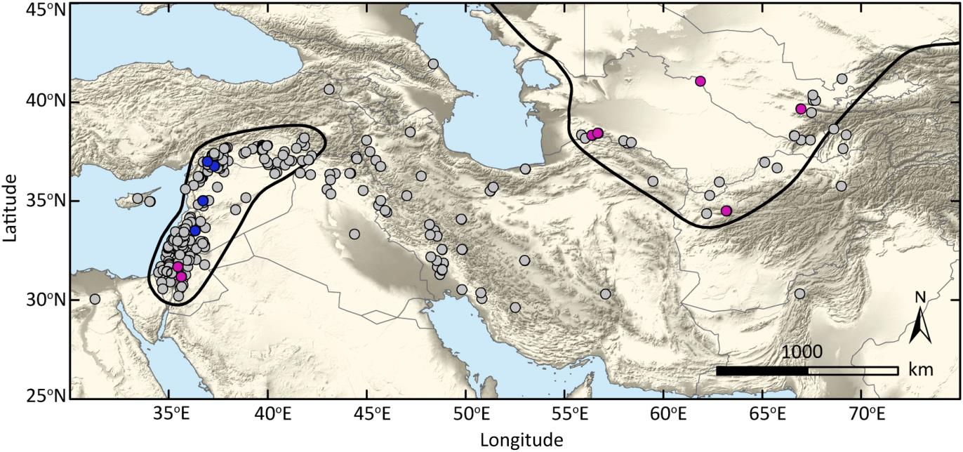
Domestication
Spontaneum | Vulgare
Shattering (brittle rachis) | Shattering resistant (non-brittle rachis)
2-row | 2-row, 6-row
Adhering hulls | Adhering, non-adhering (naked)
Winter annual | Winter, facultative, and spring annual

Slide 10
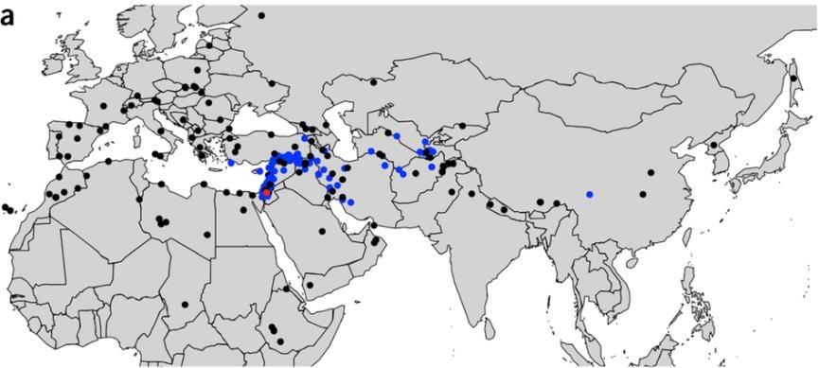
From domestication to migration
1 mile per year (?)

Slide 11
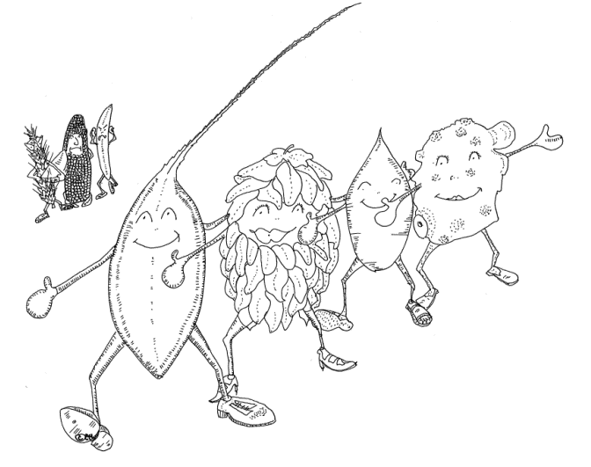
Migration and specialization
Europe
Beer
Hulls, spring growth habit, 2-row
Feed (food and some beer)
Hulls, spring/winter/facultative, 6-row
“The decree known as the Reinheitsgebot, issued in Ingolstadt in 1516, had three aims: to protect drinkers from high prices; to ban the use of wheat in beer so more bread could be made; and to stop unscrupulous brewers from adding dubious toxic and even hallucinogenic ingredients as preservatives or flavourings.”

Slide 12

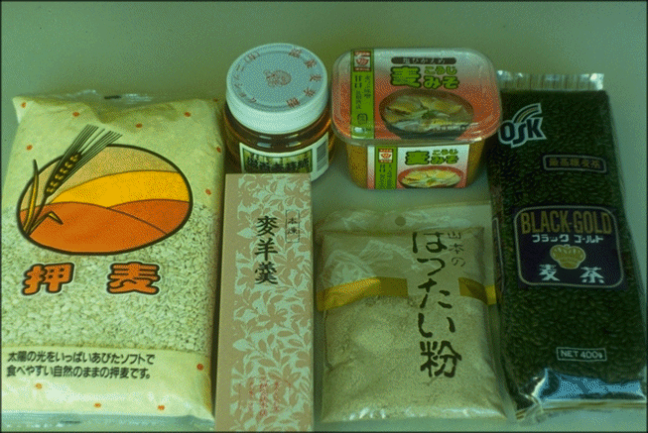
Migration and specialization
Central/East Asia – food
Naked, spring, 6-row

Slide 13
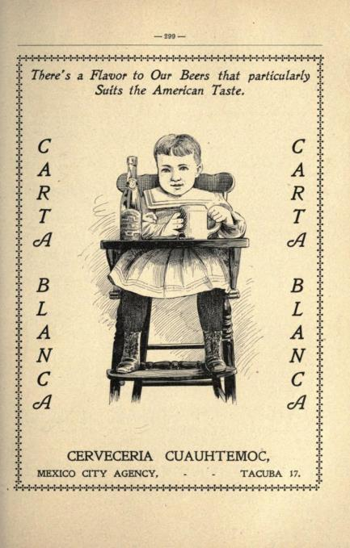
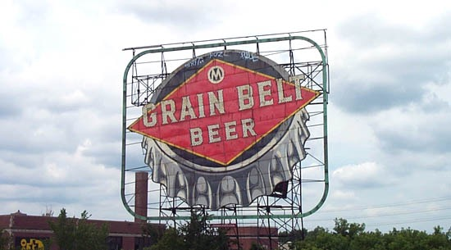
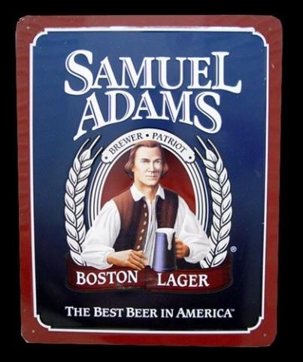
Migration and specialization
Americas (17th century - )
North and Meso
Hulls, spring growth habit, 2-row malt –Europe
Hulls, spring growth habit, 6-row malt – Europe/Asia
Hulls, spring/winter/facultative 6-row feed – Iberian peninsula/North Africa

Slide 14


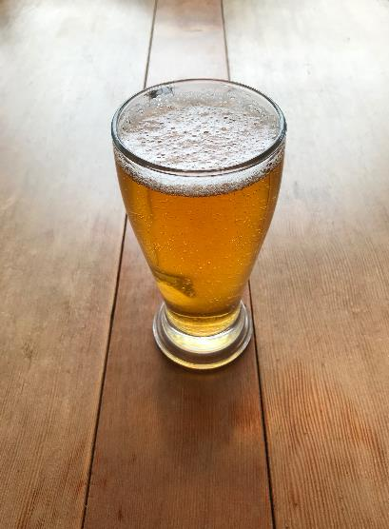
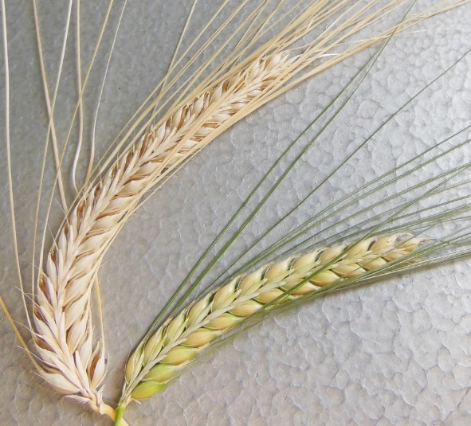
The US Barley report
Thanks to the American Malting Barley Association

Slide 15
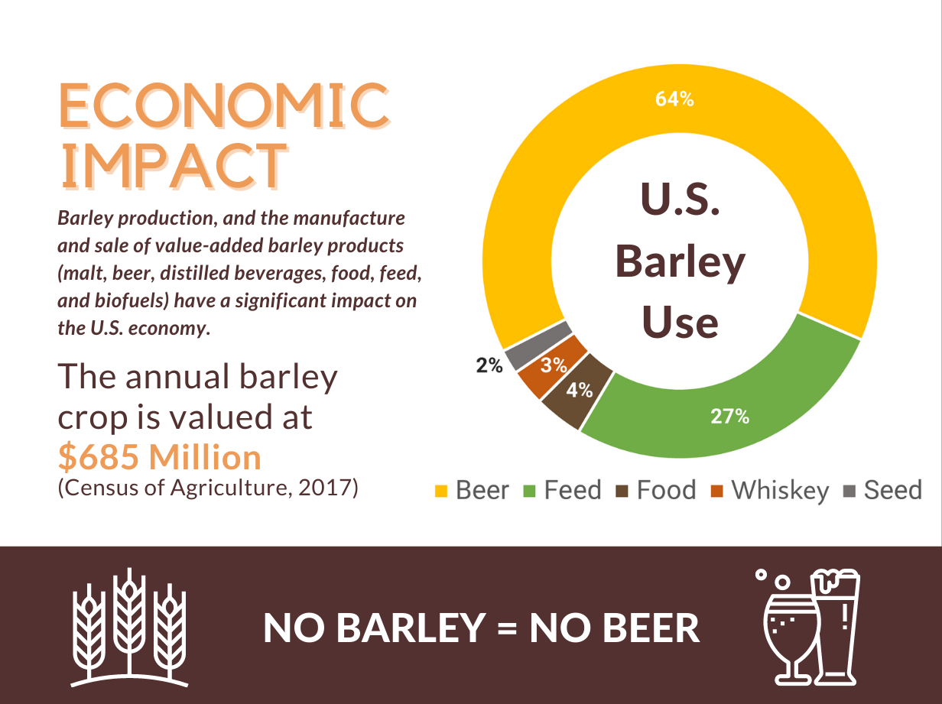
Notes:
PH

Slide 16
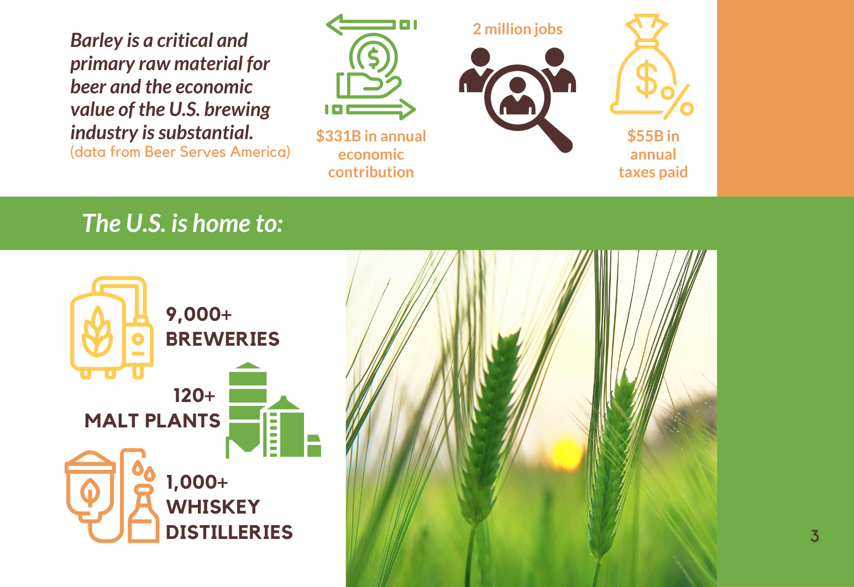
Notes:
SB

Slide 17
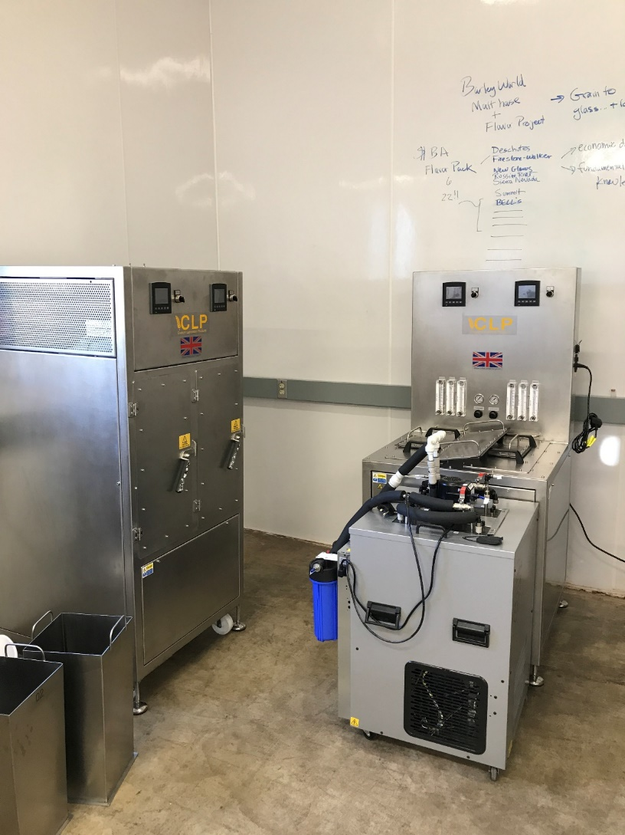
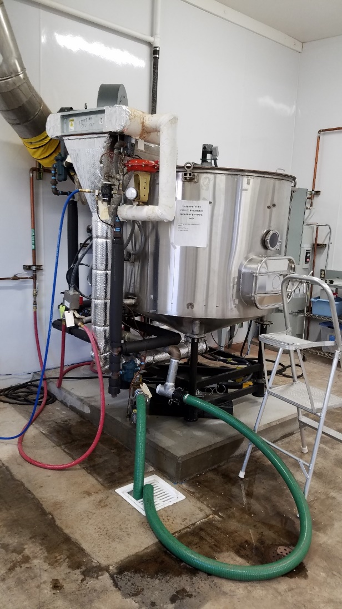
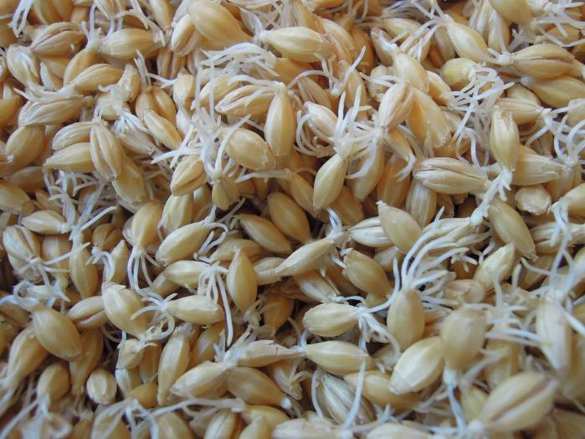
The transformative power of malting
Steeping, Germination, Kilning
Time (~1 week)
temperature (10º – 180º)
Moisture (4% – 50%)

Slide 18
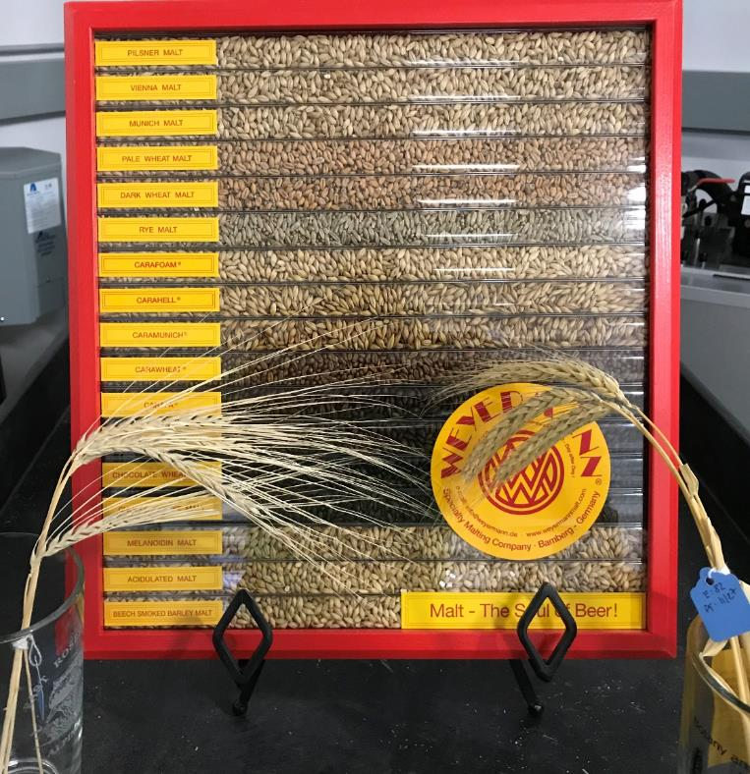
One variety: Many Malts
Time, temperature, moisture

Slide 19

Feed barley or Malt barley?
The dogma: “A good malt barley is good feed barley, but not the reverse”
The (crafty) truth: “With changes in malting protocol a feed barley can be an excellent malt barley”

Slide 20
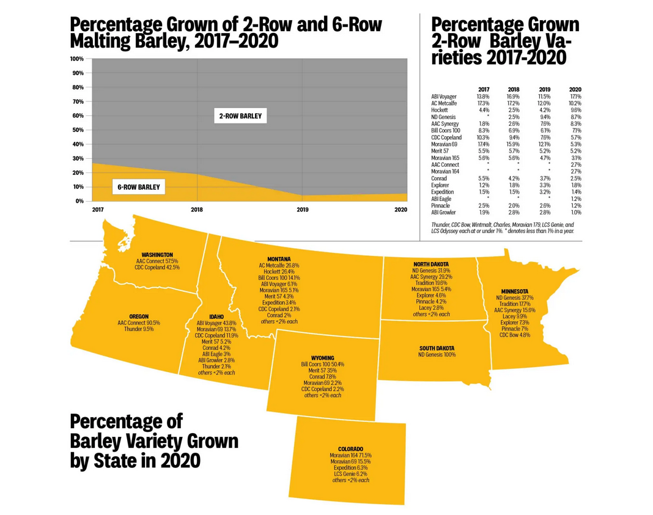
Barley varieties – heirlooms to the latest
Bere 6-row spring Scotland
Chevalier 2-row spring England
Moravian(s) 2-row spring Czech
Golden Promise 2-row spring Scotland
Maris Otter 2-row winter England
Klages 2-row spring US (ID)
Harrington 2-row spring Canada(SASK)
Morex 6-row spring US (MN)
Robust 6-row spring US (MN)

Slide 21

Breeding genetics and breeding at a
Land Grant University
Contribute to the fundamental body of knowledge
Research on climate change traits, disease resistance, and malting/brewing traits
Stimulate economic development
Use research to inform variety development and release
Education
Communicate research results and variety progress via classroom instruction and outreach

Slide 22
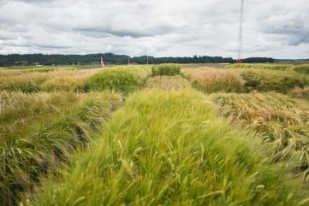
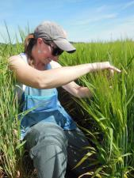
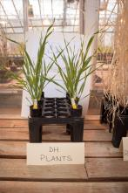
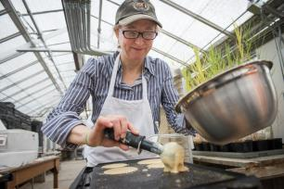
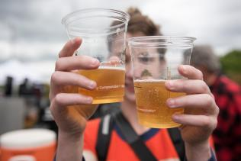
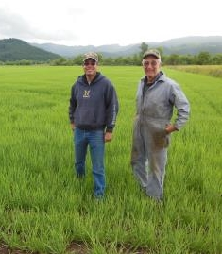
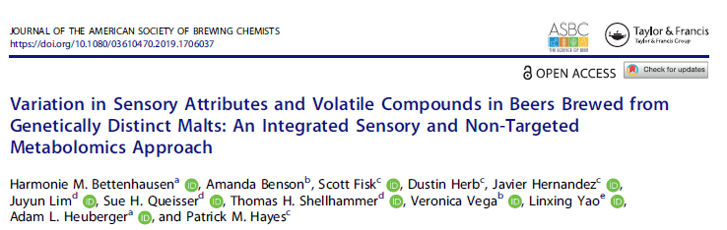
The OSU Barley Project
Crossing
Doubled haploids
5H
0.0
52_0206
3.2
A10133
A11281
3.7
A11283
12.5
A3012
13.0
A61467
13.2
A17246
15.8
5149877
19.1
5232930
21.7
52_1426
A9236
27.1
A9242
45.5
A35937
49.9
A6527
53.6
A32314
54.8
A34399
55.7
A45497
56.3
A58614
A17329
A15122
A33142
A38678
A11195
56.9
A10578
A39423
A33144
57.2
A35635
A23020
A19878
57.5
A23663
A57310
57.8
A52323
A45139
58.1
A21751
A54566
59.2
53_0654
61.6
51_1128
62.2
A62366
A16750
64.6
A14013
A62372
65.2
A27948
65.8
A58627
66.0
A28098
C13P_LOD:2.7_a:-1.3
66.2
A23036
M15H_LOD:5.8_a:-1.7
A53775
66.4
C14H_LOD:5.5_a:-4.8
66.5
A13235
C14TW_LOD:6.8_a:-0.9
67.1
A52324
A28510
A40667
70.6
A38634
A25784
C13H_LOD:10.3_a:-5.2
51_1221
72.3
51_0671
72.9
52_0441
C14P_LOD:9.4_a:-6.1
Genetics and Breeding
74.6
A39562
C14LR_LOD:3.5_a:5.6
74.8
A59246
C13BC_LOD:6.4_a:-3.3
75.5
A2132
C13BP_LOD:3.1_a:0.4
76.0
A21727
A31634
A39567
76.4
A33667
A8401
C14H_LOD:6.7_a:-5.4
77.6
C14L_LOD:4.8_a:-5.2
C14HD_LOD:7.4_a:-1.7
C13H_LOD:12.3_a:-5.6
C13HD_LOD:8.6_a:-2.8
A33802
C15HD_LOD:6.3_a:-2.1
78.8
A24436
M15HD_LOD:8.3_a:-1.5
M15M_LOD:5.3_a:6.8
C13TKW_LOD:14.3_a:-2.9
M15H_LOD:8.2_a:-2
C13P_LOD:5.1_a:-1.8
C14TW_LOD:7.6_a:-1
80.0
52_0713
C14Y_LOD:6.9_a:-318.1
80.6
52_0392
A4388
82.9
A44540
92.5
A60826
A16532
A40446
93.1
A16543
A16546
93.7
A28760
97.3
A56808
C14L_LOD:3.7_a:-4.6
A56807
101.6
A15768
C15BSR_LOD:5.5_a:7.1
A10413
C14BSR_LOD:6.6_a:5.5
A39511
102.2
A62319
102.8
A39701
C13BC_LOD:3.1_a:-2.3
51_1355
C15HD_LOD:3.3_a:-1.6
105.7
53_1427
51_0518
111.9
52_0526
A40885
120.1
A40886
52_0018
133.2
53_0098
52_0549
52_1168
135.7
A29949
52_0795
138.1
A35656
139.3
52_1061
139.9
A50994
A5043
A42576
A57844
140.5
A50995
141.1
A42579
161.6
A56719
162.8
A3016
163.1
A56725
163.4
A15237
163.8
A56720
164.2
A15242
A26145
165.1
A6950
168.9
5366981
180.3
53_0524
185.4
A17309
A47689
187.2
A52248
189.0
A61559
A19829
A19833
191.4
A19834
194.4
51_0805
200.4
51_0783
Publication, Variety/Germplasm release
51_0095
53_0929
201.1
A10668
53_0930
202.6
A10672
204.1
A10673
208.3
A25187
210.1
53_0635
214.4
51_0819
216.2
A10187
216.9
A11995
227.0
A45575
229.0
A3583
229.6
A39117
236.1
A12032
C13ST_LOD:3.7_a:-1.9
A44849
237.4
A61082
237.8
A6348
238.6
A32892
244.4
A45211
C13BC_LOD:3.2_a:-2.3
A23407
52_1018
A43929
247.8
A43332
C14SPS_LOD:2.9_a:-0.8
A44323
249.0
A44334
A55919
250.2
A51223
251.9
52_0829
C13BG_LOD:5.9_a:75.1
254.0
51_0869
A63287
A60753
262.6
A10542
A60754
263.2
52_1141
264.9
A31352
C13ST_LOD:31.2_a:-4.6
268.5
A32988
A32982
276.8
A31257
C13WC_LOD:16.5_a:-0.3
C13ST_LOD:35.2_a:-4.7
C13AA_LOD:35.3_a:-18.7
279.8
A14908
C13WP_LOD:30.1_a:-0.6
C13FAN_LOD:36.9_a:-39.6
A12049
C13ME_LOD:11.4_a:-0.9
280.4
A12052
283.1
A61914
C13BG_LOD:5_a:66.7
A44414
A22962
287.1
A19168
A59718
288.8
A55993
289.4
A54195
290.0
A37358
291.2
53_0382
293.6
51809_R
5784_F
294.1
569307
51_0857
294.7
51_0322
295.9
53_0958
5140269
53_1481
297.1
5128167
51_0401
298.3
52448_R
51881_F
547507
298.9
52048_F
53_1292
300.6
5139089
301.2
548097
302.5
546054
303.7
52_1155
305.6
53_0769

Slide 23
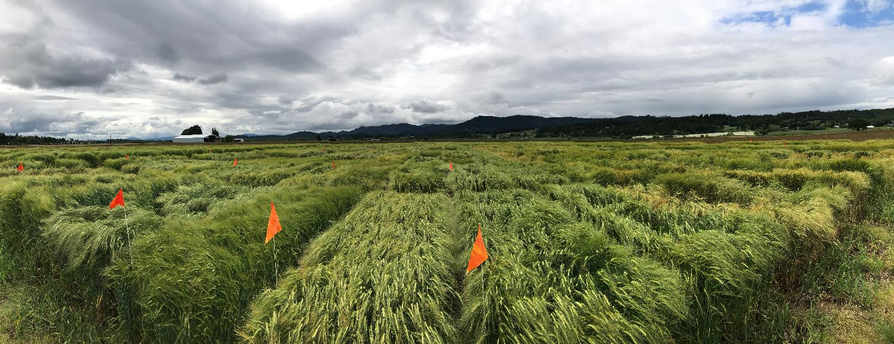
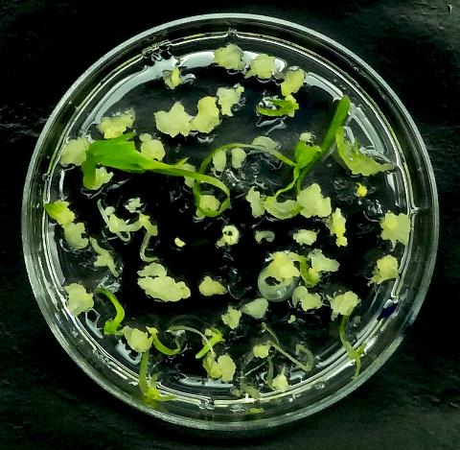
Doubled haploid breeding
“Instant homozygotes”: unequivocal phenotyping and genotyping

Slide 24
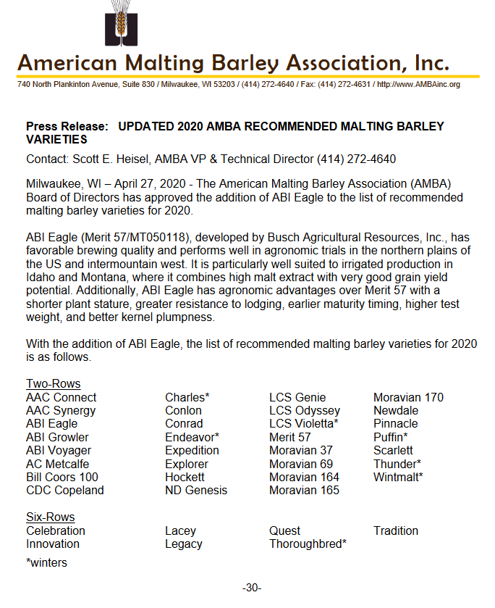
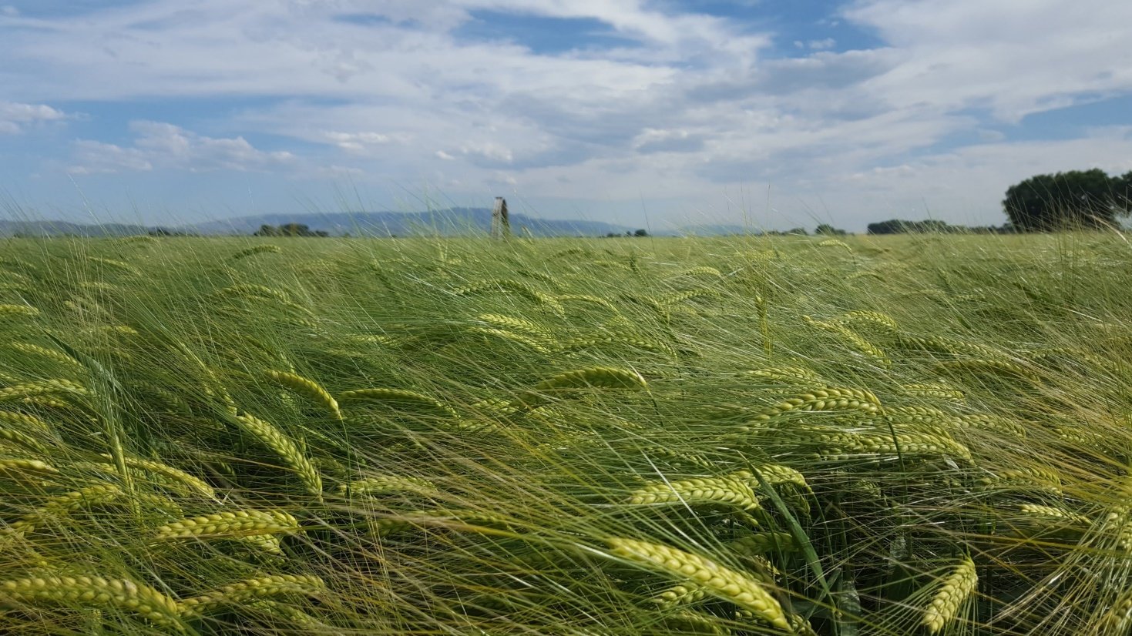
Thunder

Slide 25
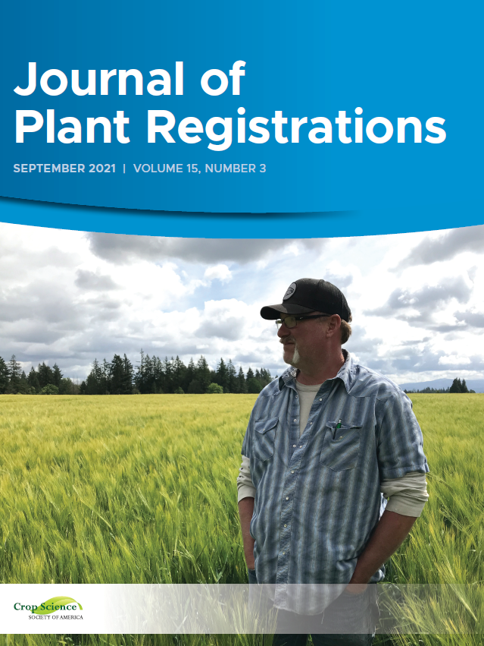
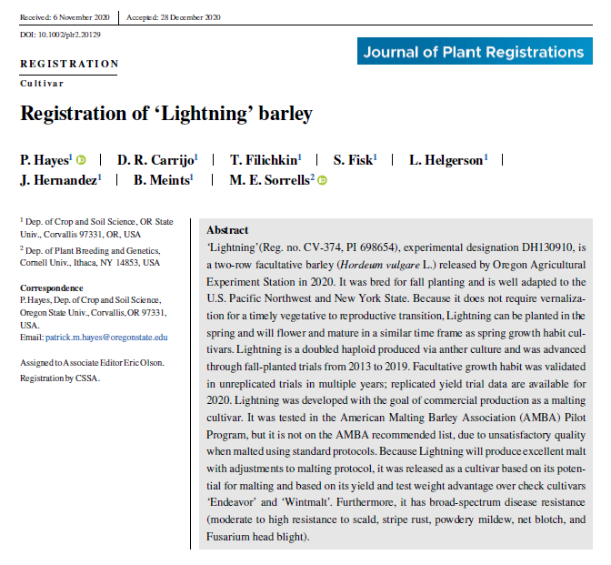
Lightning

Slide 26
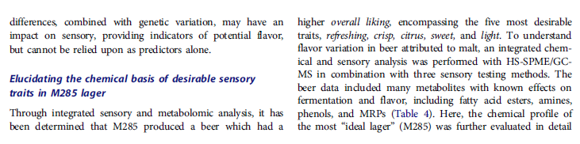
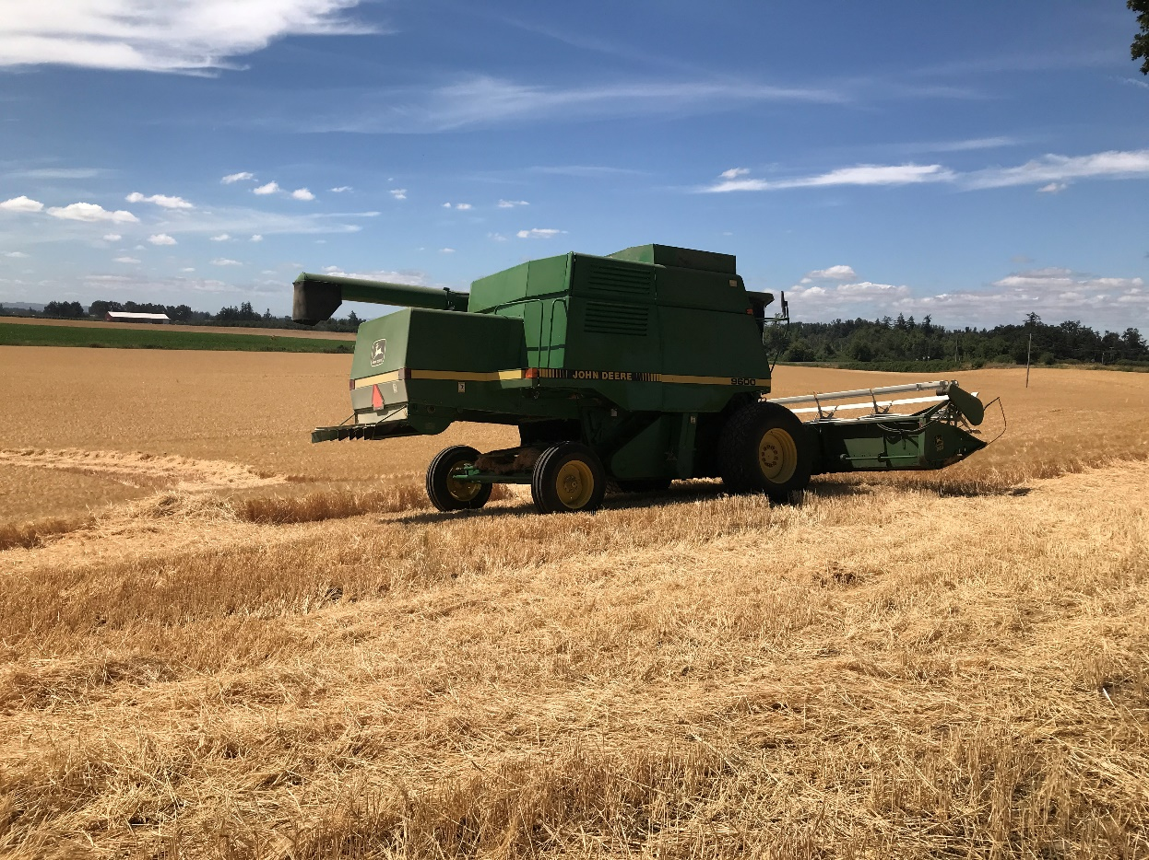

Oregon Promise

Slide 27
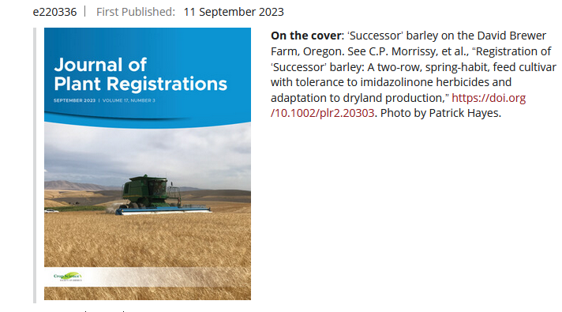
Successor

Slide 28
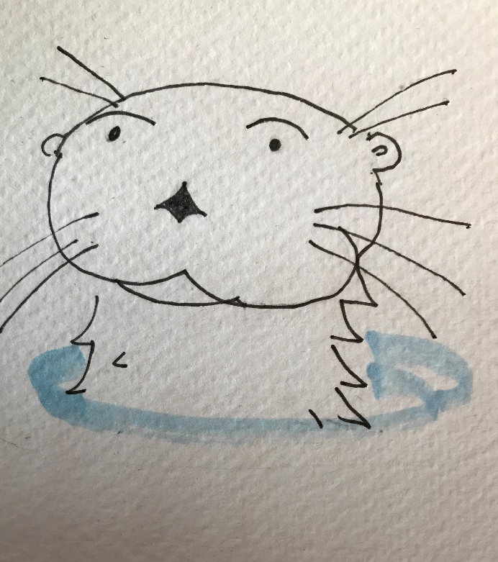
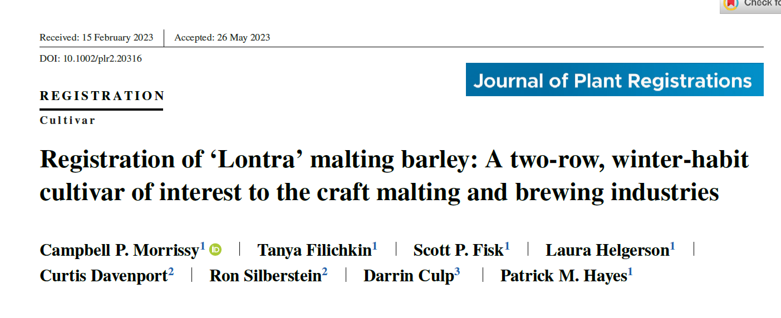
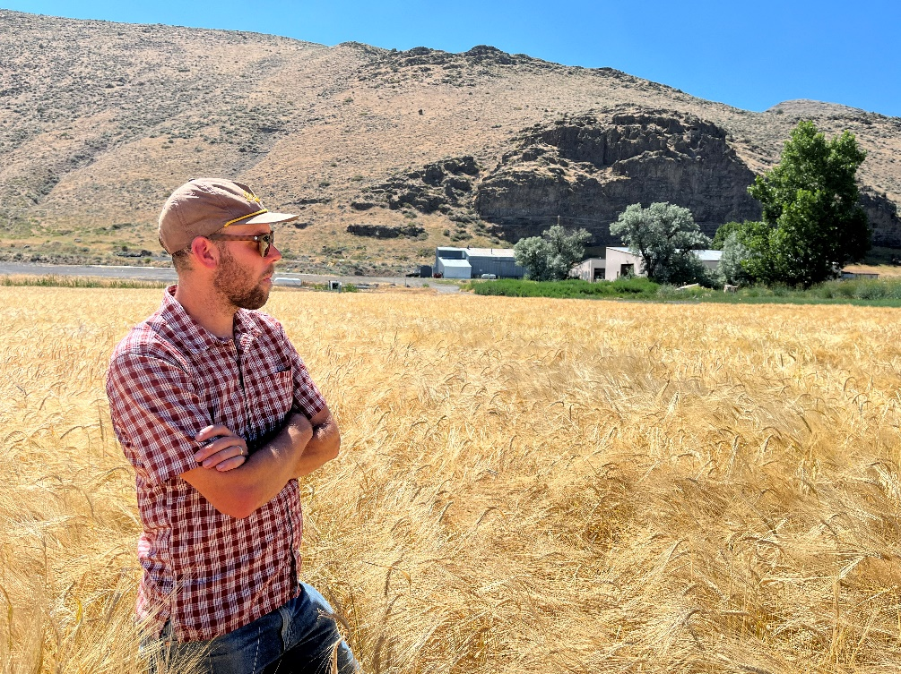
Lontra

Slide 29
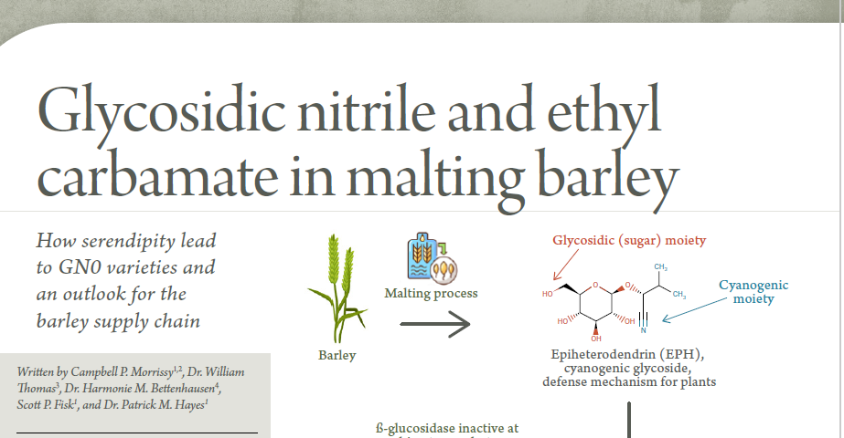

The GN 0 invasion
Flex, Top Shelf, and…..Bottom Drawer?

Slide 30

Barley contributions to beer flavor

Slide 31










Sayer-Chavez et al. Barley genes and beer flavor.
Genotyping
Linkage map construction
Beer metabolomics
Nano-brewing
Beer sensory
Mapping population
Micro-malting
Malt quality analysis
QTL analysis
Candidate genes
HvDep1
HvMKK3

Slide 32

Is it time for barley to go naked after 8,000 years?

Slide 33



Crossing, selection (phenotypic, genetic/ genomic), mutants, GMOs, and CRISPR
Golden Promise
(gamma irradiation of Maythorpe, ari-e, 1968)
LOX
Mechanism
Loss of function deletions
DMS
https://www.nytimes.com/2023/09/25/dining/climate-change-fruits-vegetables.html

Slide 34

Grow your own barley?
The Oregon Naked Barley Blend
https://barleyworld.org/barley-info/seed-availability

Slide 35

https://barleyworld.org/sites/barleyworld.org/files/final_osu_barley_zine.pdf

Slide 36

Barley questions
What’s with the 2-row vs. 6-row thing?
What are advantages of facultative growth habit – and what precautions could be necessary?
If it weren't for malting and brewing, would barley go extinct?
Can flavor alone propel a barley variety to stardom?
Of what potential value are wild barley and ancient land races to barley breeders today and in the future?
Speculate on why so many domestication traits, and traits of value to modern plant breeding, are loss of function mutations.
Do the contributions of barley to beer flavor merit further research?
What about naked barley – is it time barley gave up the hull after 10,000 years?

