Slide 1
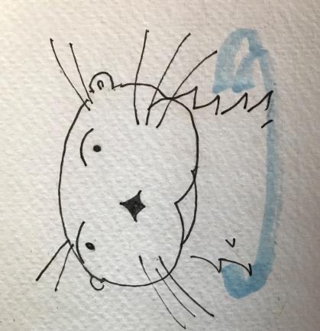
Creating a modern heirloom variety
Lontra: The New World Otter

Slide 2
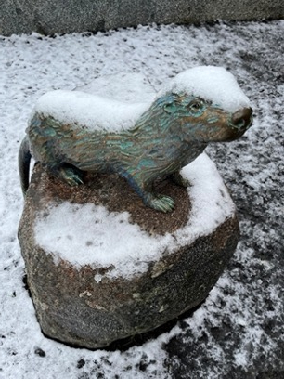
The Participants. The Flow
Darrin Culp: An otter in the Klamath Basin
Campbell Morrissy: Rompin’ Research and otter be a good new world beer
Scott Fisk: Research malting and raising a Lontra
Curtis Davenport: Admiral Malting and flooring a new world otter

Slide 3
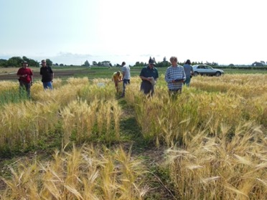

The Genesis: What are the contributions of a barley genotype (via its malt) to beer flavor?
The World Core
Golden Promise and the Oregon Promise (x Full Pint)
Maris Otter and the Romp of Otters (x 04-028-36 and Violetta)

Slide 4
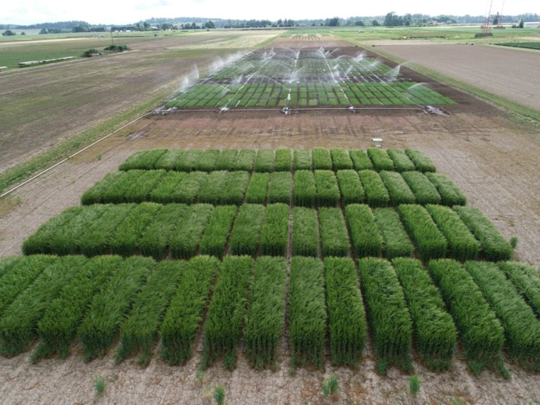
Flavor, climate change, and breeding fall-planted barley
From the Romp of Otters to Lontra. The Story

Slide 5
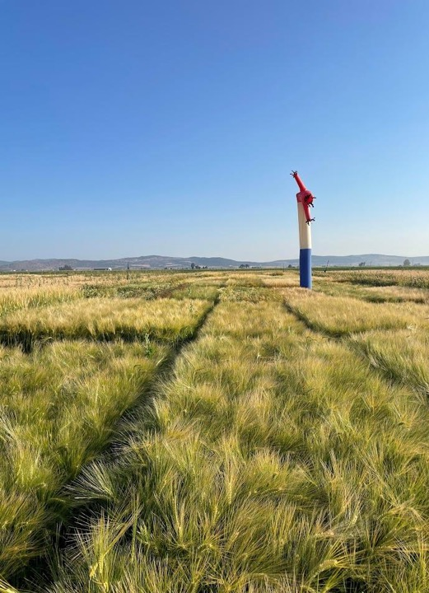
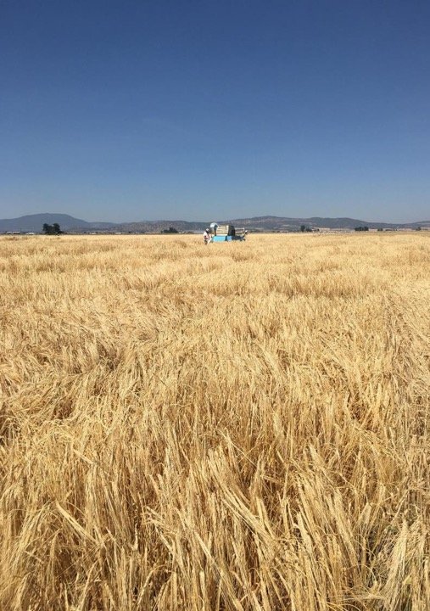
Klamath Basin Agriculture and the Potential for Winter Malting Barley

Slide 6
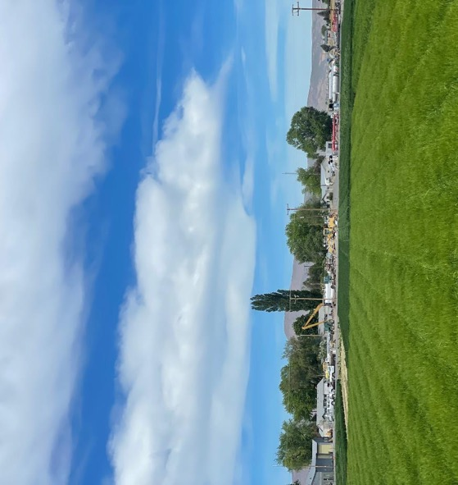
History of Klamath Basin Barley
Largest production region for barley in Oregon 35-40% of Acreage
Roughly 10% of acreage is for malt barley
Proven production of high-quality barley with high yield, low protein, plump kernels
Access to malting facilities via railroad system

Slide 7
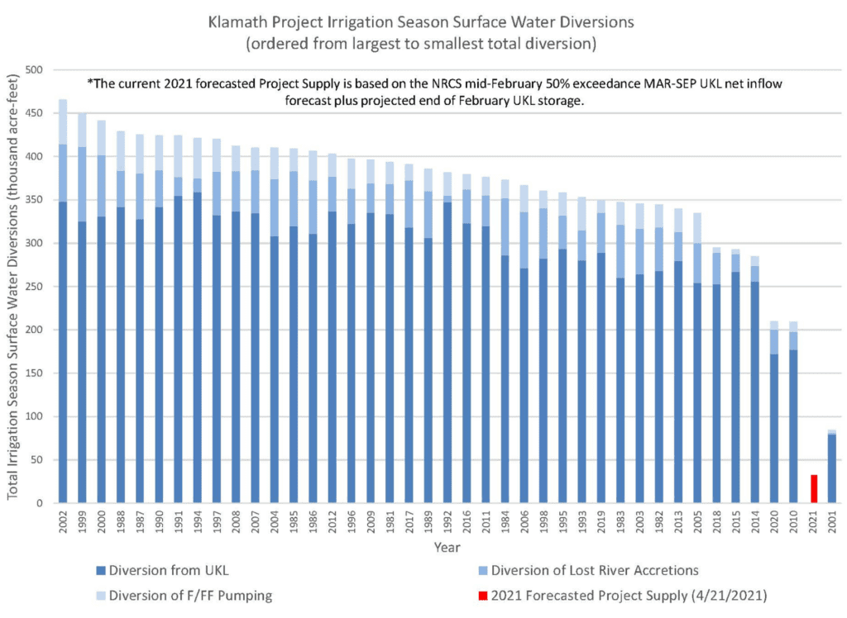

Slide 8
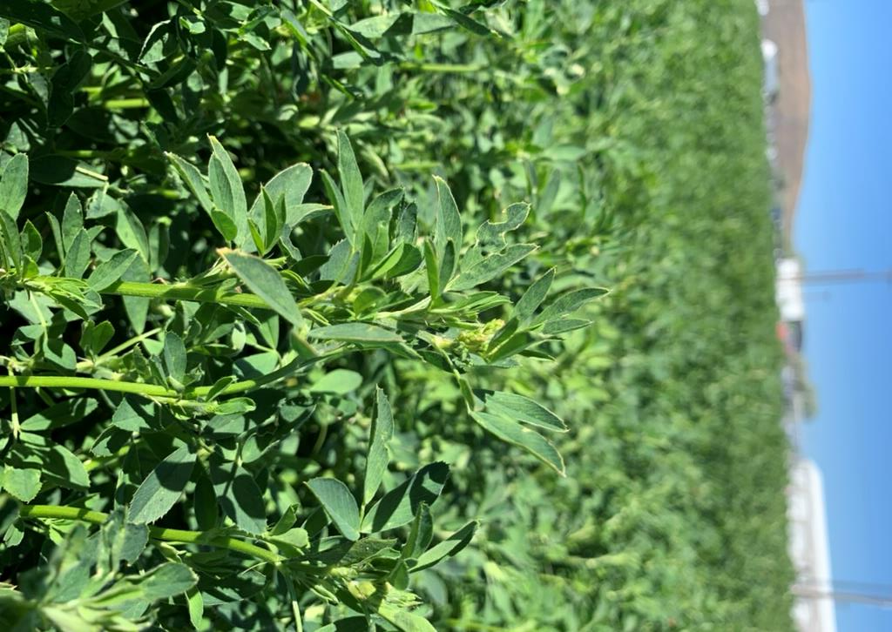
Agriculture changes with limited irrigation deliveries
California drought has caused increased alfalfa production with consistently higher hay prices
Irrigation being used on high value row crops such as potatoes and onions
High interest in dual purpose grain that can be harvested for forage or grain
Still a need for crop rotation of grain
  Grass type for suppression on weeds and diseases

Slide 9
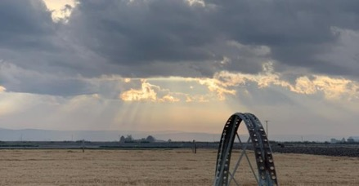
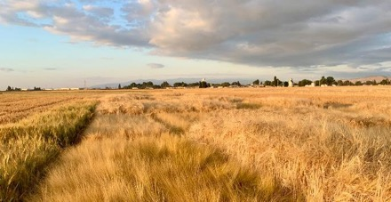
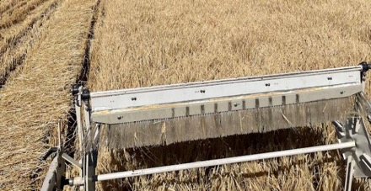
Winter Barley Benefits
Can take advantage of winter precipitation and mature earlier in season (early-June heading)
  Average 10-12 acre inches of applied water
  Wheat needs 14-18 acre inches of irrigation (middle to late June heading)
Barley has lower nitrogen requirements compared to wheat
Established stands minimizes winter erosion and nutrient leeching

Slide 10
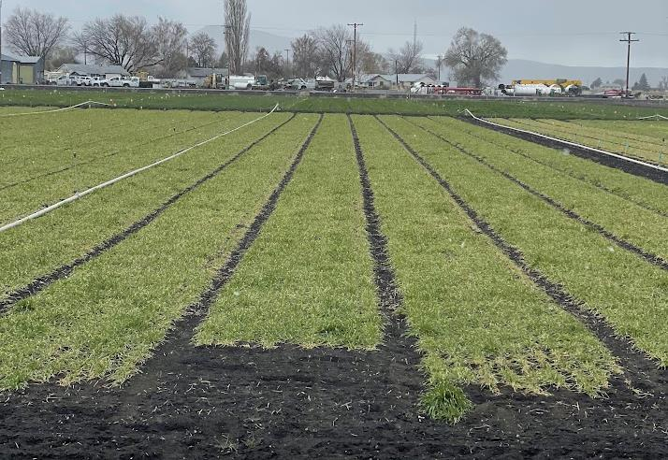
Winter Barley Issues?
Less winter hardy than wheat
Goose damage/feeding in spring
Winter heaving and freeze thaw wind blown soil
Planting date critical for good establishment

Slide 11
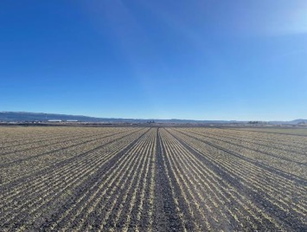
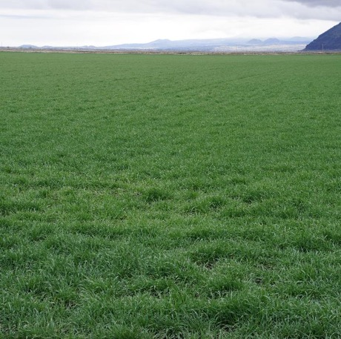
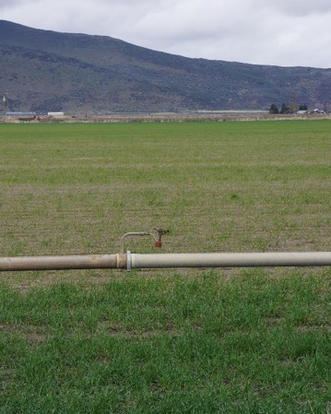
Grower Needs
Variety malt houses want
  Maybe Lontra?
High contract prices
  Currently malt prices $280/ton
  Better than wheat?
Cultural management work to minimize winter kill/damage
Strong crop insurance programs

Slide 12
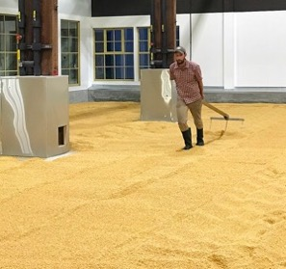
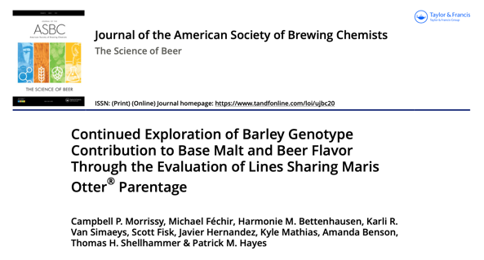
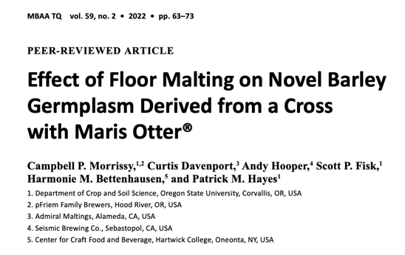
The Romp of Otters

Slide 13
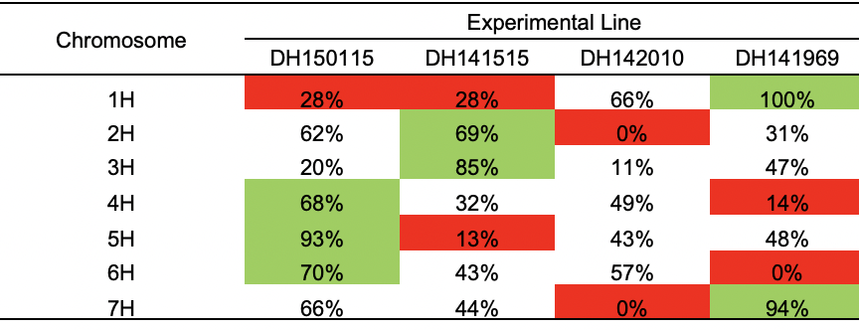
The Romp of Otters
Population of 85 doubled haploids developed from crosses of Maris Otter® X Violetta and 04-028-36 (Ackermann Saatzucht GmbH & Co).
Culled to 4 selections for malt and beer sensory.
Percentage contribution of Maris Otter to each chromosome of four progeny. Color gradient shows relative inclusion of Maris Otter genome between lines on each chromosome: red – lowest inclusion on each chromosome, green – highest inclusion.

Slide 14
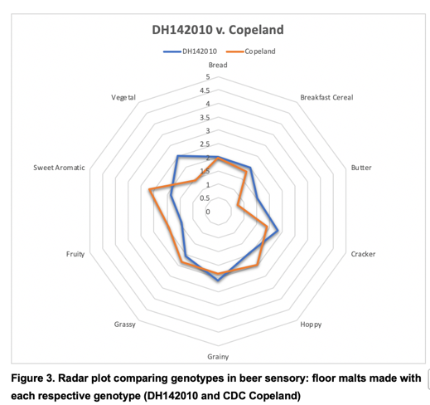
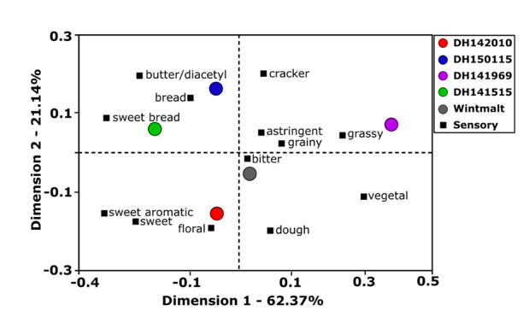
Romp 1.0 – Research Malts & Beers
Romp 2.0 – Floor Malts & Craft Beers
Sensory in both projects showed significant, but nuanced, differences.
Beer is greater than the sum of all parts…

Slide 15
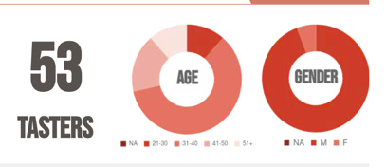
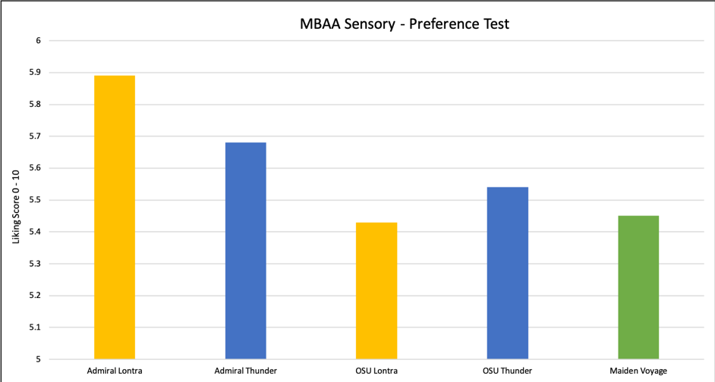
Romp 3.0 – Floor vs. Pneumatic
Consumer Sensory – MBAA DNW

Slide 16
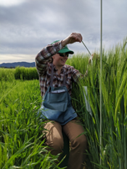
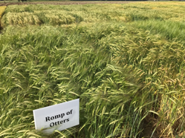
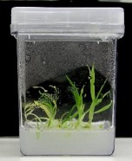
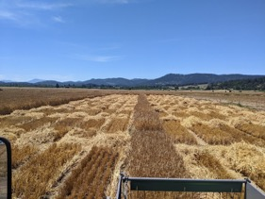
A Romp Through Time
Crossing
04-028-36/Maris Otter
Violetta/Maris Otter
2013
Doubled Haploid Production
N = 85
2014-15
Phenotypic Selection & Research
85 → 47 → 10 → 4 → Lontra
2015-23

Slide 17
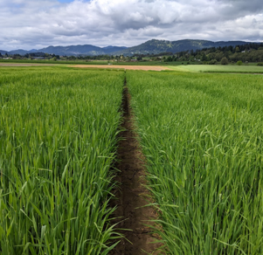
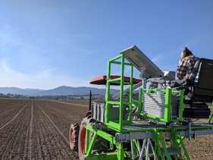
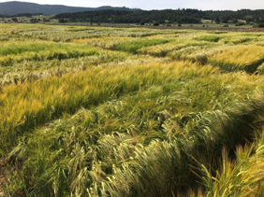
Agronomics
Western Oregon (Corvallis & Lebanon) 2017-2019

Slide 18
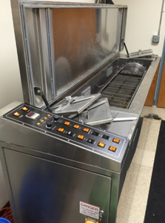
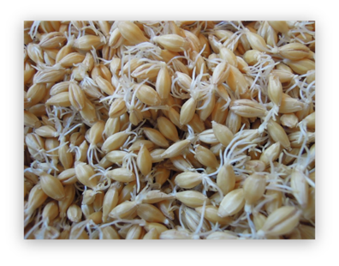
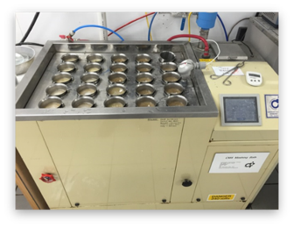
Micro-malting
Western Oregon (Corvallis & Lebanon) 2017-2018

Slide 19
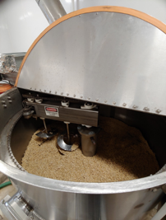
Pilot Malting at OSU
Romp 1.0 – Corvallis, OR 2019
  Standard kiln recipe.
  Water sensitive.
  47% Steep-out moisture. Similar water uptake to Wintmalt.
Romp 3.0 – Tulelake, CA 2022
  Pale kiln recipe.
  Not water sensitive.
  46% Steep-out moisture. Similar water uptake to Thunder.
  Sprayed twice to increase modification due to protein level.

Slide 20
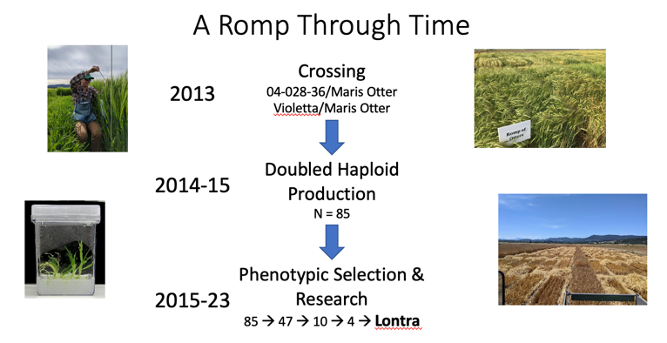
Admiral joins the Raft
Outreach to OSU Barleyworld- 2020
Customer interest in UK “heirlooms”- Maris Otter and Golden Promise
Admiral/Grower interest in Fall-planted barley

Slide 21
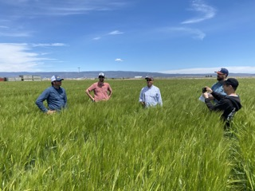
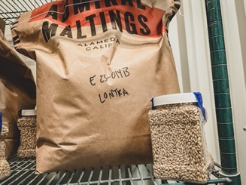
Evaluation/Product Development timeline
CY2020
Enough Grain from test plots for three 50# Pilot batches
1ac seed increase planted at IREC Tulelake in Fall 2021
CY2022
Pilot Malting for Romp 3.0 project
30ac production field planted in Tulelake Fall 2022

Slide 22
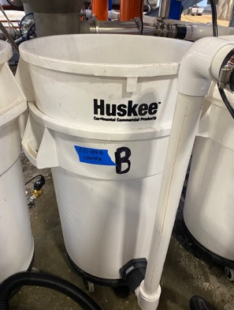
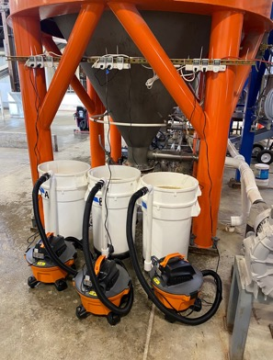
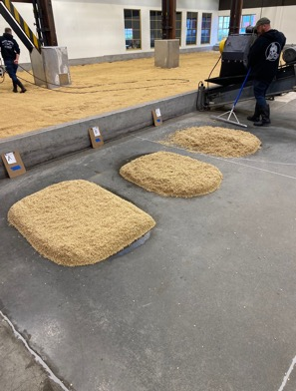
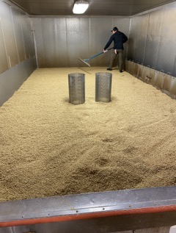
Pilot Malting at Admiral

Slide 23

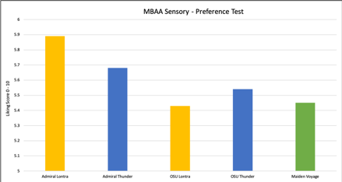
Malting Observations
Tolerant to cold steeping temperatures
  Successful BG modification despite 54F steep temps/ 49F air rests
Tolerant to high kiln temperatures
  Low color development even with high protein
Floor vs Pneumatic Malt Quality
  Variety/Environment drive MQ?
  Process drives flavor?

Slide 24
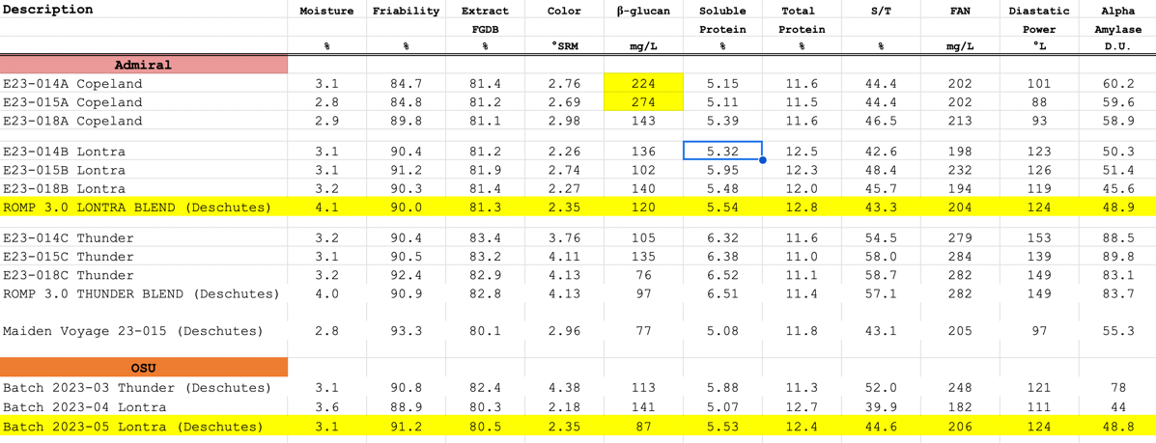

Slide 25
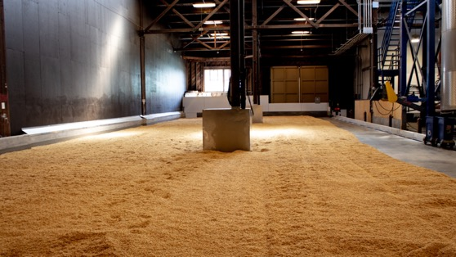
Onward!
Commercial scale evaluation/limited edition products late 2023-2024
  6-8 full size batches
~100 ac to be planted for malting Fall 2023
~10ac planted for Certified Seed
CY2023
CY2024
New Lontra products released
300-400ac planted for malting?

Slide 26
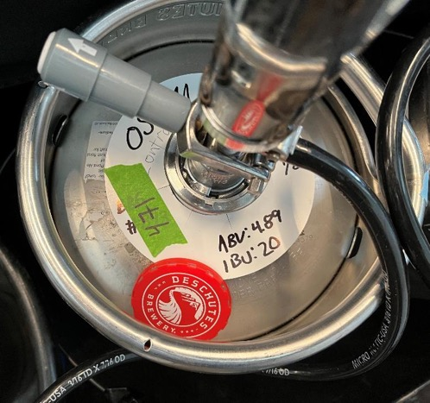
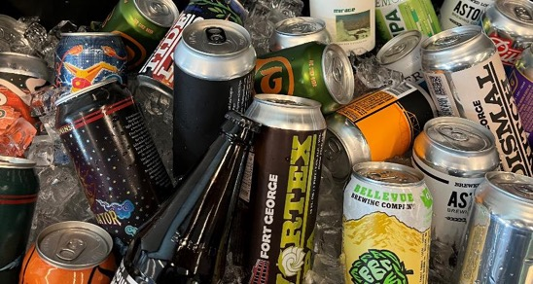
Lontra. Your modern heirloom?

Slide 27
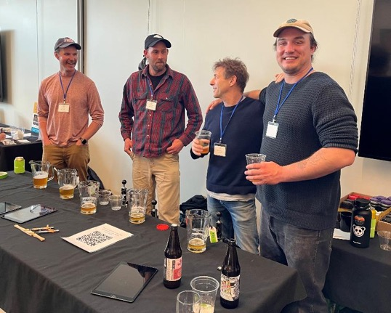
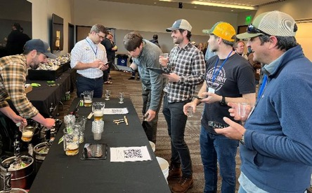
Thanks!!!!!!
Craft Malsters Guild, Admiral Malting, Brewers Association, Deschutes Brewing, Flavor 6-pack
Panelists, pFriem Brewers, OSU Barley Project

