Slide 1
Continued Exploration of Barley Genotype Contribution to Beer Flavor and the Application of This Knowledge to Variety Development and Release.
Notes:
Questions via chat or raise your hand. Happy to answer clarification questions in real time.

Slide 2
Outline
Barley Genotype Contribution to Beer Flavor – What do we still want to know?
Romp of Otters 1.0 – What does Maris Otter contribute to a breeding population?
Romp of Otters 2.0 – How does the top otter perform in a craft, floor malting system?
Brewers Association Nitrogen Trials (BANT) – Investigating genotype x location on malt quality and beer flavor.
Lontra Variety Release – An alternate path for variety assessment and release.
Conclusion and Questions

Slide 3
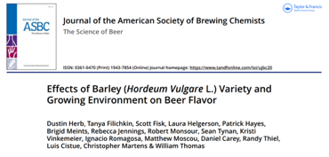
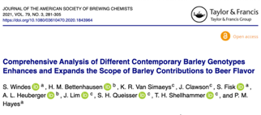
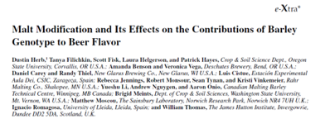
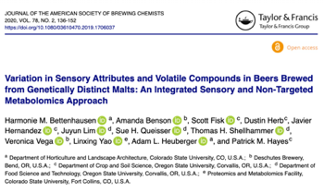
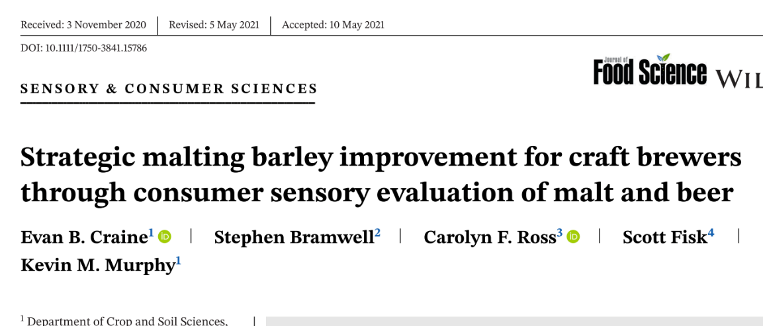
Does barley variety impact beer flavor?
Intrepid funders: The Flavor Pack & Brewers Association
Notes:
And others… Li et al.
Herb et al set the stage. Follow up studies designed to verify, understand, and help put results in perspective.
Bells, Deschutes, Firestone Walker, New Glarus, Russian River, Sierra Nevada, and Summit.

Slide 4
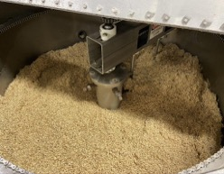
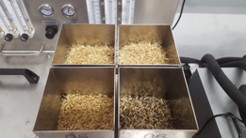
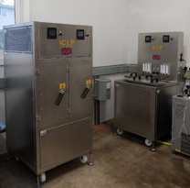
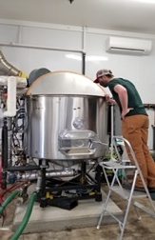
Does Barley Variety Impact Beer Flavor?
Micro Malting
500g samples.
Standard protocols (std. and WS).
”Research Malt”
Baseline for pilot malting.
MQ analysis.
Flavor research → Hot steeps & metabolomics.
Mini Malting – “Uni-Malter”
50-150kg batches.
Optimized protocols.
Water sensitivity, steep-out moisture, germ temp/time.
Different malt types.
MQ analysis.
Flavor research → Pilot brewing.
Photos: Scott Fisk & Campbell Morrissy
Notes:
Brought malting in house. Two systems to allow for flexibility based on trials, needs, and grain quality.

Slide 5
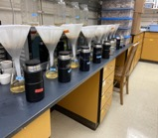
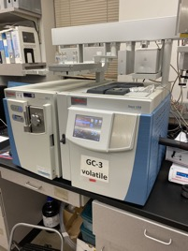
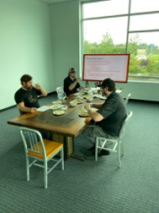
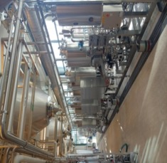
Flavor Pipeline
Malting
Hot Steep
Metabolomics
Sensory
Brewing
Photos: Scott Fisk, Campbell Morrissy, & Dr. Harmonie Bettenhausen
Notes:
Flavor takes time.
First need enough grain to malt and brew. Resource and $$ intensive.
The question of hot steep. What does it tell us? Potential to accelerate the process but so much we don’t know.

Slide 6
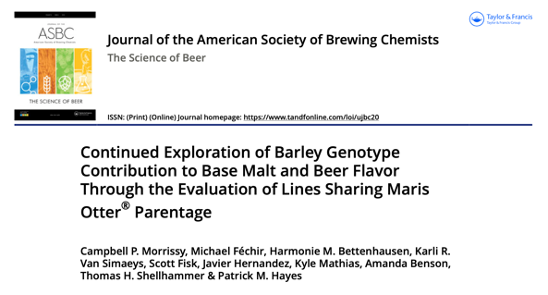
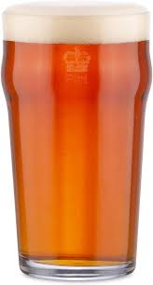
Romp of Otters 1.0

Slide 7
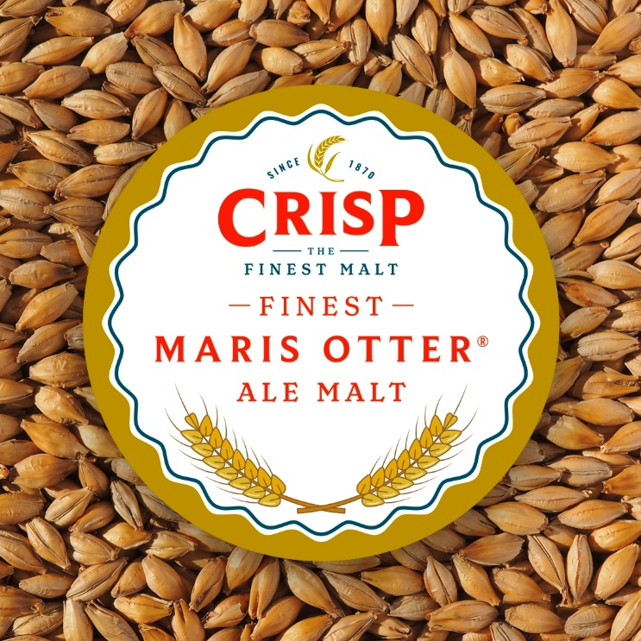
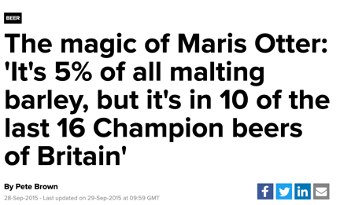
Why Maris Otter?
Notable “heirloom/heritage” winter barley.
Released in 1966 and became the major winter barley of its day... but dropped from UK list in 1989.
Continues to be grown, malted, and advertised as a premium, identity preserved product.
Still a relevant % of UK malting barley acreage (~2%* of all purchases).
Brewers use it as a base malt for its contributions to beer flavor.
https://www.morningadvertiser.co.uk/Article/2015/09/29/The-magic-of-Maris-Otter-It-s-5-of-all-malting-barley-but-it-s-in-10-of-the-last-16-Champion-beers-of-Britain
https://crispmalt.com/malts/finest-maris-otter-ale-malt/
Notes:
Believe 5% is of brewing malting barley. Last I looked it was ~2% of all malting barley (brewing and distilling). MAGB makes clear distinction between the two due to size of SMW industry.
Susceptible to lodging, scald, and lower yields compared to contemporary lines.

Slide 8
Mother Otter?
AMBA Listed (3/9 winters)
MAGB Listed (1/3 winters)
Stockinger EJ. The Breeding of Winter-Hardy Malting Barley. Plants. 2021 Jul;10(7):1415
AMBA – American Malting Barley Association
MAGB – Maltsters Association of Great Britain
Notes:
Other notable lines: Halcyon, Pipkin, Venture, Talisman
Winter malting barley rooted in the UK where mild winters are the norm.

Slide 9
The Romp
Population of doubled haploids derived from crosses of Maris Otter and elite winter malting lines.
Agronomic selection to the final four: Strips planted in Fall 2018 and harvested in Summer 2019.
Full pipeline: malting; brewing; hot steep and beer sensory; and hot steep and beer metabolomics.
Maris Otter not included in flavor trials due to intellectual property issues.
Description | Pedigree | Developer
Wintmalt* | (Opal × 3087 / 96) × 1922−23 | KWS Saat SE & Co. KGaA
DH141515 | Violetta / Maris Otter | Oregon State University
DH141969 | Violetta / Maris Otter | Oregon State University
DH150115 | 04-028-36 / Maris Otter | Oregon State University
DH142010^ | 04-028-36 / Maris Otter | Oregon State University
*control ^Lontra (the top otter)
Notes:
Maris Otter is prohibited from being exported from the UK as seed… even for research. There was a small amount available for a brief time that allowed for crossing.

Slide 10
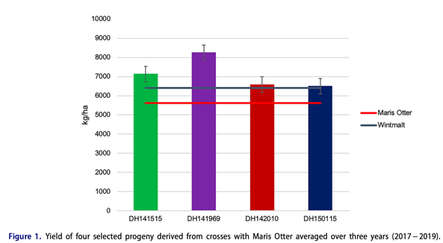
Agronomics
Genotype | Protein (%) | TW (g/L) | Plump (>6/64) | Thin (<5/64) | GE – 4 mL (%) | WS (%)
Wintmalt | 8.26 | 642.9 | 97.1 | 0.3 | 99 | 32
DH141515 | 9.94 | 672.5 | 97.3 | 0.2 | 100 | 68
DH141969 | 10.31 | 660.5 | 94.1 | 0.5 | 98 | 49
DH142010 | 9.23 | 640.9 | 97.2 | 0.3 | 100 | 75
DH150115 | 9.49 | 658.9 | 91.5 | 1.2 | 99 | 20
TW, test weight; GE, germination energy; WS, water sensitivity.
Notes:
515 and 969 out yielded Wintmalt & Maris
All out yielded Maris
For a brief moment (on the plant breeding scale) the otter was grown in Corvallis.

Slide 11
Malting
All lines performed well in the malt house despite water sensitivity. Only Wintmalt met all the specs for all-malt brewing.
Experimental lines tended to over-modify a bit resulting in high S/T (50% lines) and FAN (75% lines).
Enzyme package in check, except for DH141969. All higher than Crisp.
Low BG for all lines indicates that adjustment of malting protocol may produce malt with even proteolytic modification.
Genotype/Product | Moisture (%) | Friability (%) | Extract (FGDB%) | Color (°SRM) | β-Glucan (mg/L) | Protein (%) | S/T (%) | FAN (mg/L) | DP (°L) | α-Amylase (20°DU)
Wintmalt | 4.3 | 98.9 | 83.6 | 1.84 | 40.0 | 10.1 | 38.4 | 167 | 115 | 58.8
DH141515 | 4.4 | 98.7 | 83.3 | 1.64 | 61.0 | 10.5 | 44.0 | 197* | 139 | 68.4
DH141969 | 4.1 | 95.6 | 81.2 | 1.75 | 73.0 | 10.3 | 43.2 | 177 | 162* | 62.3
DH150115 | 4.3 | 98.6 | 83.0 | 1.98 | 73.0 | 9.7 | 48.4* | 201* | 120 | 57.9
DH142010 | 4.5 | 96.7 | 84.6 | 1.70 | 76.0 | 10.5 | 46.7* | 210* | 131 | 61.0
Crisp® Maris Otter Extra Pale | 5.5 | 92.1 | 82.4 | 1.87 | 69.0 | 10.1 | 46.0* | 198* | 107# | 59.9
S/T, soluble to total protein ratio; FAN – free amino nitrogen; DP – diastatic power.
*Exceeds AMBA specifications for all-malt brewing. #Below AMBA specifications for all-malt brewing.
Notes:
Fermentation proceeded as normal, producing beers with similar amounts of alcohol by volume (ABV) and a similar real degree of fermentation (RDF) and associated parameters. Realized bitterness units (IBU) were all within a spread of 1.5 IBU. Both sets of parameters showed less variance than in previous studies using similar beers brewed at the Deschutes Brewery[8] and with comparable equipment at Oregon State University.[10] The beers showed some spread in final pH but compared to the fermentation start, the total drop was similar (0.95 − 1.20 pH units). Diacetyl (2,3-butanedione) levels showed some variation, but even the highest value of 17μg/l (DH150115) was at the lowest threshold value reported in the literature.

Slide 12
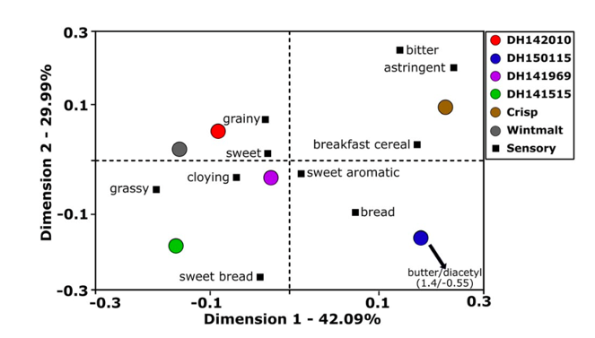
Hot Steep Sensory
Difference from Control (DFC)
Aroma - All samples except DH141969 significantly different from control (Wintmalt).
Flavor/mouthfeel – 3 of 5 samples significantly different.
Check-all-that-apply (CATA)
Attributes selected from Draughtlab’s Base Malt Flavor Map
Crisp® Maris Otter Extra Pale – plotted away from all other malts. Plotted close to bitter, astringent and breakfast cereal. Other than cereal, away from Maris Otter like attributes.
Notes:
DH150115

Slide 13
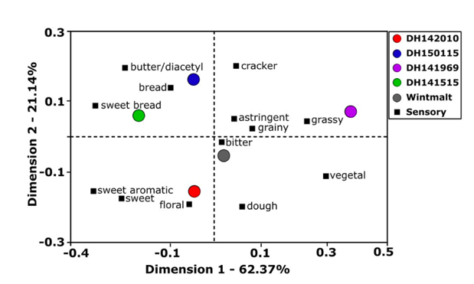
Beer Sensory
Difference from Control (DFC)
Only DH14969 was different from control (Wintmalt).
‘969 not different in hot steep, but different in beer.
Check-all-that-apply (CATA)
Wintmalt (control) was most neutral beer.
AHC showed a sub grouping of DH141515 & DH150115 + DH142010 & Wintmalt.
Maris Otter like descriptors: Sweet Bread + Bread (515, 115); Sweet + Sweet Aromatic (010).
Notes:
Some loose trends from hot steep:
010 and Wintmalt stayed close to each other but Wintmalt moved right to the middle
515 and 115 didn’t group with each other in Hot Steep but moved to each other in beer. However, they stayed with sweet bread and bread respectively.

Slide 14
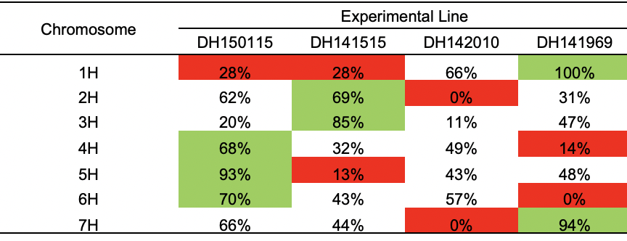
Maris & 5H?
Sayre-Chavez et al. identified beer flavor QTL for honey and toasted on 5H.
‘115 plotted with Bread and Butter/Diacetyl and scored high on Sweet Aromatic and Sweet Bread, but ‘115 also highest color…
Flavor QTL mapped near SD2 locus – dormancy and WS. All lines ≥98% GE, ‘115 lowest WS (20%).
Highly speculative … but still cool.
Notes:
93% of allele calls on 5H ‘115
Sayre-Chavez et al. spring population (Oregon Promise) different malts and beers.
Minor QTL for honey and toasted on 3H; ‘515 mapped with sweet bread in steeps and beers.

Slide 15
Conclusions
The four Maris Otter-derived progeny showed strong agronomic outcomes and produced acceptable malts and beers.
Malt flavor showed obvious differences, and while beer sensory differences were present, they were nuanced. Chemical profiling did not provide further distinction.
Some attributes associated with Maris Otter were present in the progreny but direct relation is hard to make.
So what next?

Slide 16
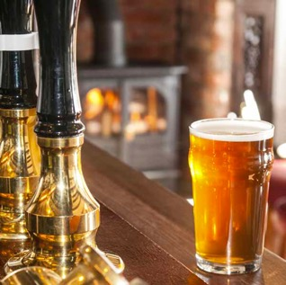
What makes Maris Otter Special?
It has been said that it is not just the variety, but…
the British maritime climate,…
the unique soil type, and…
the floor malting process.
Photo: American Homebrewers Association

Slide 17
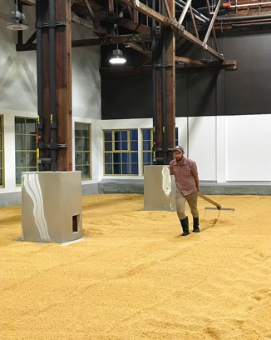
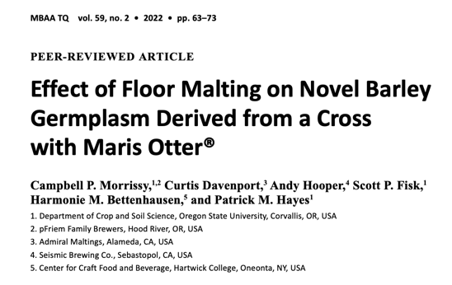
Romp of Otters 2.0
Photo: Admiral Maltings
Notes:
Collaboration between OSU Barley Project, Admiral Maltings, and Seismic Brewing
Floor malting found to produce chemically different malt from pneumatic system.

Slide 18
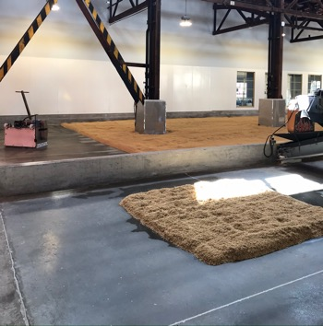
Romp of Otters 2.0
Can we floor malt the top “otter” and pull through more of the unique flavors associated with Maris Otter?
Does a winter habit line, grown in the same environment (Klamath Basin), perform as well or better for the maltster than their usual spring barley?
DH142010 – Winter Habit
CDC Copeland – Spring Habit
Photo: Admiral Maltings
Notes:
Collaboration between OSU Barley Project, Admiral Maltings, and Seismic Brewing
Floor malting found to produce chemically different malt from pneumatic system.

Slide 19
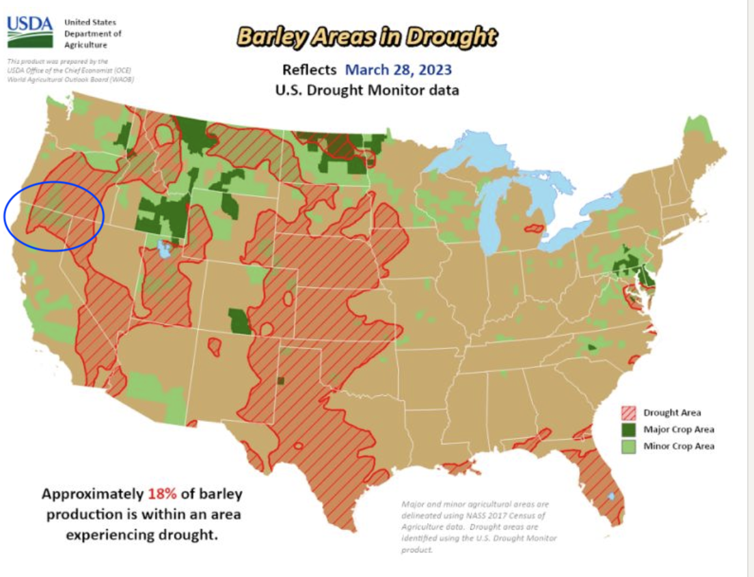
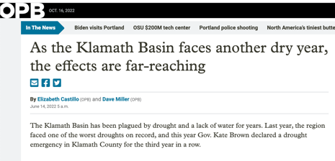
Winter Barley in the Klamath?
Drought and water restrictions continue in the Klamath Basin. Water managed for agriculture, fisheries, recreation, and ecological purposes.
Popular crops like potatoes, alfalfa, and wheat all have high irrigation requirements.
Winter barley could be a step in the right direction.
Historic malting barley supply chain in the basin – GWM continues to contract and is increasing acreage.
There is no doubt that “Brewing Californian” barley has risen steadily in favour with British Brewers.
1936, Journal of the Institute of Brewing
Source: USDA OCE
https://www.opb.org/article/2022/06/14/klamath-basin-faces-another-dry-year/
Notes:
Drought and potatoes? Not unlike the San Luis valley
Drought map is 2023, sad to see with so much winter rain.

Slide 20
Barley & Agronomics
Variety/Line | Protein (%) | Test Weight (g/L) | Plump (>6/64) | Thin (<5/64) | GE – 4 mL (%)#
CDC Copeland | 11.20 | 759.4 | 80.0* | 3.8* | 100
DH142010 | 10.53 | 877.9 | 94.9 | 0.5 | 99
*outside AMBA guideline for all-malt brewing. # No water sensitivity found in DH142010, no data for Copeland
Copeland: irrigated in late spring/early summer.
DH142010: supplemental irrigation available but none provided.
Notes:
Copeland, winter flooded, spring irrigated.
DH142010, supplemental irrigation available but none provided.

Slide 21
Malting
Bespoke pilot malting protocol – experimental and control malted within a commercial batch of Maiden Voyage pale ale malt.
Pilot floor malting protocol produced quality malt, and Copeland performed similarly to commercial batch.
Extract – Copeland 3.1% lower than DH142010.
DH142010 produced similar malt quality to the pneumatic, pale malt-type except for the expected higher color and lower enzymes.
Comparable malt quality to Crisp® Maris Otter - surprisingly high proteolytic modification.
Malt/Genotype | Moisture (%) | Friability (%) | Extract (FGDB%) | Color (°SRM) | β-Glucan (mg/L) | Protein (%) | S/T (%) | FAN (mg/L) | DP (°L) | α-Amylase (20°DU)
Copeland Plant Scale - Floor | 3.5 | 92.1 | 79.4# | 3.5 | 49 | 11.2 | 47.8* | 197* | 117 | 56.9
Copeland Mini - Floor | 3.5 | 94.5 | 79.1# | 4.1 | 43 | 10.3 | 56.2* | 219* | 121 | 73.6*
DH142010 Mini - Floor | 3.6 | 92.2 | 82.8 | 3.3 | 48 | 10.3 | 50.4* | 194* | 111 | 47.4
DH142010 Micro - Pneumatic | 4.4 | 90.6 | 83.8 | 1.8 | 45 | 10.3 | 47.1* | 190 | 137 | 59.3
Crisp® Maris Otter Floor | 5.4 | n.d. | 82.6 | 3.1 | 102 | 10.5 | 48.1* | 215* | 106# | 48.9
S/T, soluble to total protein ratio; FAN – free amino nitrogen; DP – diastatic power.
*Exceeds AMBA specifications for all-malt brewing. #Below AMBA specifications for all-malt brewing.
Notes:
Higher steep out moisture may have driven protein modification

Slide 22
Hot Steep – Between Malt Types (n=14)
Key Descriptors
Pneumatic ‘010 – dough, grainy, grassy
Floor ‘010 – bread, breakfast cereal, cracker
No significant differences detected (p=<0.05), but possibly due to low replicates (n = 14).

Slide 23
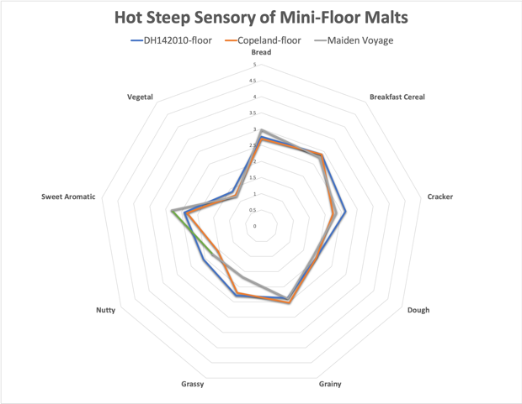
Hot Steep – Between Malt Types (n=23)
Key Descriptors
Copeland-floor – bread, breakfast cereal, grainy
DH142010-floor – bread, breakfast cereal, cracker
Maiden Voyage – bread, breakfast cereal, sweet aromatic
No significant differences detected (p=<0.05), but not surprising based on radar plot. Only cracker and nutty mapped >0.15 points different between mini-malts.
Notes:
Nutty closest to significant (p = .1161)

Slide 24
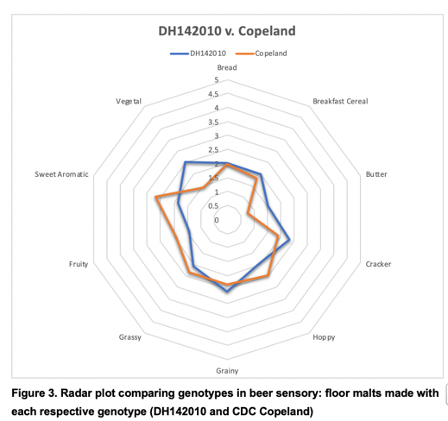
Beer Sensory – Between Malt Types (n=26)
Key Descriptors
Copeland-floor – fruity, grassy, grainy, sweet aromatic
DH142010-floor – cracker, grainy, vegetal
Butter* (p=0.0182) and Vegetal** (p=0.0022) were both significant.
Preferences
The beer brewed with Copeland was preferred by 16 of the 26 panelists. However, not significant using a X² test (p=0.239).
*Both had similar VDK results (33 and 28ppb respectively).
**DMSp or DMS not measured.
Notes:
The panel was able to differentiate between different malts made with the experimental genotype. This is not too surprising, but a good indicator that the panel is strong.
The panel was unable to differentiate between similar malts made with the different varieties.
The beers produced from the two malts were similar but did have detectable differences. While butter was one of two significant descriptors, the actual VDK #s were only 5ppb apart and DH142010, which scored hire in sensory, was actually the lower of the two in VDK. This indicates that there are other drivers of this flavor in these beers.
There was not a significant preference between the two beers: 16 preferred the CDC Copeland, while 10 preferred the DH142010. At that response rate, that difference is not significant over random chance.

Slide 25
Conclusions
Malts made from two different varieties not unique… but beers did have some interesting differences.
Based on agronomics and malt quality there is potential for winter barley in the Klamath.
Opportunities for varieties of interest, but that are outside of AMBA pipeline.
Research floor malting procedure needs work but high potential for future use in variety assessment.

Slide 26
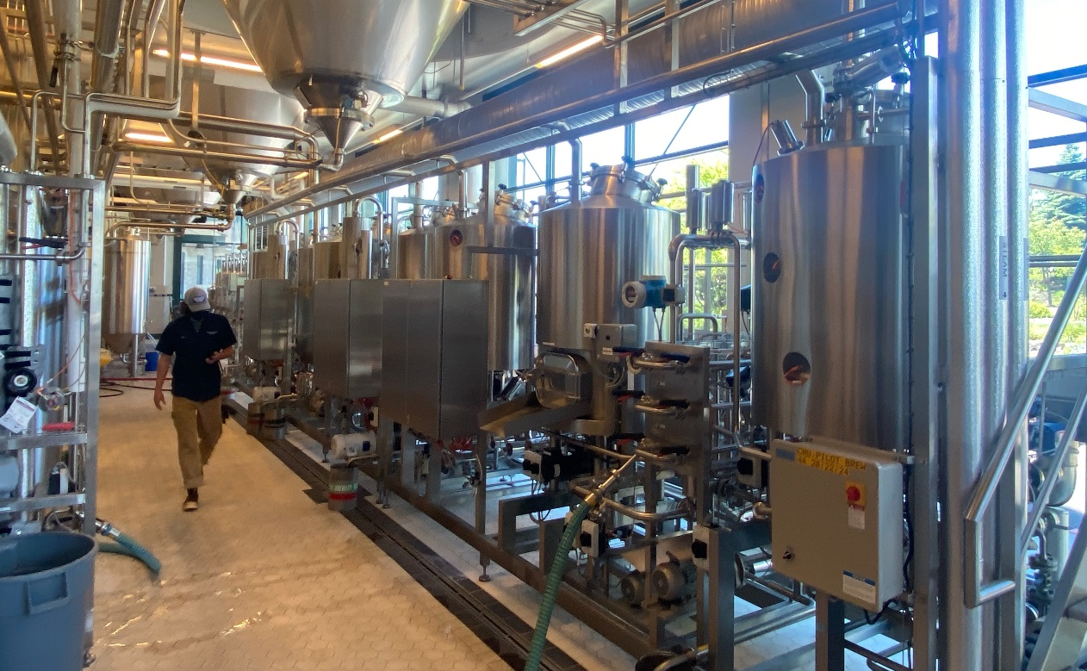
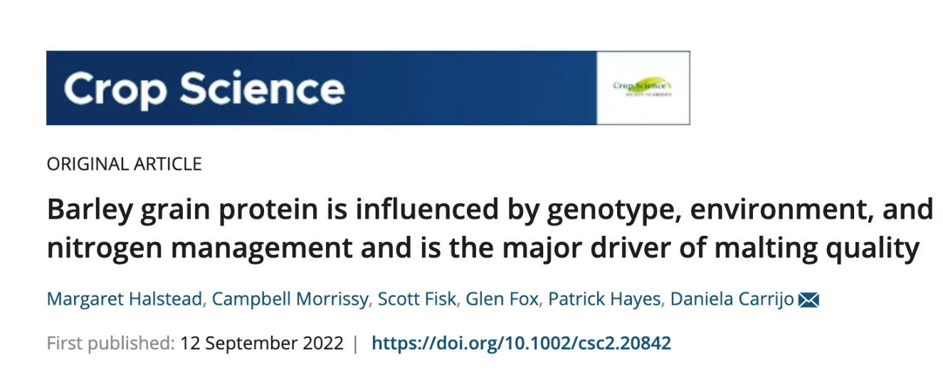
Brewers Association Nitrogen Trials
Photo: Campbell Morrissy at Deschutes Brewery

Slide 27
This section was adapted from two recently published manuscripts:
Barley grain protein is influenced by genotype, environment, and N management and is a major driver of malting quality. Halstead, M et al. Crop Science
5 genotypes (Thunder, Lightning, DH140963, DH142010, DH141132) x 3 locations (Corvallis, OR; Pendleton, OR; Tulelake, CA).
Micro-malts (0.5kg) – research protocols: standard and water sensitive.
Barley Variety and Growing Location Provide Nuanced Contributions to Beer Flavor Using Elite Germplasm in Commercial-type Malts and Beers. Morrissy, C et al. JASBC
3 genotypes (Thunder, Lightning, DH140963) x 3 locations (same).
Mini-malts (100kg) – bespoke malting protocols per entry, pilsner-style malt, commercial-like golden ale.

Slide 28
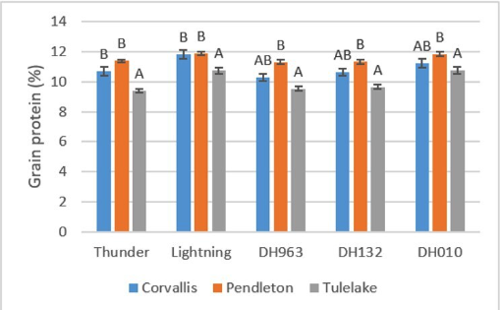
GxL effect on Malt Quality
Malt quality is a major driver for variety release. Maltsters contract grain to meet specific protein specifications.
Significant Genotype x Location effect on grain protein (p<0.001).
Thunder-Tulelake: 9.4% protein in a line that is primarily grown for adjunct brewing (COR – 10.7%; PEN– 11.4%).
Grain protein was primary driver of “all-malt” score with a strong negative correlation.

Slide 29
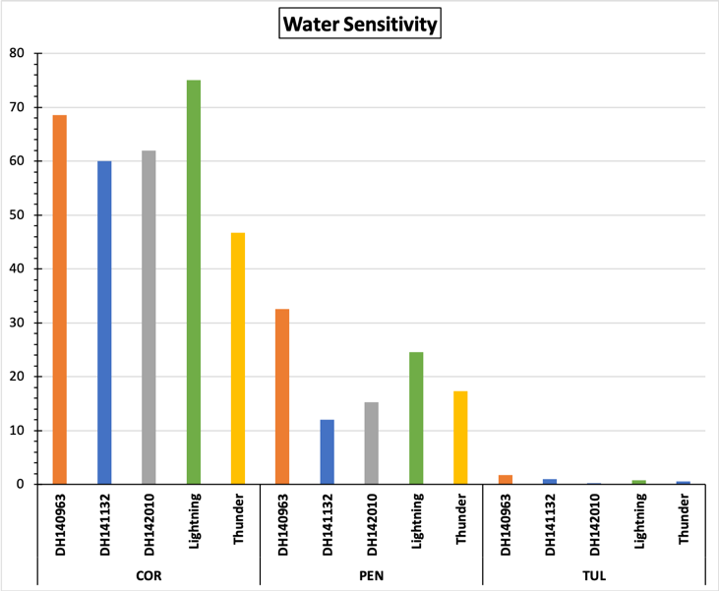
Dormancy & Water Sensitivity
Dormancy: All entries ≥95% (4mL).
(AMBA spec ≥98%)
Water Sensitivity: Significant differences across lines and locations.
Significant Line x Location effect: p < 0.001.
Overall most problematic at Corvallis and least at Tulelake.
WS impacts hydration rate during steeping → modification → flavor?
Water sensitivity by line at each location. Location mean is shown by horizontal line. *Tulelake mean (0.85%) is not visible due to axis scale.
Notes:
Water sensitivity a major driver in developing malting protocols.
Steep moisture control challenging in the malt house.
Lightning known to be problematic, but only most severe in Corvallis.

Slide 30
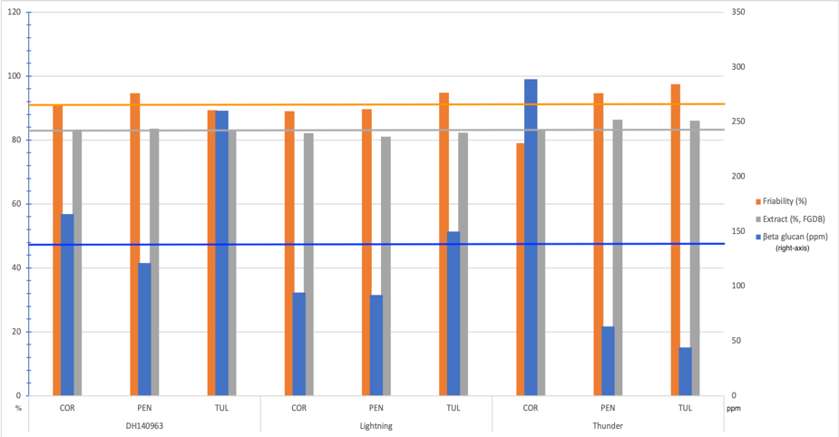
Cytolytic Modification
ß-G a bit all over the place – Lightning was most even across locations. Perhaps explains solid performance in brewhouse.
All lines met AMBA extract spec. (>81.0%).
Water sensitivity is potential driver for the spread of modification.
Experimental mean for each parameter shown as horizontal lines.
Notes:
BG – hydration.

Slide 31
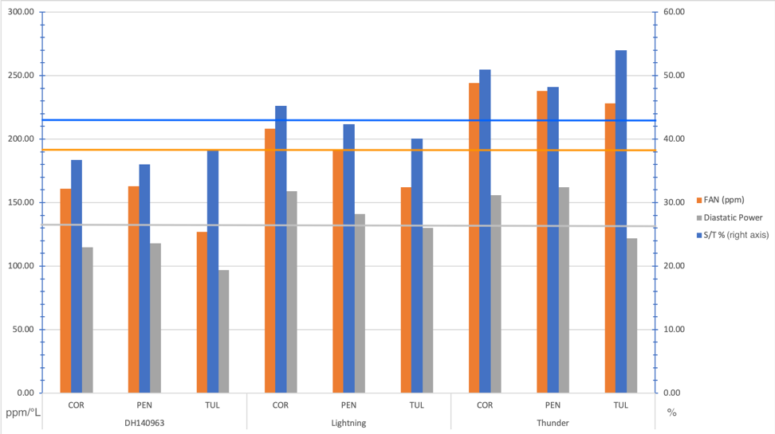
Proteolytic Modification
Under – DH140963
All locations <40% S/T
Even – Lightning
Over – Thunder
All >200 FAN and 2/3 >250
2/3 locations >50% S/T
Under/Even/Over based on AMBA malt guidelines, not specialty malt specifications.
Experimental mean for each parameter shown as horizontal lines.
Notes:
Thunder takes up water quickly, hard to manage steep out moisture. Targeted very low final steep out, but still saw high modification. 963 the opposite, very slow uptake and hard to modify. Targeted high steep out and had to spray multiple times during germ to achieve targets.

Slide 32
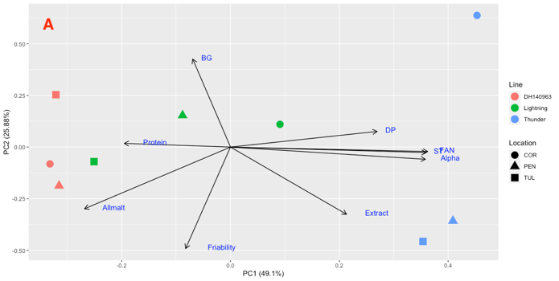
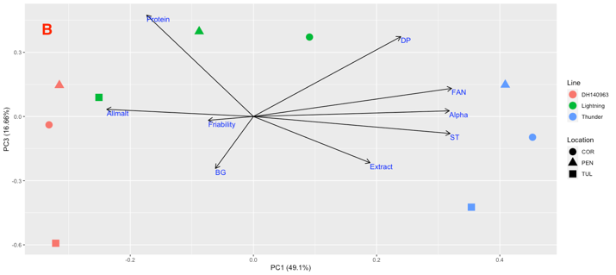
Mini Malting
DH140963 seems least susceptible to location effect.
Lightning most susceptible to location.
Thunder may be highly susceptible to modifications issues driven by water sensitivity and water uptake.
Unsure if Thunder-COR is outlier or possible trend.
Notes:
Figure 2: Principal component analysis of malt quality results. The first three principal components explained 91.64% of the variance. Figure 2a shows PC1 and 2 and figure 2b shows PC1 and 3.
Thunder – a widely planted winter variety yet craps out in high rainfall environments.

Slide 33
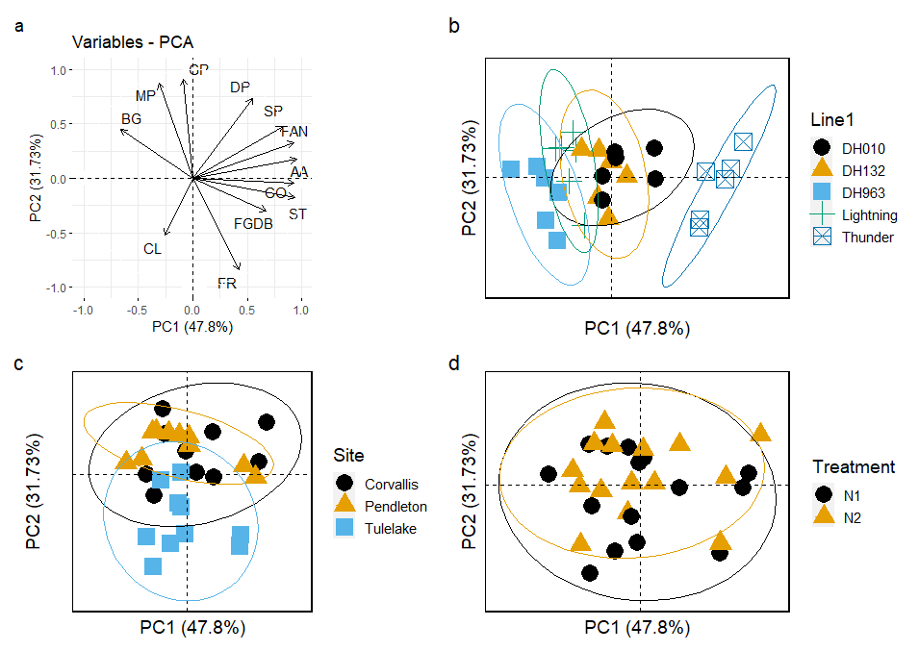
Micro Malting
Grain protein was primary driver of “all-malt” score with a strong negative correlation.
As grain protein was influenced heavily by GxL interaction, a conclusion can be made on GxL and malt quality.
N treatment increased grain protein but was not as significant as line, location, or interaction.
Notes:
N treatment – same application at planting in Fall; N2 received an application at heading.
All-malt score is a tool developed by the USDA-ARA CCRU.
Figure 2: Principal component analysis of malt quality parameters. PCA loadings for PC1 and PC2 (a) and PCA scores separated by barley line (b), location (c) and N treatment (d). AA- alpha amylase; BG- beta glucan; CL- clarity; CO- color; DP- diastatic power; FAN- free amino nitrogen; FGDB- malt extract (fine grind dry basis); FR- friability; GP- grain protein; MP- malt protein; SP- soluble protein; ST- ratio of soluble to total protein.

Slide 34
So what does the beer taste like?
Well… kind of the same with nuanced differences. Similar conclusions to other work just on variety.
Two sensory evaluations:
Descriptive analysis – check-all-that-apply (CATA).
Only one significant descriptor – bread.
Projective mapping (Napping).

Slide 35
CATA Analysis
Only significant attribute was bread.
Significant, positive correlation with FAN (r = 0.74), S/T (r = 0.82),⍺-amylase (r = 0.75), and extract (r = 0.69).
TH-PEN and TH-TUL were two of the darker beers but no correlation between color and bread.
Low RDF plots with dough, grainy, caramel, and watery. DH-TUL was below spec for FAN and DP. But not significant descriptors.
Low RE plots with vegetal, grassy, medium body, and astringent. But not significant descriptors.
Terroir effect an extension of modification?
p<.0.05
Notes:
TH-TUL & TH-PEN plot with bread, the only significantly different descriptor.
All TUL samples has no WS and plotted on lower half of plot.
USE table from chapter 3.
Non-significant descriptors. Worth mentioning given the sample size. More reps – better resolution?
TH TUL and TH PEN the highest and 3rd highest FAN

Slide 36
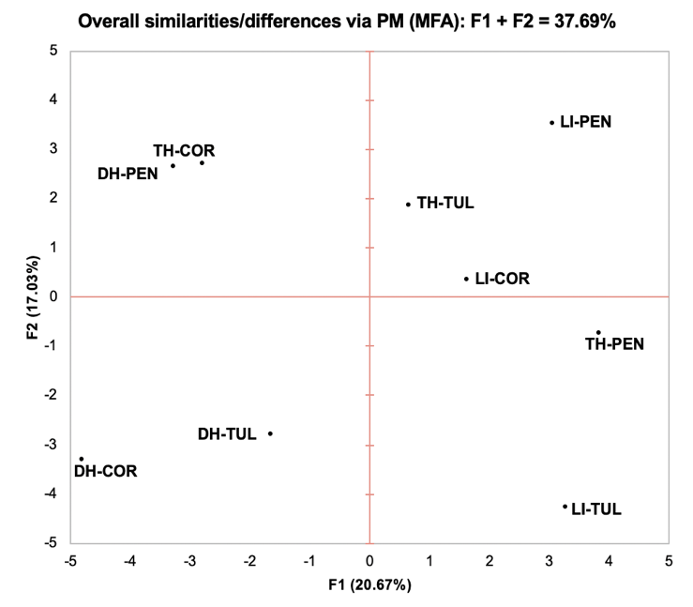
Projective Mapping
Small groupings that don’t line up with CATA results. Mix of lines and locations.
Perceived sensory differences that may be associated with attributes not captured in descriptive analysis.
TH-COR + DH-PEN – highest IBU and negative correlation to low IBU (LI-TUL).
Hops from same lot and storage conditions.
No other clear groupings based on brewing analysis.
Variation from other variables such as yeast and fermentation?
IBU
Notes:
Highlight

Slide 37
Conclusions
Grain protein is a major driver of malt quality and predictive of all-malt score when using a standard protocol. However, bespoke malting parameters can mitigate GxL effects.
Confirmation of barley variety providing nuanced contributions to beer flavor, however elite material showed even more muted separation.
Disparate malt quality can still produce acceptable beers.
Possible opportunities for barley genotypes that don’t produce elite malt quality but show superior agronomics (e.g. Lightning).

Slide 38
Lontra – Variety Release
DH142010 named ”Lontra,” after the genus of the North American river otter (not to be confused with Lutra).
Released in March 2023.
Not evaluated via AMBA pipeline.
Unlikely to see broad adoption + limited entries available to breeders.
One of only a few varieties released in collaboration with craft maltsters and brewers.
Others: Butta-12 (UC-D), Avalon (VT)

Slide 39
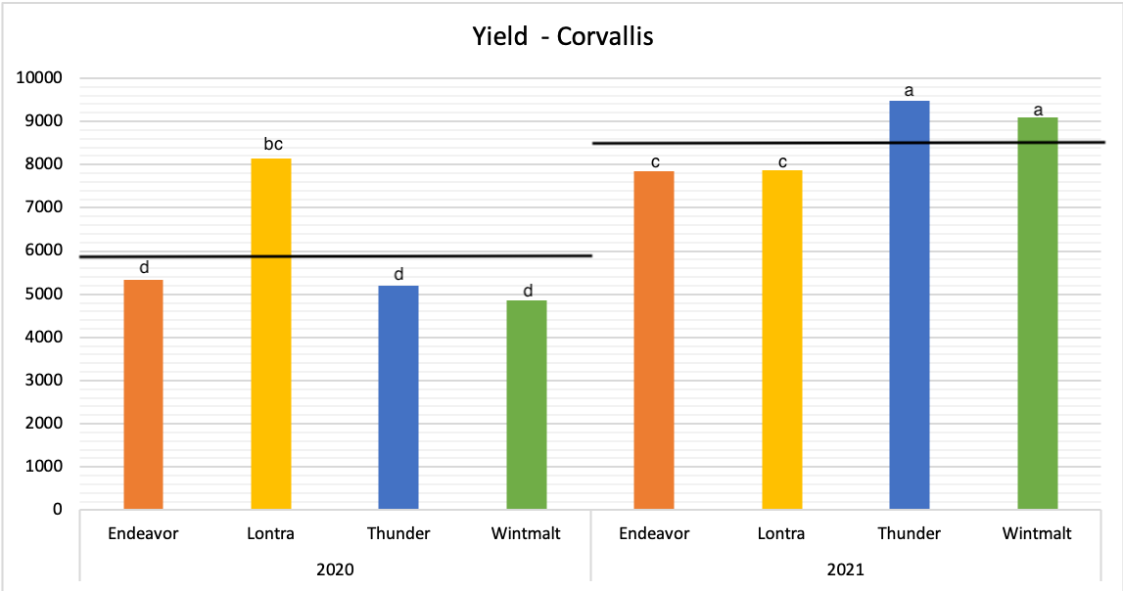
Lontra – Variety Release
Yield in Corvallis in ‘20 and ’21. Significant variety x year interaction. Lontra stable between years.
Year means shown by black lines.
Notes:
Tulelake 2020 – Lontra not significant from Thunder. Stable across years. Not the best yielder but will do it year over year.

Slide 40
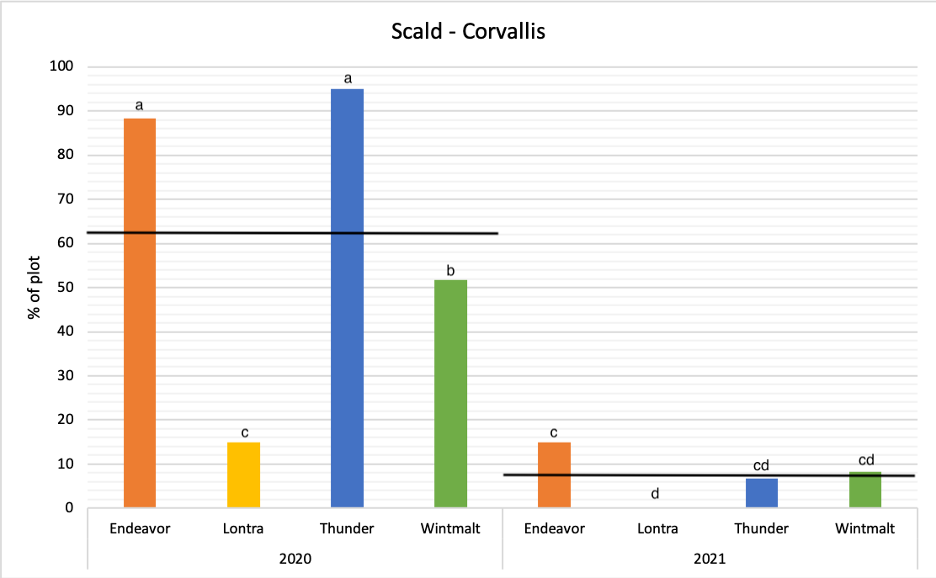
Lontra – Variety Release
Scald evaluation in Corvallis in ‘20 and ’21. Significant variety x year interaction.
Year means shown by black lines.
Notes:
Scald is a fun one to look at as it is one of the major contemporary deficiencies of Maris Otter.

Slide 41
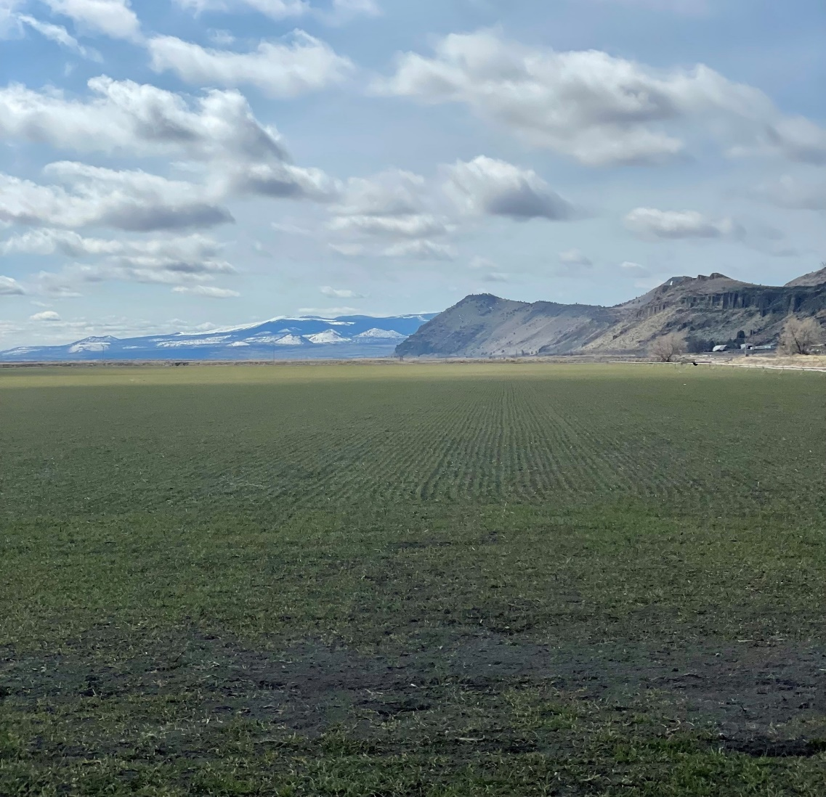
Lontra – Swimming in the Klamath
2021 – 2022
1ac at UC-IREC yielded ~5,500lbs.
22lbs breeder seed at OSU → WA State Crop Improvement for foundation seed production.
2022 – 2023
4,200lbs planted on ~30ac under conventional conditions with John Crawford (research MTA).
1,300lbs for malting trials.
1,000lbs → Admiral
300lbs → OSU
Mini-malts → Deschutes Brewery 2hL brews
→ pFriem Family Brewers sensory.
Photo: Darrin Culp, UC-IREC

Slide 42
Lontra – Swimming in the Klamath
2022 | Protein | Plump | Thin | TW | Yield
Variety | % | >6/64” | <5/64” | g/L | kg/ha
Thunder | 10.8 | 92.0 | 4.0 | 646.2 | 8002.9
Lontra | 11.5 | 89.5 | 0.6 | 639.7 | 6904.4
Agronomic data from larger scale evaluations performed at UC-IREC during harvest year 2022. Thunder was planted in a 0.04ha plot and Lontra was planted in a 0.40ha plot.
2023 harvest will show effect of standard farm management on Lontra.
Notes:
Thunder seems to thrive in Tulelake.
Lontra does well in poor growing environments and/or more heat stress tolerant. CY’20 no difference between Thunder and Lontra
Lontra seems to avoid thins even if plums aren’t very high.

Slide 43
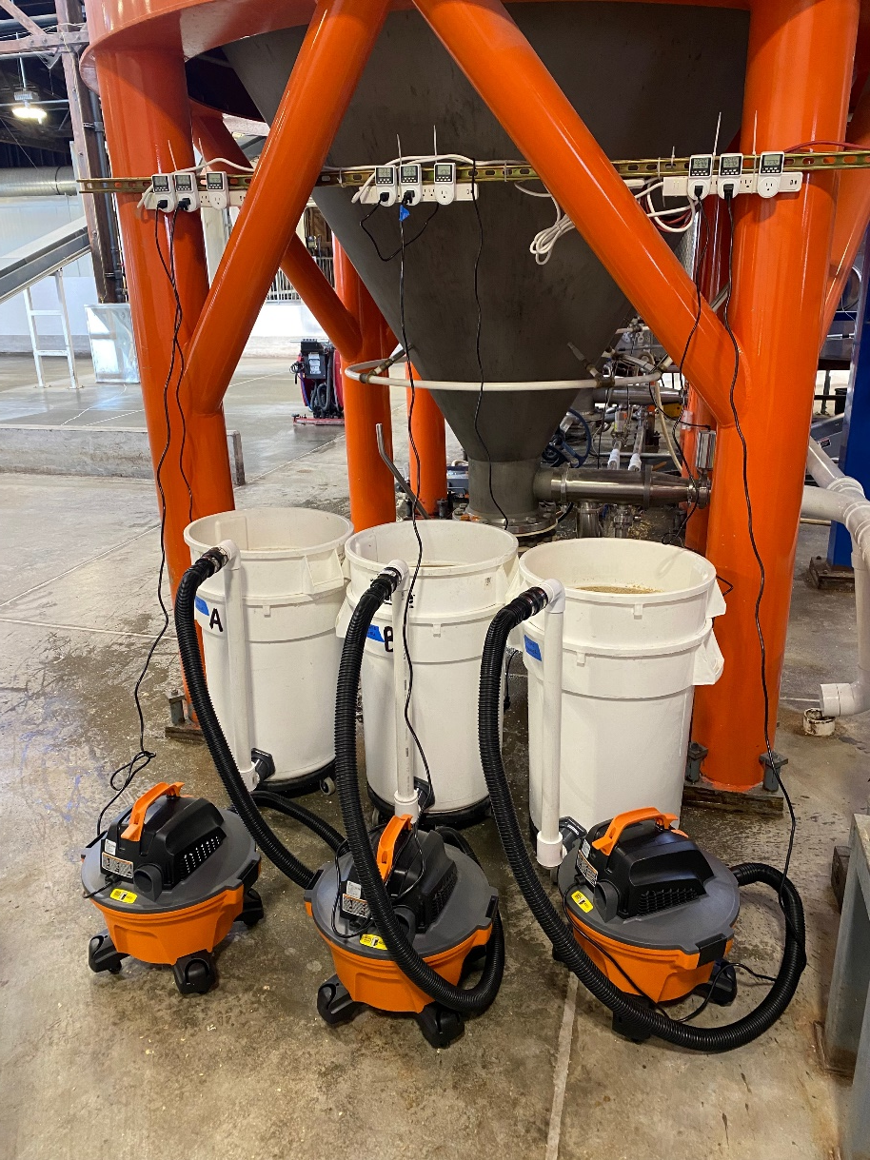
Romp 3.0 – Further evaluation of floor malting with Klamath barley.
Does floor malting produce significantly different beers compared to pneumatic malt?
Is there a floor malting * variety interaction?
Continued evaluation of winter malting barley in the Klamath.
Evaluation of upgraded mini-floor malting protocol.
Entry | Moisture | Friability | Extract | Color | β-glucan | Protein | S/T | FAN | DP | AA
 | % | % | FGDB (%) | °SRM | mg/L | % | % | mg/L | °L | D.U.
Lontra - Pneumatic | 3.1 | 91.2 | 80.5# | 2.35 | 87 | 12.4* | 44.6 | 206* | 124 | 48.8
Lontra - Floor Malt | 4.1 | 90.0 | 81.3 | 2.35 | 120* | 12.8* | 43.3 | 204* | 124 | 48.9
Maiden Voyage (Copeland) | 2.8 | 93.3 | 80.1# | 2.96 | 77 | 11.8 | 43.1 | 205* | 97# | 55.3
*Above AMBA spec
# Below AMBA spec
Photo: Admiral Maltings

Slide 44
Conclusions and Next Steps
Conclusions
Barley genotype contributes to beer flavor… but it is only a minor player in the overall matrix of brewing ingredients and malting and brewing process.
A population derived from a cross with Maris Otter resulted in a barley variety that meets floor maltsters expectations for craft brewing.
The Lutra otter was destined for all-malt brewing, and Lontra lives up to this expectation.
Continued investigation into the quality of winter barley has resulted in more options for growers.
Malt with that does not necessarily meet the malt quality guidelines set forth by AMBA, can still produce high quality beers that meet sensory expectations in these scenarios.
Re-thinking “many barleys are called, but few are chosen.”
A variety release pipeline outside of the mainstream.
Next Steps (there is always more…)
Romp 3.0 – in process.
Barley genotype contribution to… spirits flavor!

Slide 45
Thank you to the collaborators and funders who supported this work.

Slide 46
Acknowledgements
Lulu Cowan-Morrissy
Kai Morrissy-Cowan

Slide 47
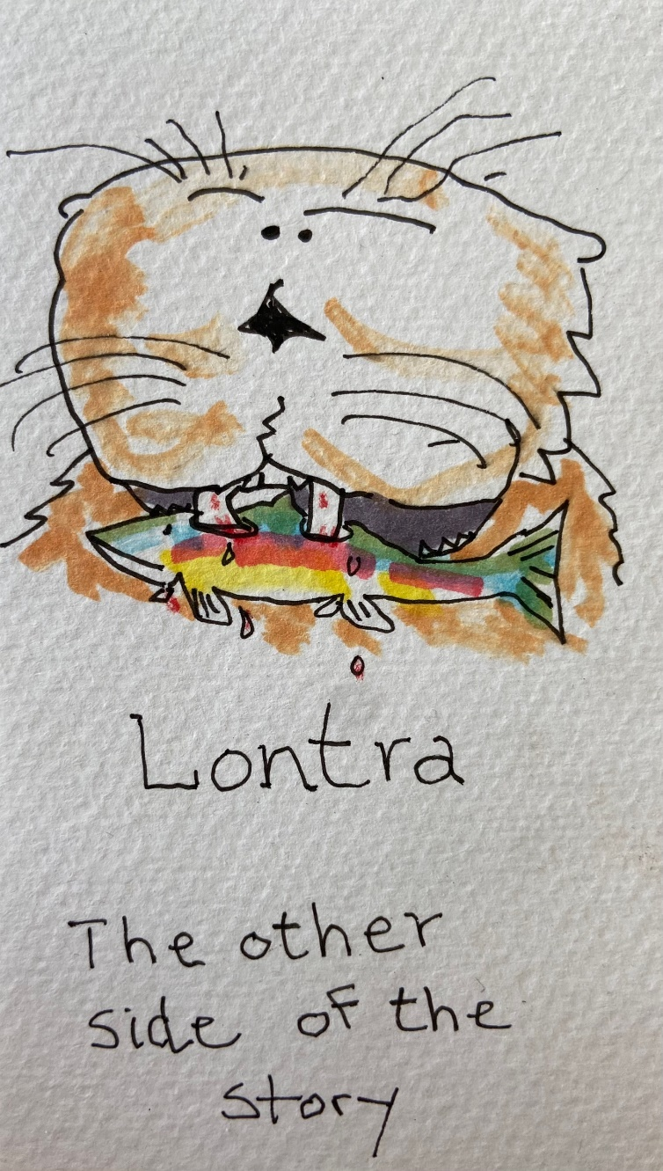
Questions?

