Slide 1
Barley Prospects for a Changing Climate

Slide 2
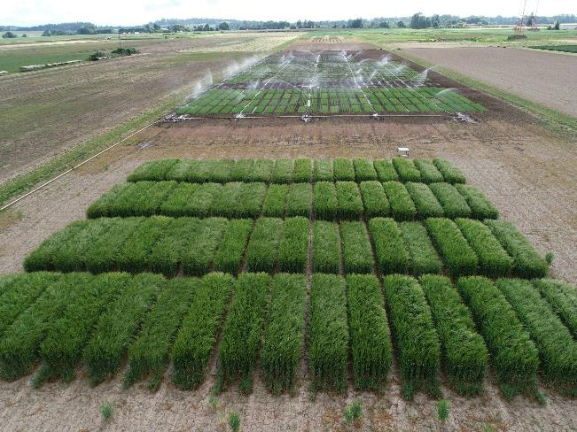
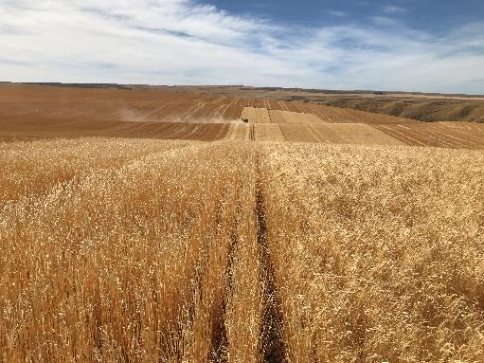
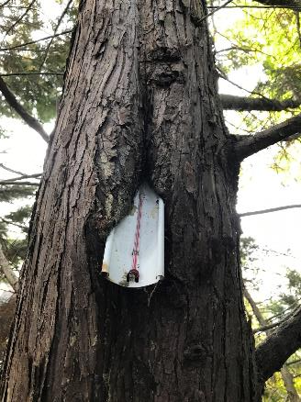
The Climate is changing
Net warming trajectory, with increased volatility
Familiar barley cropping areas may no longer be productive, new cropping areas may emerge, but on average the 2021 harvest will likely be the norm, rather than the outlier

Slide 3
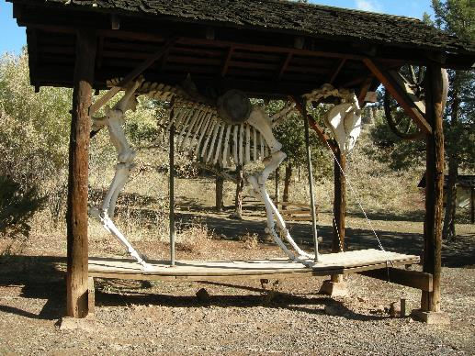
If 2021-style harvests are the new normal…
Not-so-great barley will be more expensive
Great barley will be more expensive
Who pays?
Ideally a collaborative relationship between farmers, maltsters, brewers, and consumers
Naïve?
Make that a local/personal goal - larger market forces will prevail amongst the mega-fauna gathered at the shrinking water holes

Slide 4
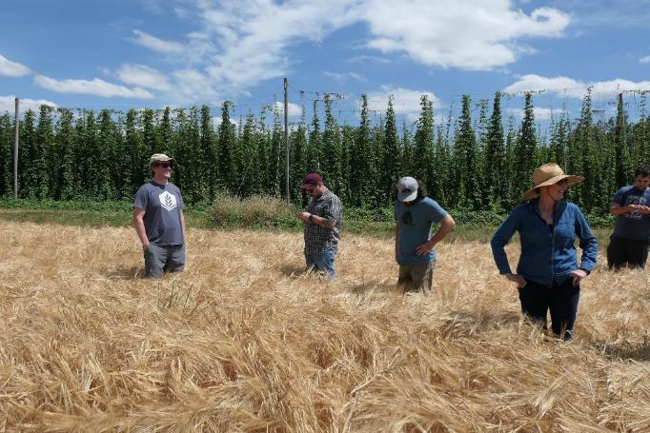
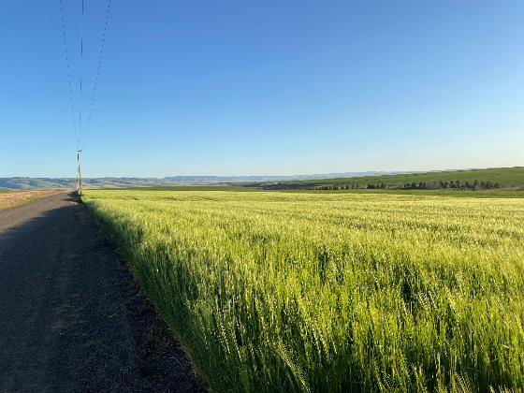
Farmers
Pencil out long-term rotation benefits of barley
Explore new markets – feed, food
Use political leverage to support cropping system diversity
Support local, long-term relationships with breeders, malsters, brewers, and consumers

Slide 5
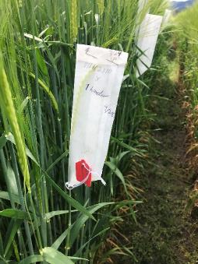
Plant breeders
Target the usual traits, with renewed vigor
More yield for less input
The proper balance of dormancy vs. pre-harvest sprouting risk
Solutions to water sensitivity
All breeding tools needed – that latest gadget is not necessarily the answer
A contemporary plant breeding trajectory
A CRISPR tale
Support local, long-term relationships with farmers, malsters, brewers, and consumers

Slide 6
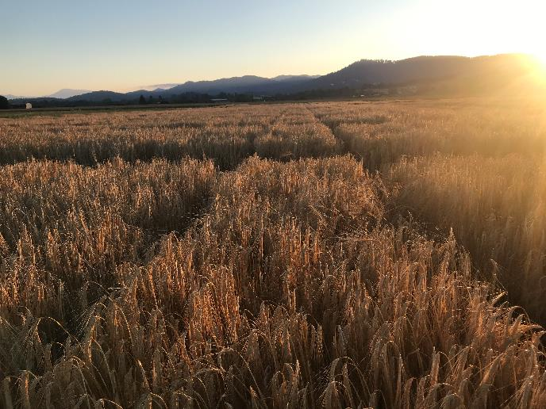
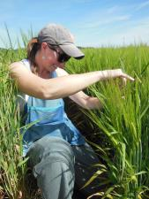
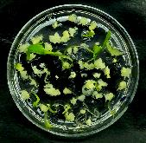
The breeding cycles
Crossing
Doubled haploids
Genetics and Breeding
Publication, Variety/Germplasm release

Slide 7
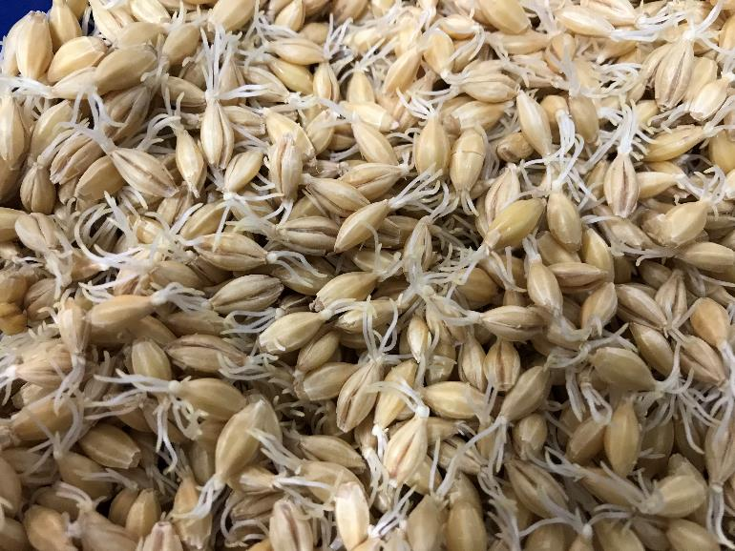
Malsters
Gymnastics
Supply chains
Processing
Distributing
Water conservation
Exogenous agents?
Support local, long-term relationships with breeders, brewers, and consumers

Slide 8
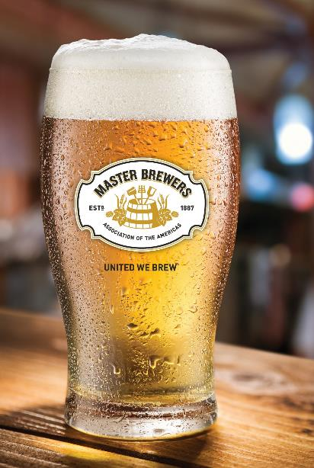
Brewers
Gymnastics, per maltsters
Support local, long-term relationships with farmers, maltsters, brewers, and consumers
Hobson’s choices
seltzers and beyond
…beer of the third category?

Slide 9
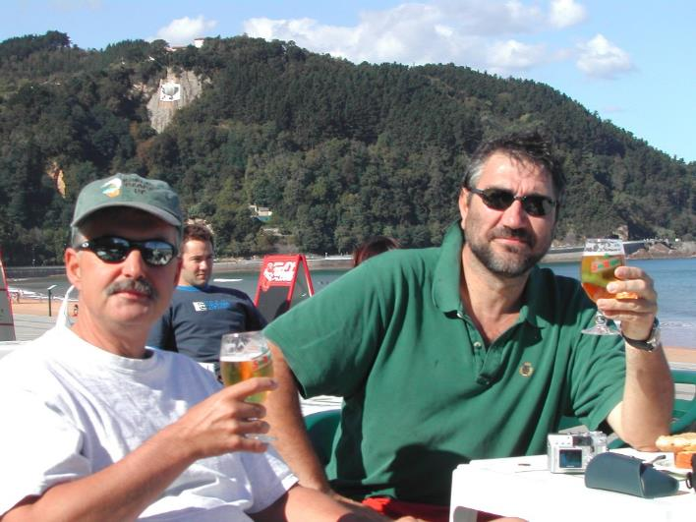
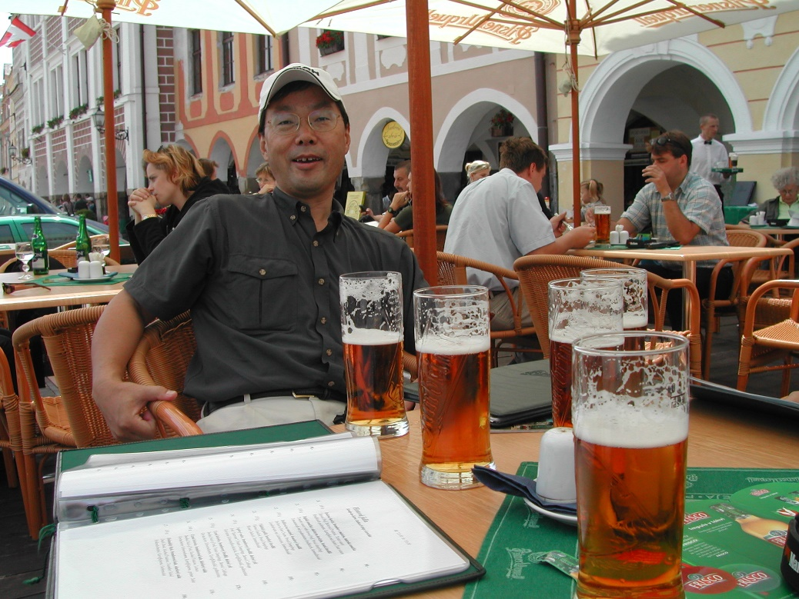
Consumers
Care!
Pay!
Support local, long-term relationships with farmers, breeders, maltsters, brewers

Slide 10
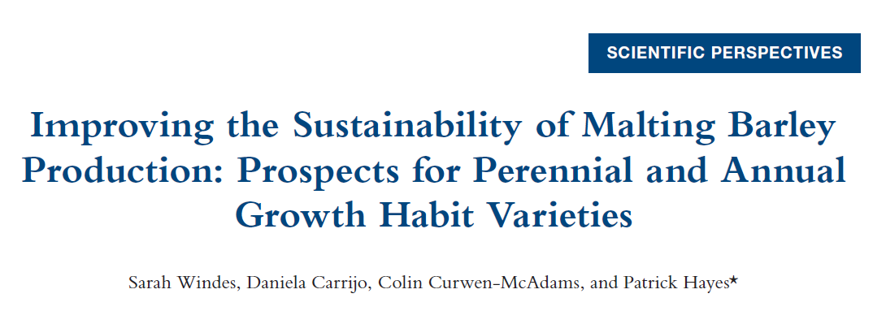
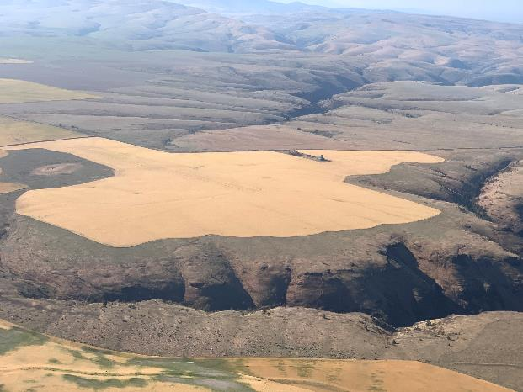
Musings with implications for barley in the time of climate change..
A digression into prospects for perennial barley
The Western Rivers Conservancy/John Day river barley project

Slide 11
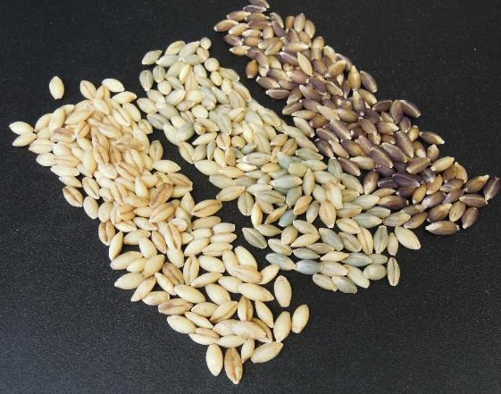
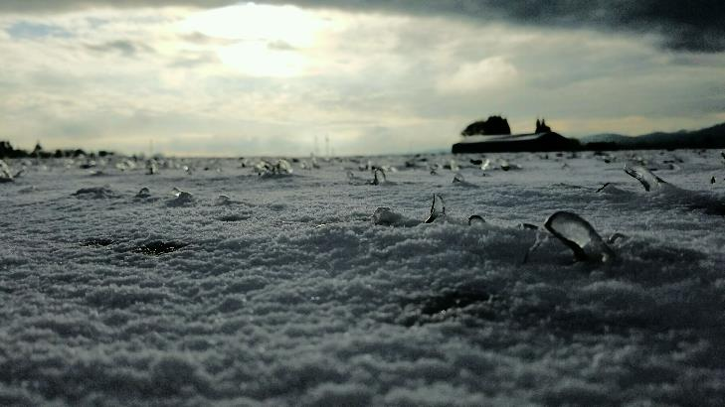
Long-term prospects
Fall planted barley makes better use of available precipitation
Ants at the picnic – winter survival, herbivory
Naked barley: multi-use, giving farmer alternative markets and maltsters/brewers high extract, 0 GN
Ants at the picnic – threshability/germination

Slide 12
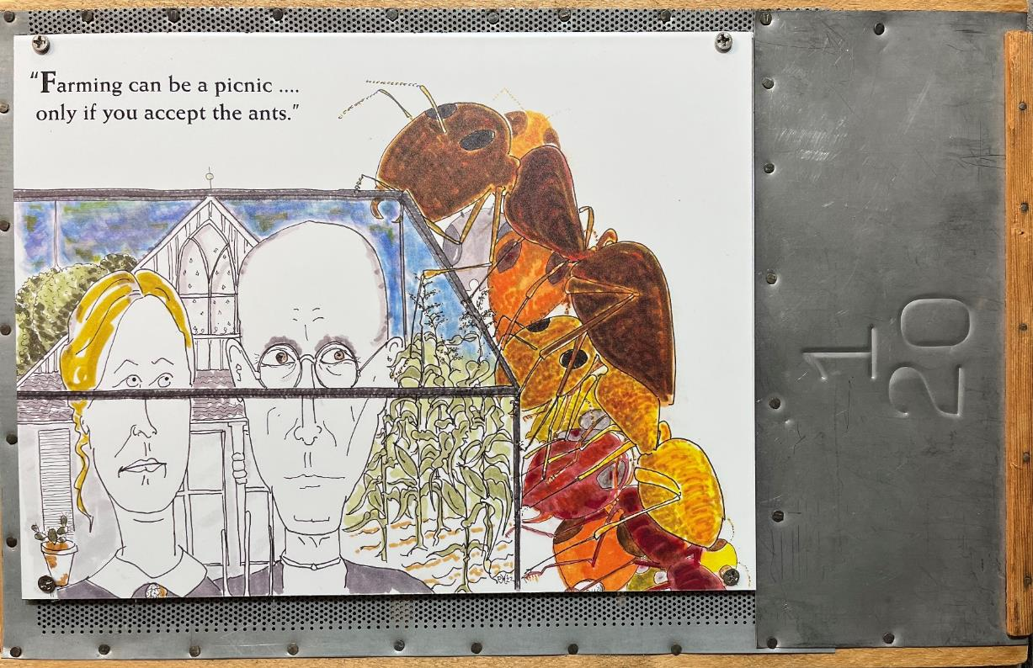
Thanks,
and cheers!!

